Slide 1
Lab 2

Slide 2
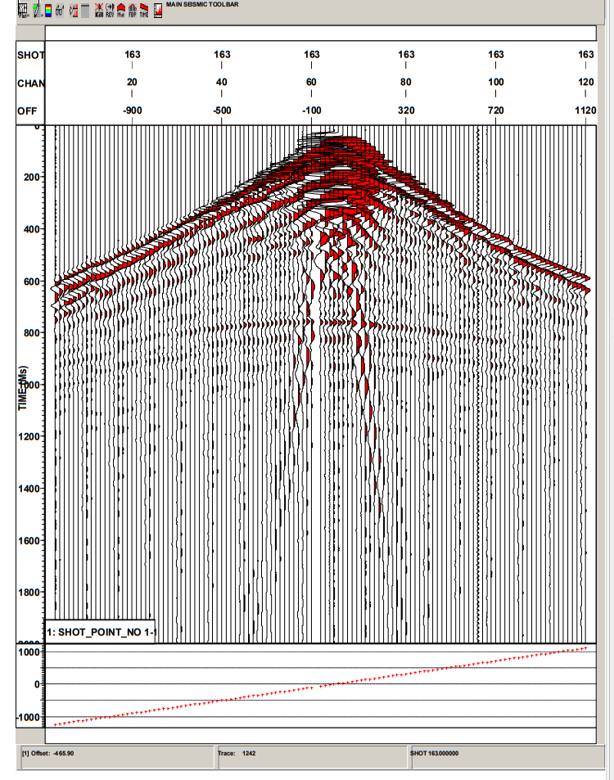
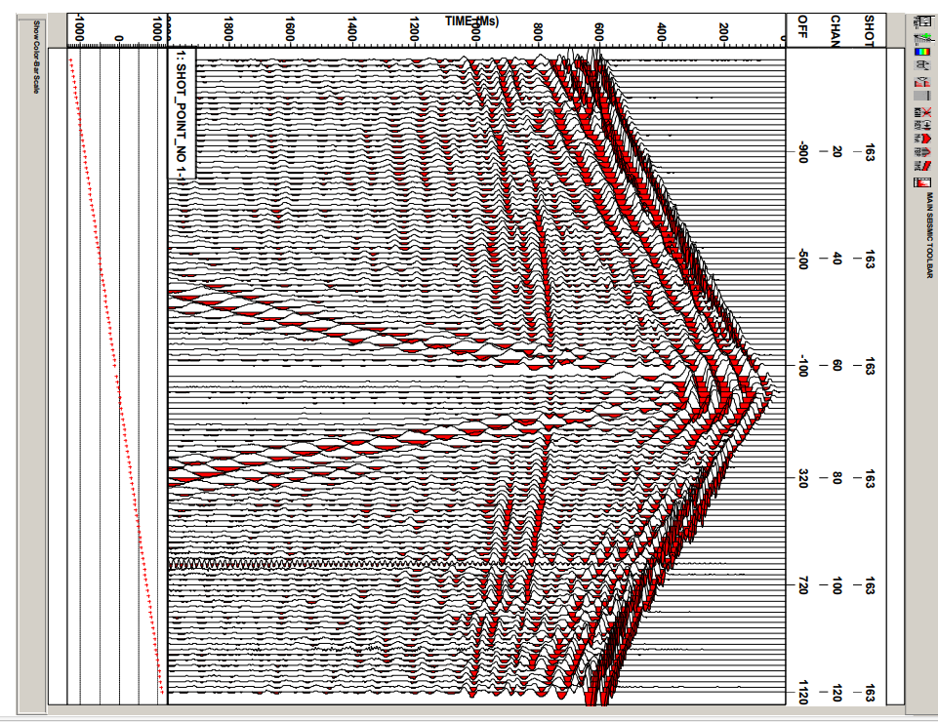

1. Compare the unscaled and scaled data plots. Comment on the features which you see better or worse on these plots (recognize wave arrivals on top of noise, variations of amplitudes, travel times, slopes of travel-time curves).
How do you describe first arrivals?
How do amplitudes behave far from source?
How do reflections behave?
Scaling boosts later and far-away amplitudes and makes the arrivals easier to see.
To identify refractions, you should zoom and see where the slopes of arrivals change.
Use rulers to recognize the t,x slopes.
When identifying the different types of waves, don't just mark the intervals but try carefully measuring the times and offsets at several points.

Slide 3

1. Compare the unscaled and scaled data plots. Comment on the features which you see better or worse on these plots (recognize wave arrivals on top of noise, variations of amplitudes, travel times, slopes of travel-time curves).
In this scaled data plot, the amplitudes can be better appreciated, in deeper times, the direct waves can be better appreciated and the arrivals of the waves at the top of the ground roll noise can also be appreciated.
Direct arrivals
Exponential scaling applied to compensate the geometrical spreading: amplitudes were recovered.
Reflection waves
Ground roll
Refraction waves

Slide 4

2. Determine near which channel shot 163 was fired. Mark the shot location with a flag on the top margin of the plot.
In split-spread geometry, the source is located somewhere in the middle of the receiver cable, usually at the center.
Here. Shot 163 was fired.

Slide 5
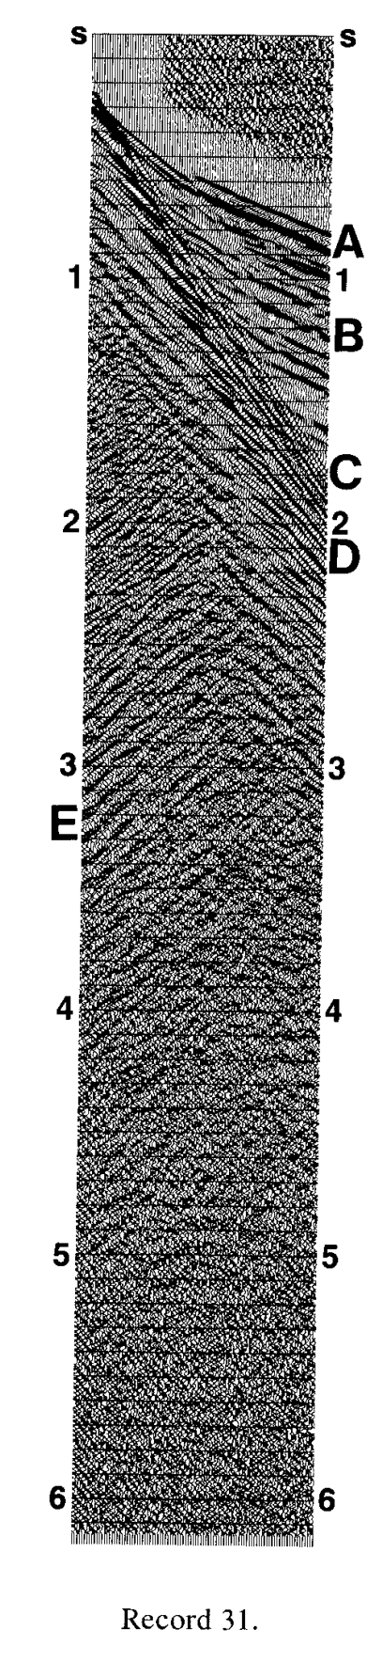
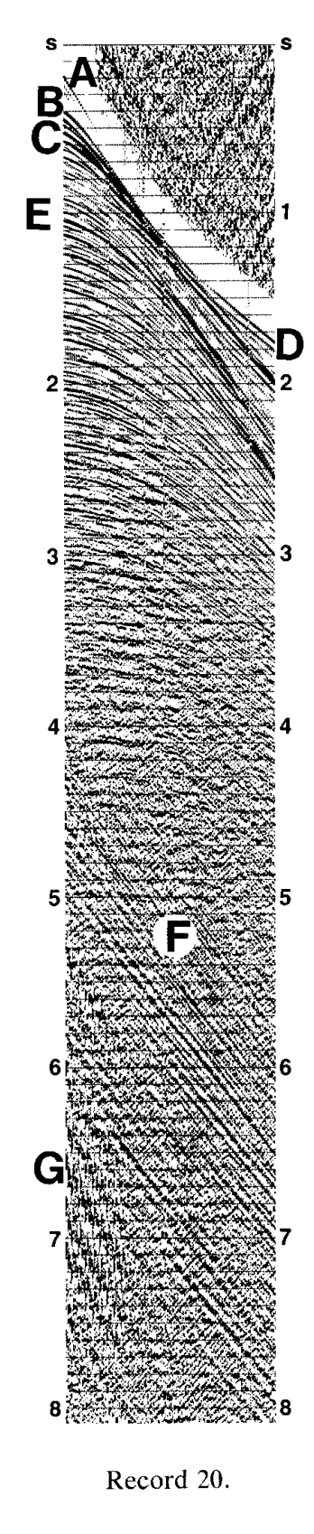
3. Identify all linear events (those aligned along approximately straight lines in (T,X) plane):
Refractions; note any changes in time-distance moveouts;
b. Ground roll. This is a band of strong and low-frequency arrivals with very large moveout (low velocity).
b) Ground roll: which is characterized by its low frequency, high-amplitud appearance. Ground roll with linear moveout.
Linear events
T
a) Refracted waves should look like: refraction arrival D in Record 20, and refraction arrival A in Record 31.
Reference: Yilmaz, Ozdogan, Record 20 and Record 31. Pages and 38, respectively.
X

Slide 6
4. Locate the cross-over points if they exist (the distances where deeper refractions overtake other refractions or direct waves).
5. Use a ruler to reasonably accurately pick the coordinates and times of the first breaks in the plots. Plot them on a T-X diagram (time vs. offset plot). Use Matlab (recommended) or Excel for plotting.

Slide 7
Try to identify slopes of arrivals change.
Try measuring these slopes
Use rulers to recognize the t,x slopes
The slopes should have units of slowness [ms/m]
Determine the velocities.
Seismic velocities should be in the range 2-5 m/ms
Here I have considered the first break as the positive amplitude (red).

Slide 8
6. Calculate the apparent velocity of each linear event, including the ground roll. The apparent velocity equals 1/slope on the T-X diagram.
Slope=
Apparent velocity= 1/slope
Apparent velocity=

Slide 9

7. Identify two reflection hyperbolas. One of them is quite clear and the other maybe a little spotty. Just mark the intervals where you see them.
Direct arrivals
Reflection waves:
hyperbolic moveout
Ground roll
Reflection hyperbolas
Refracted waves were not recognized
Exponential scaling applied to compensate the geometrical spreading: amplitudes were recovered.

Slide 10
8. Pick the arrival times of these reflections and compute their stacking velocities using the X 2 – T 2 analysis (for explanations of the method, see the end of this document).
Make the table of (x,t) and produce the (x^2, t^2) plots.
9. Combine the refraction and reflection results in a final velocity model. Comment on the agreement between refraction and reflection travel-time data.

Slide 11
10. Estimate the frequency of the noisy trace on channel 96. (Count the number of periods n per T = 200 ms, and the frequency will be f = n/T). Based on the frequency, can you guess what is the likely cause of this noise?

Slide 12
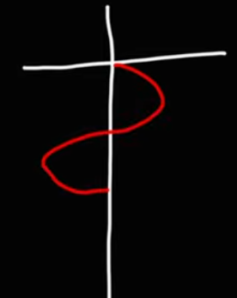
This is one cycle

Slide 13
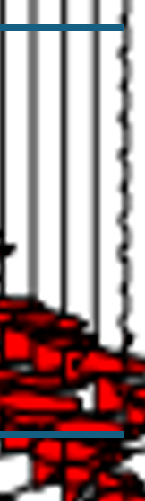
f = n/T
f =
Based on the frequency, can you guess what is the likely cause of this noise?

Slide 14
Back up
Seismic Data Analysis
Yilmaz

Slide 15

Record 1:
A number of reflections are present in this record with reasonably good S/N ratio. A genuine reflection is recognized in common shot gathers by its hyberbolic nature.
In split-spread geometry, the source is located somewhere in the middle of the receiver cable, usually at the center. A dipping horizon yields a skewed hyperbola on a common shot gather, while still yielding a symmetric hyperbola on a common-midpoint gather. Reciprocity of sources and receivers provides this symmetry. From the reflection hyperbolas, note tha the subsurface is made up of nearly horizontally flat layers. Any irregularity in the shape of the moveout hyperbola can be attributed to near-surface effects and lateral variation in velocity.

Slide 16
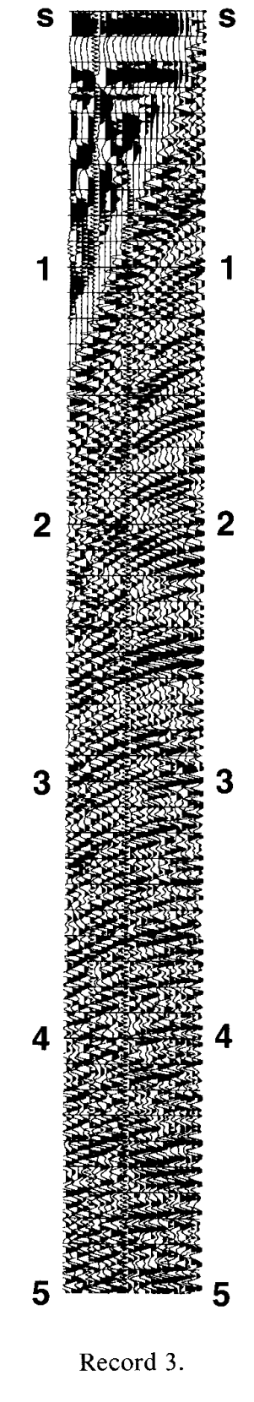
Record 3:
Was obtained using dynamite, contains a series of reflection with nearly perfect hyperbolic moveout, especially between 1 and 3 s.

Slide 17
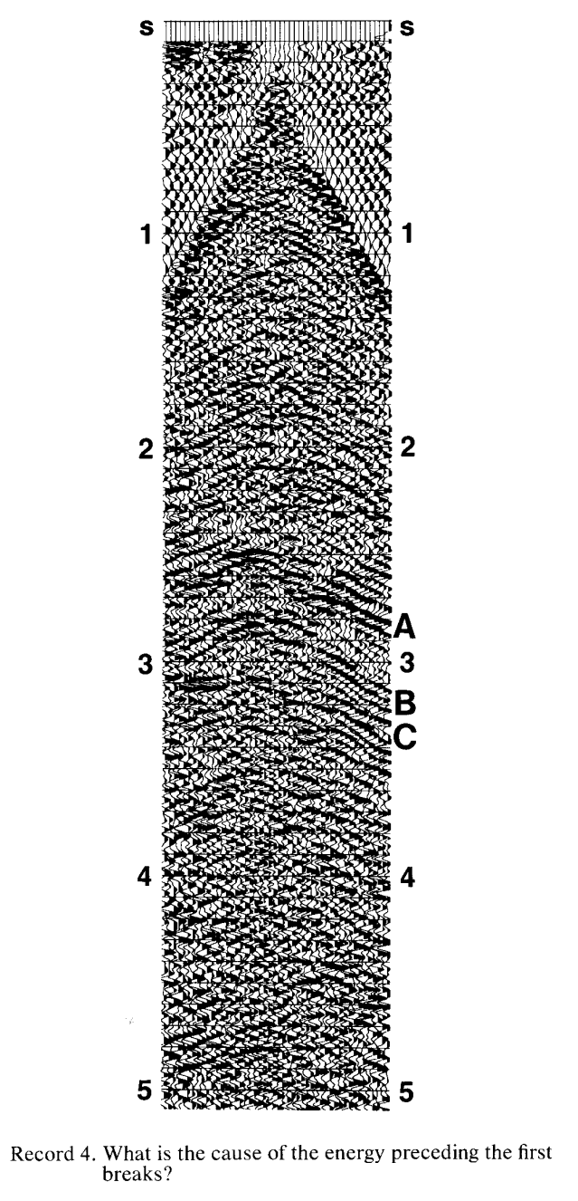
Record 4:
Contains events with complex moveout between 2.5 and 3.5 s. Events A, B y C have skewed hyperbolic moveout.

Slide 18
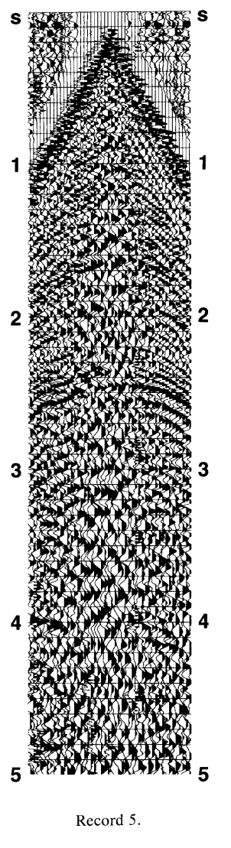
Record 5:
Has some ground roll energy, which is characterized by its low frequency, high-amplitud appearance. This kind of energy tipically is suppressed in the field by using a proper receiver array.

Slide 19
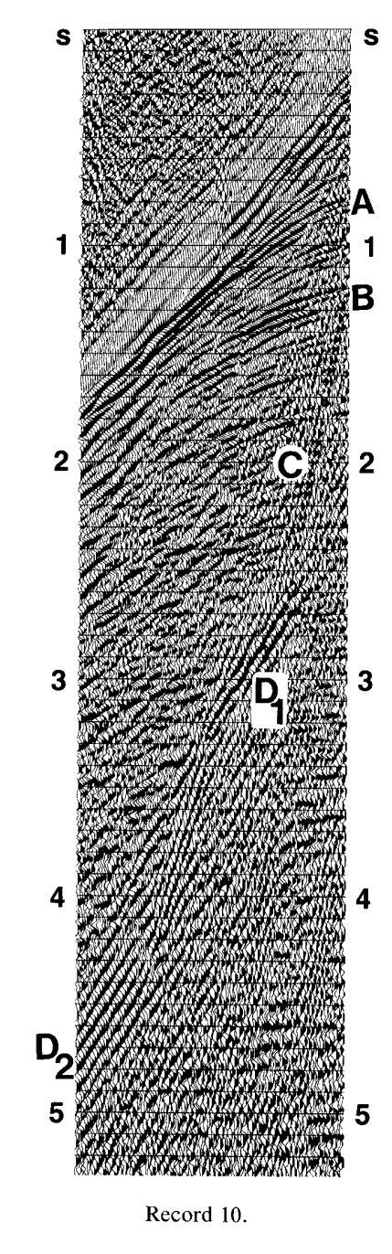
Record 10:
Contains two strong shallow reflectors, A and B in addition to ground roll energy C. Also a bundle of energy, with extremely large moveout is noted between 2.5 and 5 s.

Slide 20
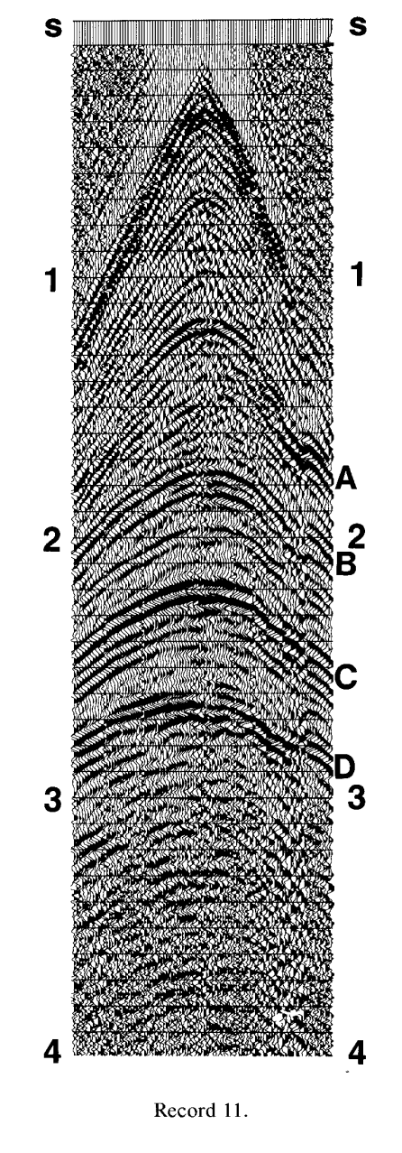
Record 11:
Contains four prominent reflections. This record is from Alaska, where the thickness of the permafrost layer can be irregular.

Slide 21
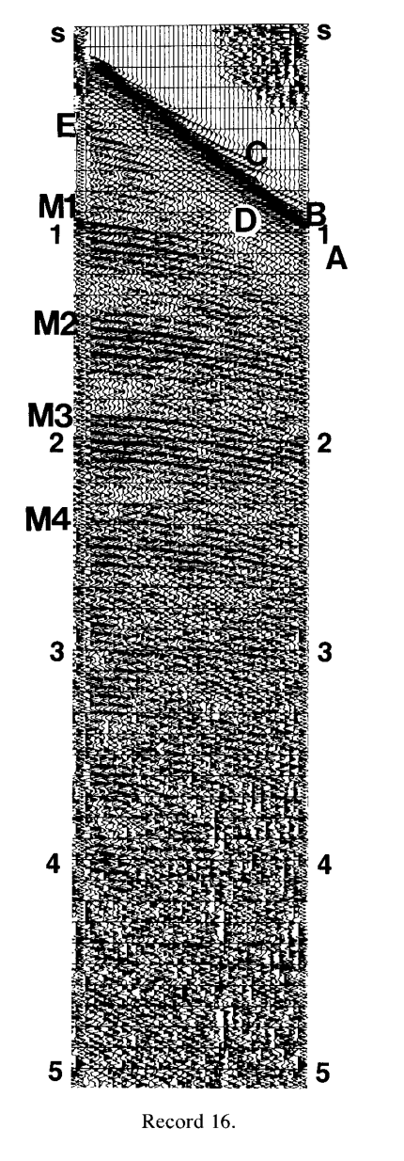
Record 16:
Wave packet A is made up entirely of guided waves. Direct arrivals B carry the highest frecuency componentes, while lower frecuencies C arrive earlier. This record has a reflection E and long-period multiples M1 through M4.

Slide 22
Record 20:
Marine record. Direct arrivals A are significantly suppressed by receiver arrays in the field. We can see the water bottom reflection B on short-offset traces. Note a shallow reflector C and associated refraction arrival D.

Slide 23
Record 31:
Primarily made up of guided waves. A is a refraction arrival, B multiples, C is direct arrival.

