Slide 1
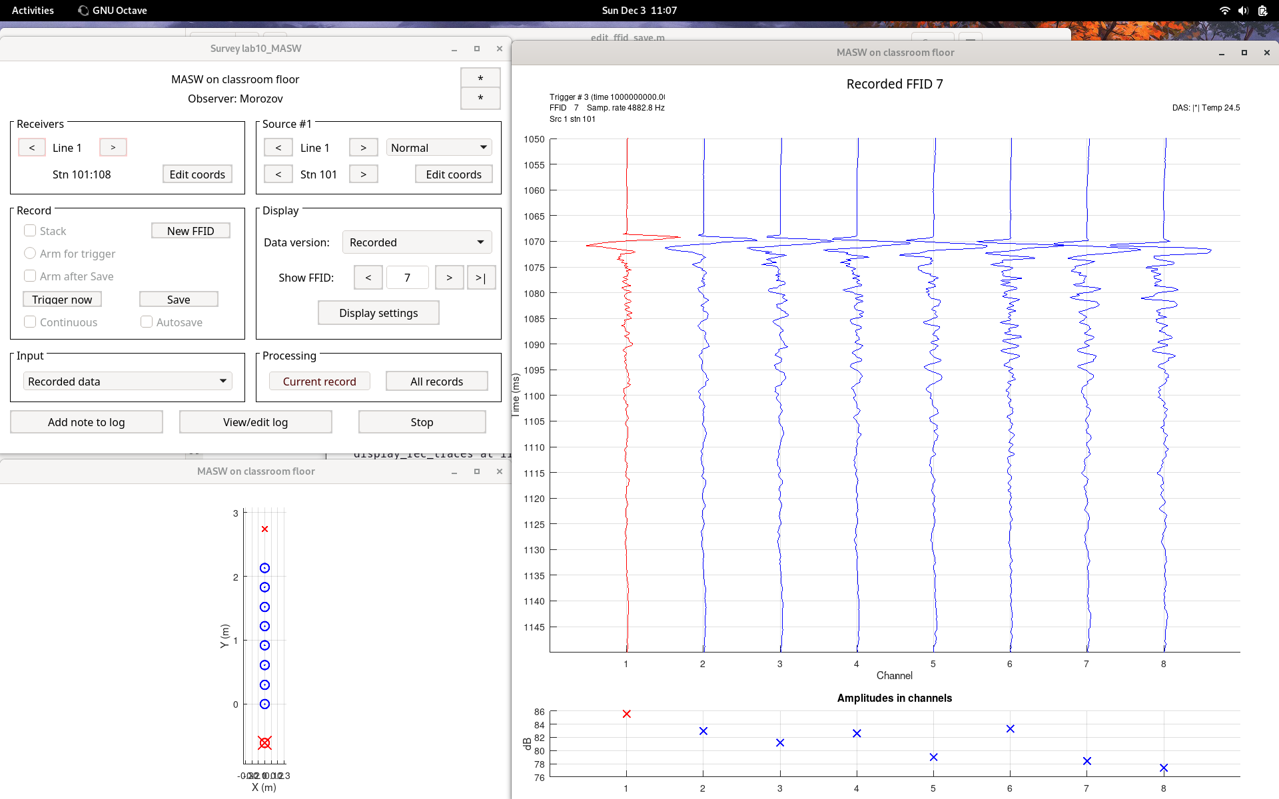
Layout if the experiment and sample record (ffid=7)

Slide 2
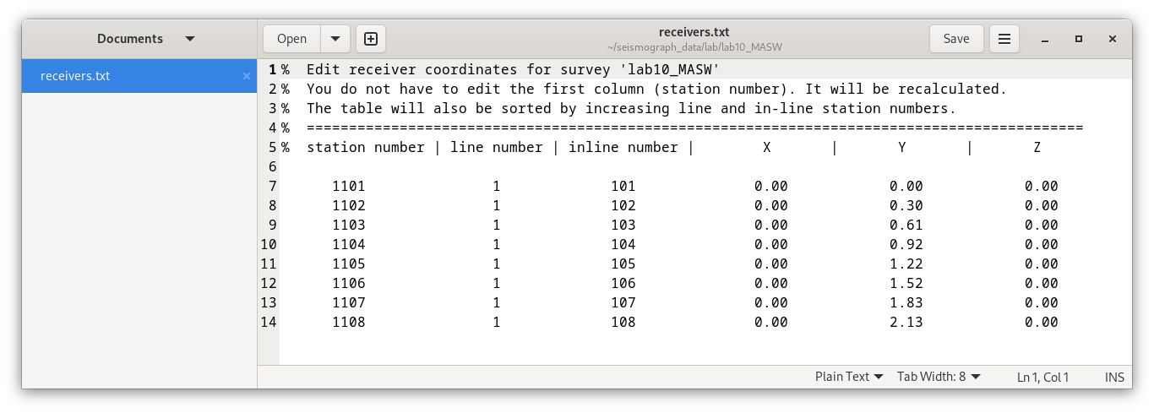
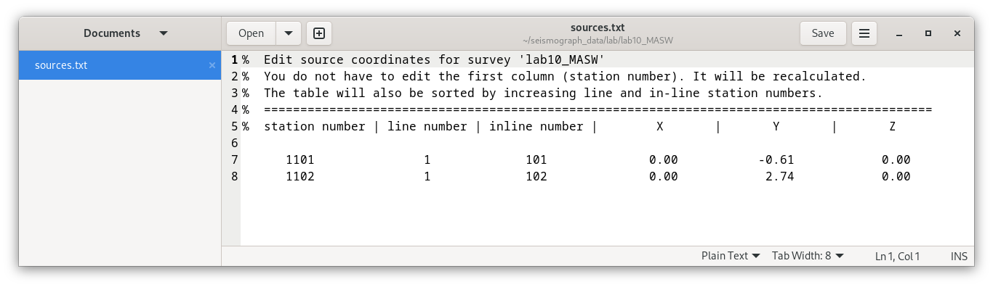
Source and receiver coordinates

Slide 3
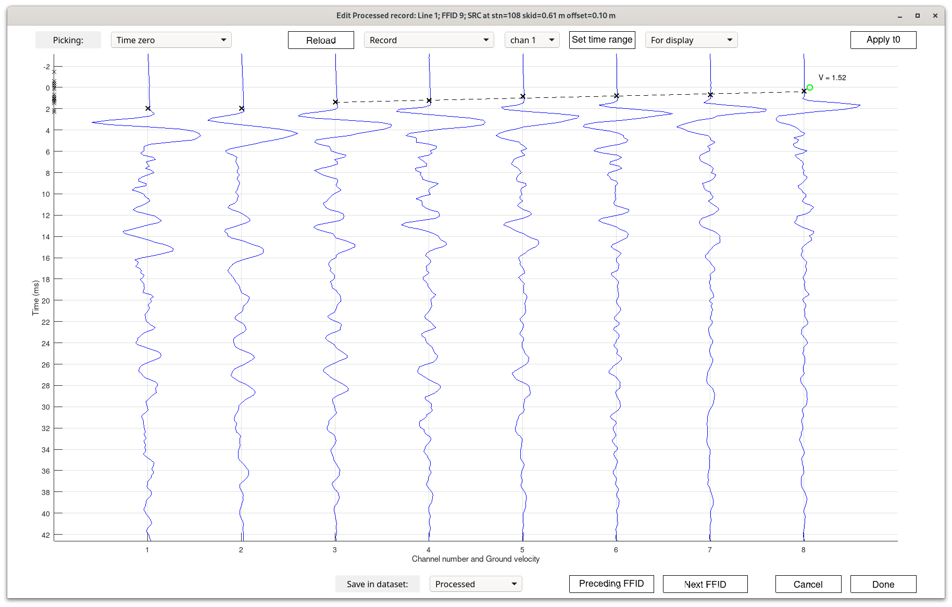
Picks and velocity in FFID 9

Slide 4
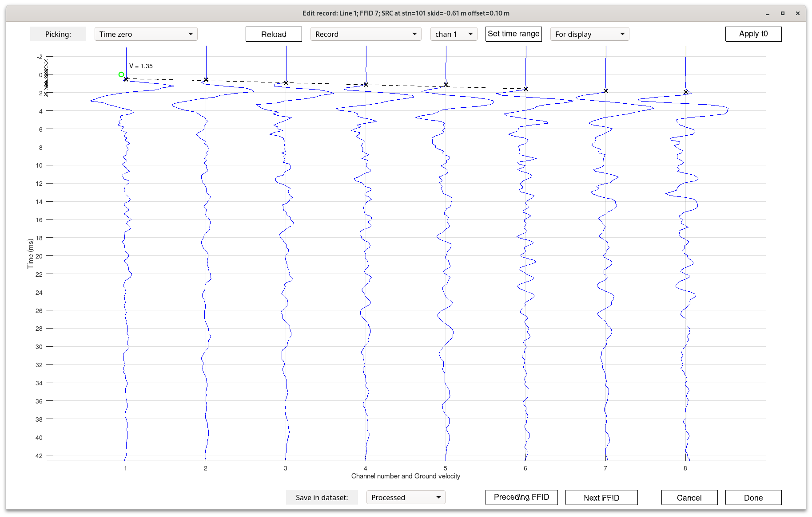
Picks and velocity in FFID 7

Slide 5
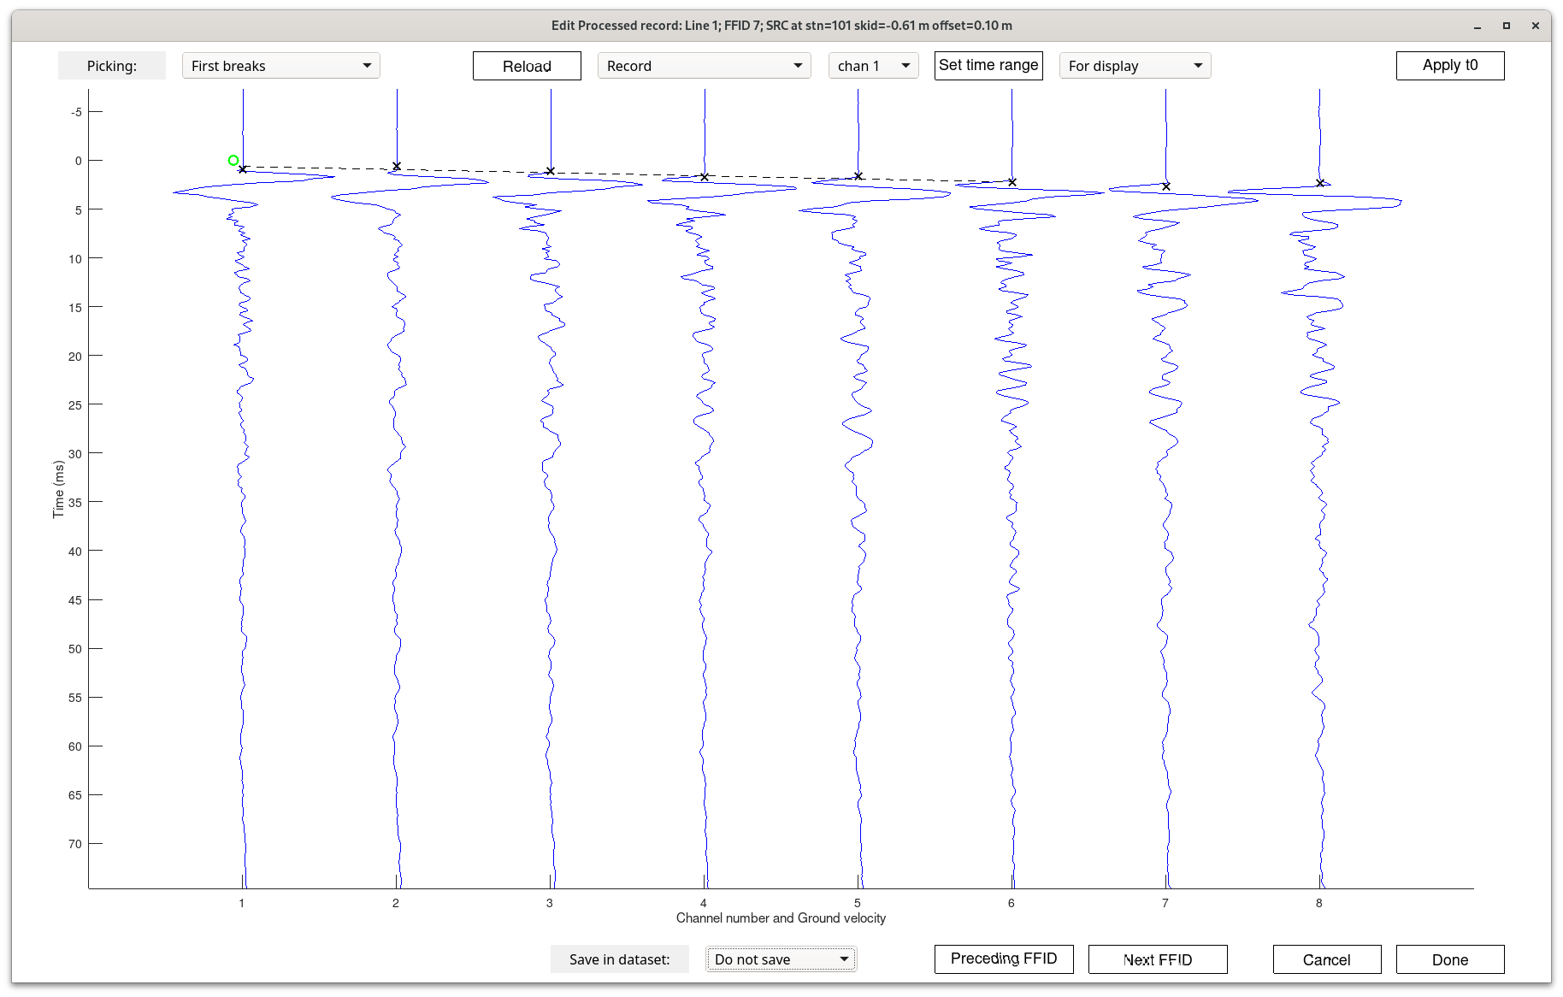
ffid=7 strike from stn 101 (on the left)

Slide 6
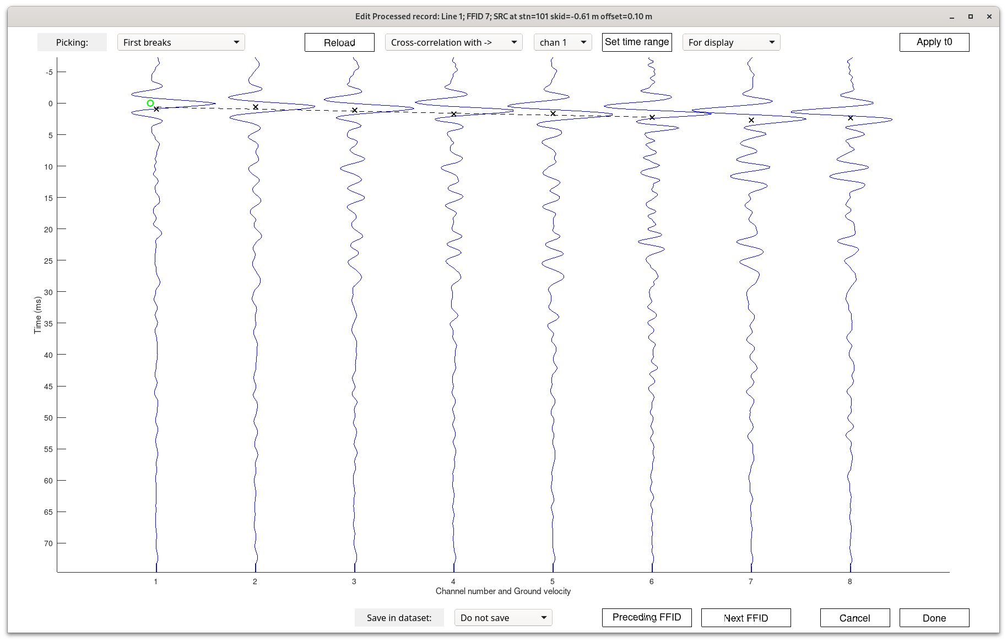
Cross-correlations with chan=1 in the same record

Slide 7
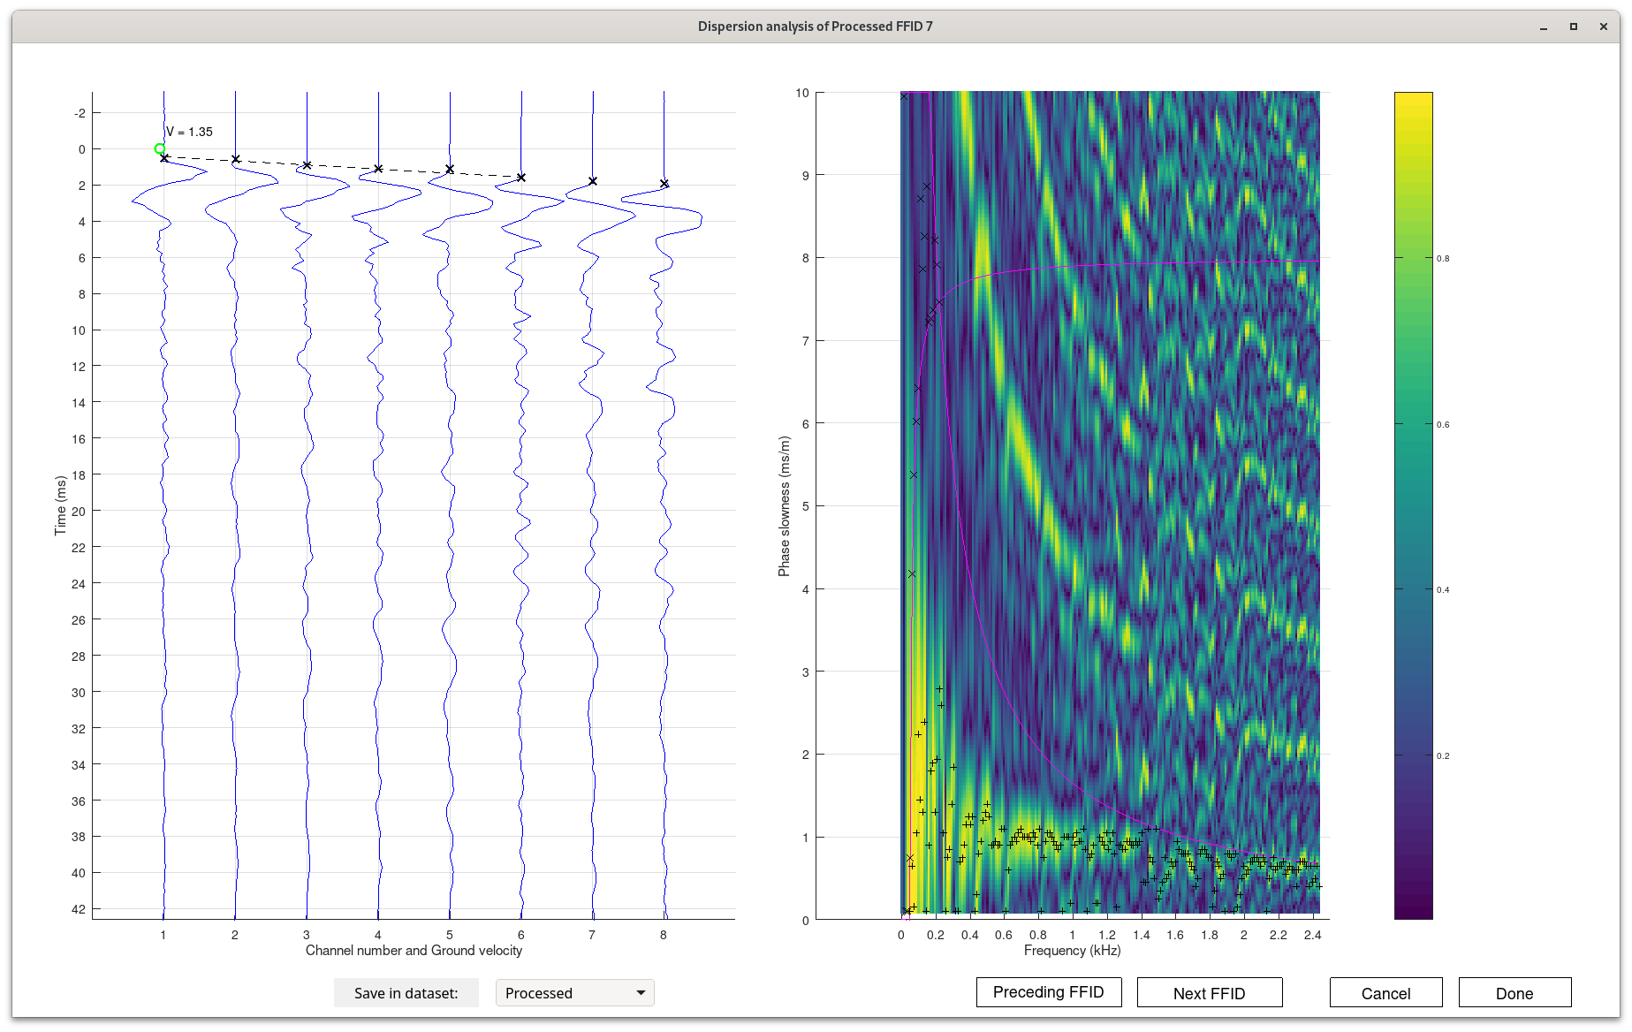
MASW Dispersion analysis of FFID 7
At frequencies f > about 1.4 kHz, velocity is higher and close to V=1.35 m/ms seen in first arrivals.
At lower frequencies, slowness is about 1 ms/m and velocity is also about 1 m/ms.
This means that velocity at low frequencies appears to be LOWER than at high frequencies
This could be due to the flexural mode of floor deformation (?)
Hyperbolas are aliased semblance peaks.

Slide 8
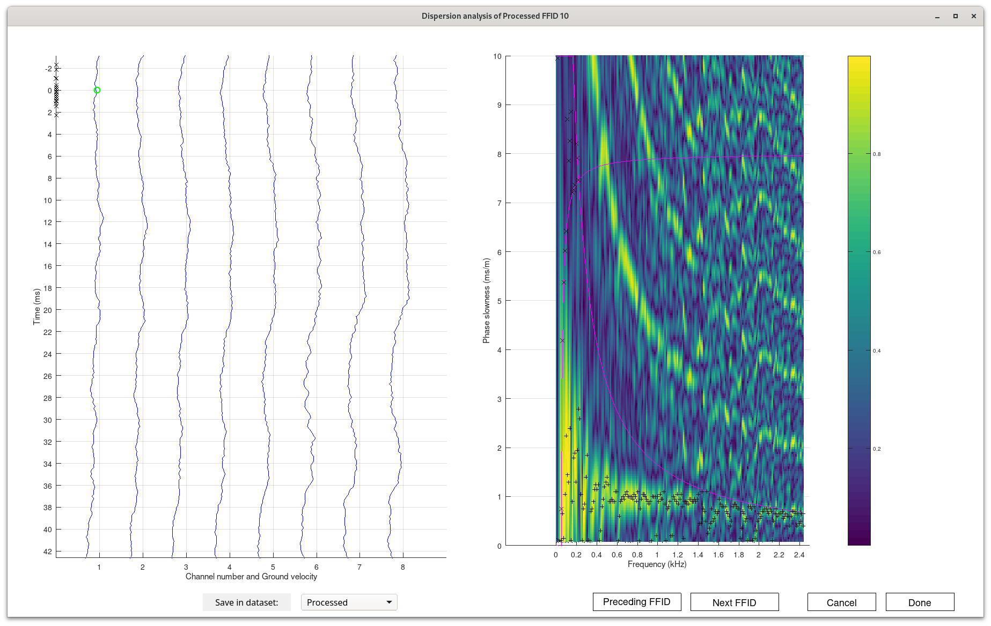
Vibrator record FFID 10 shows similar result

Slide 9
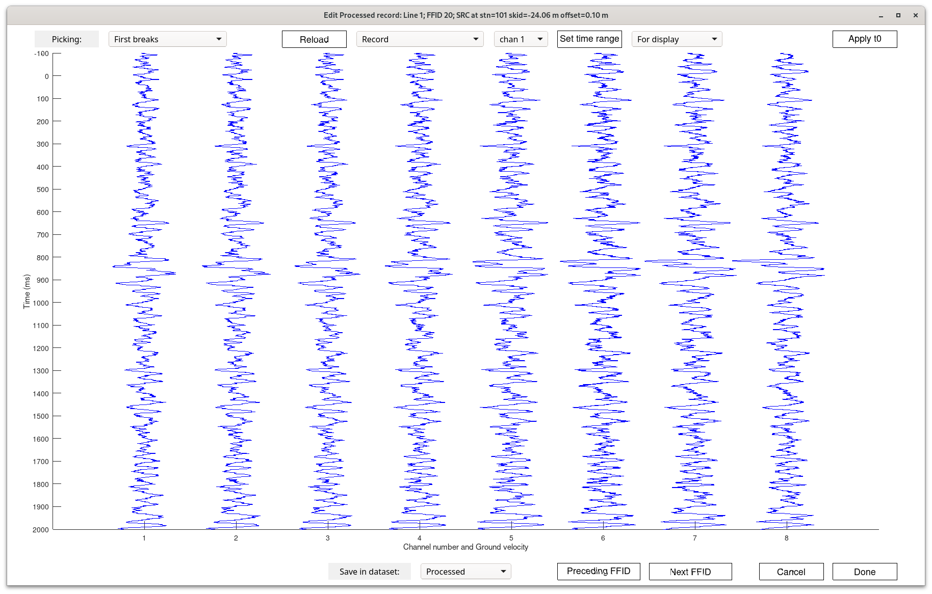
Noise record ffid=20 (first two seconds)

Slide 10
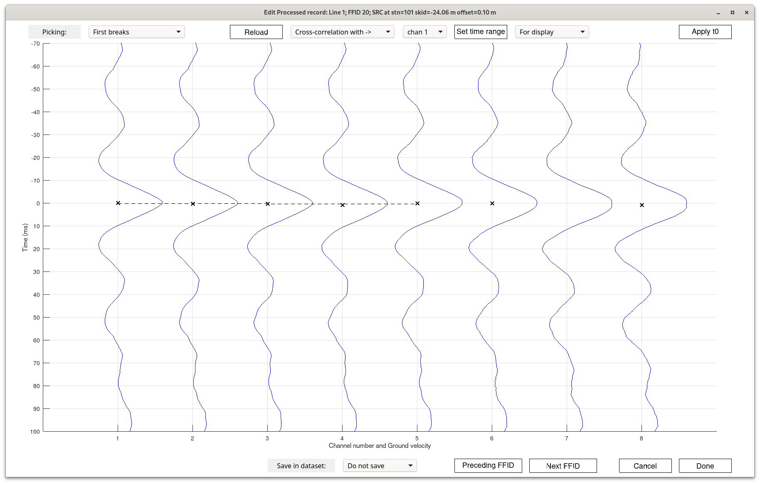
Cross-correlation of the same ffid 20 (first 100 ms)
Looks like we only see the low-frequency “standing wave” (no moveout with distance). Measure the period and frequency!

Slide 11
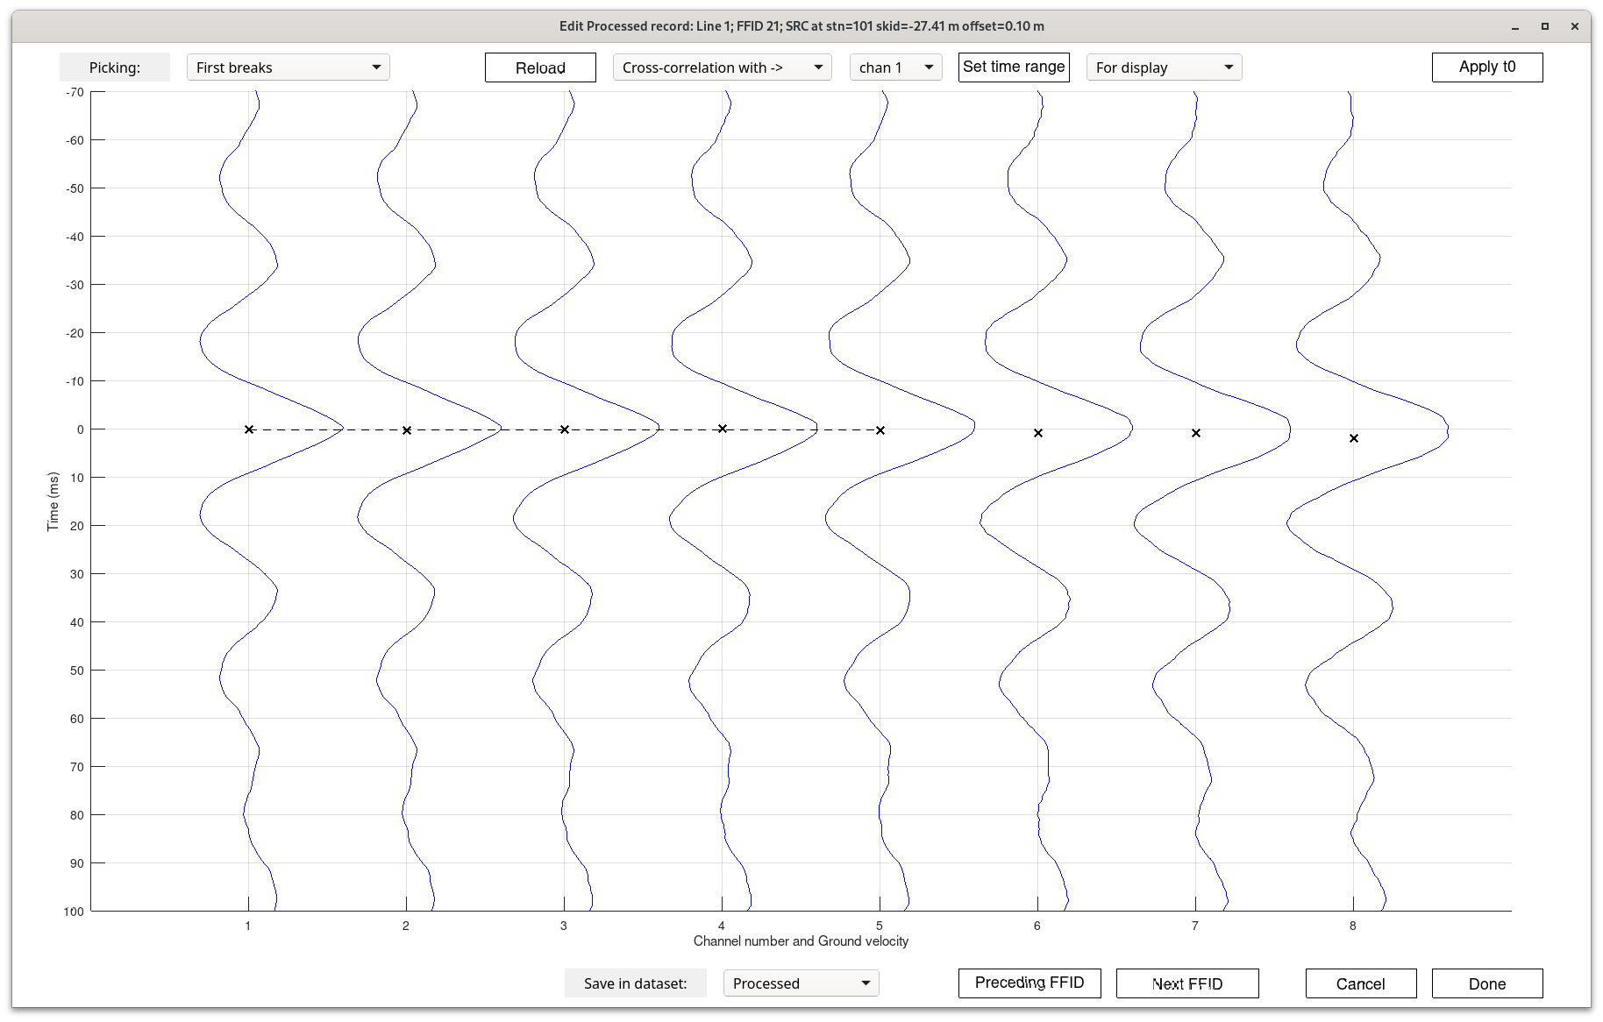
Cross-correlation of the next ffid 21
Note that there still is a noticeable moveout on the right (crosses)! We’ll have to apply low-cut filter to see it better (can’t do it now).

Slide 12

Cross-correlation of ffid 22
More of the high-frequency waves are seen, but still not too well.

Slide 13
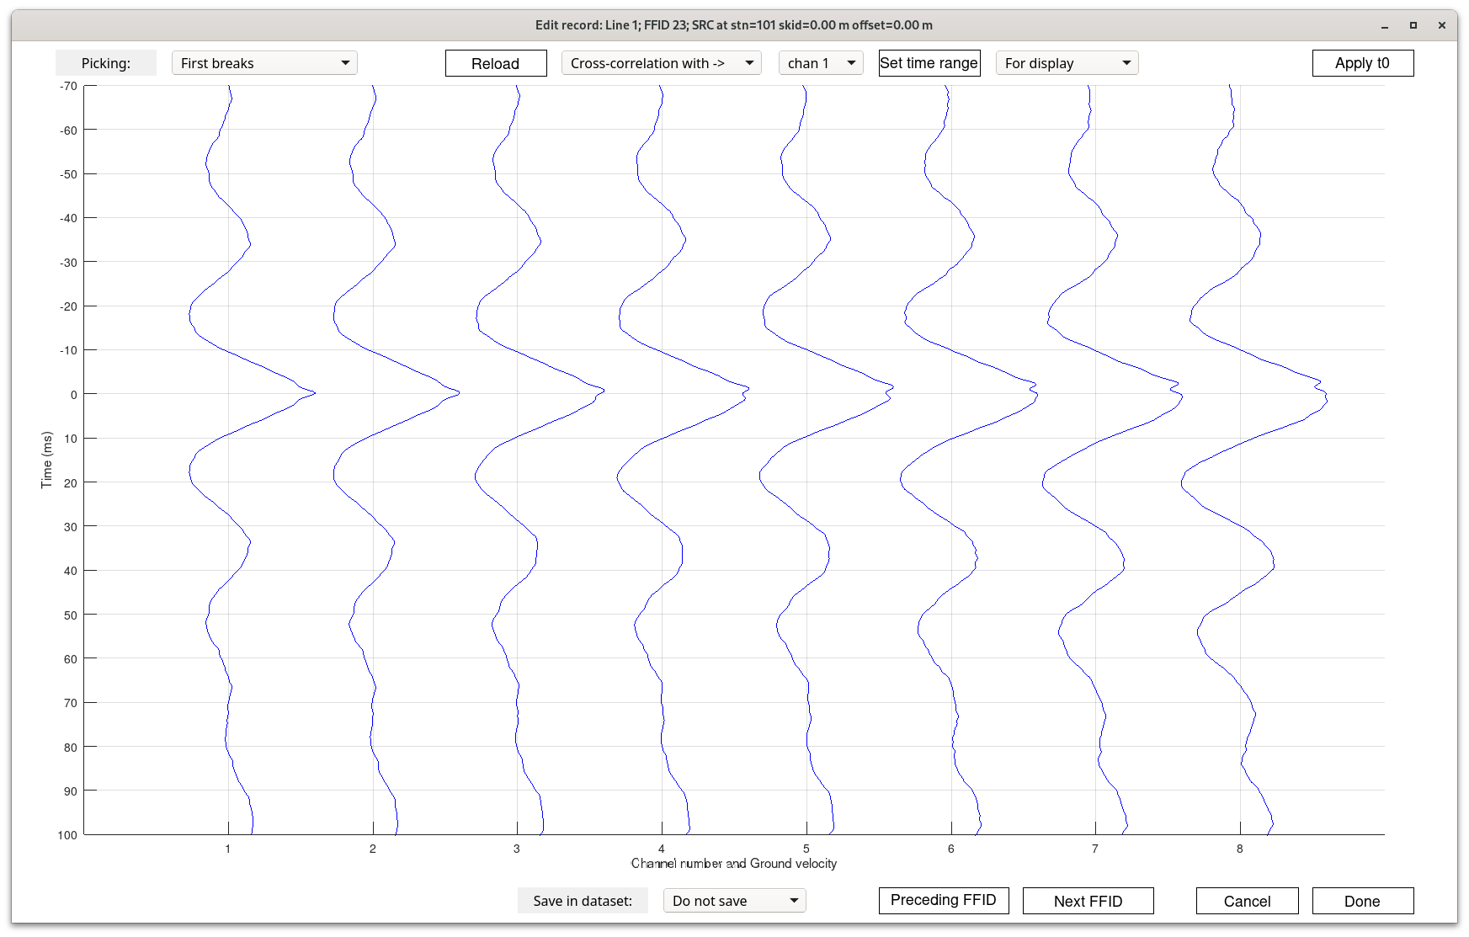
Cross-correlation of ffid 23
More of the high frequency waves ...

