Slide 1
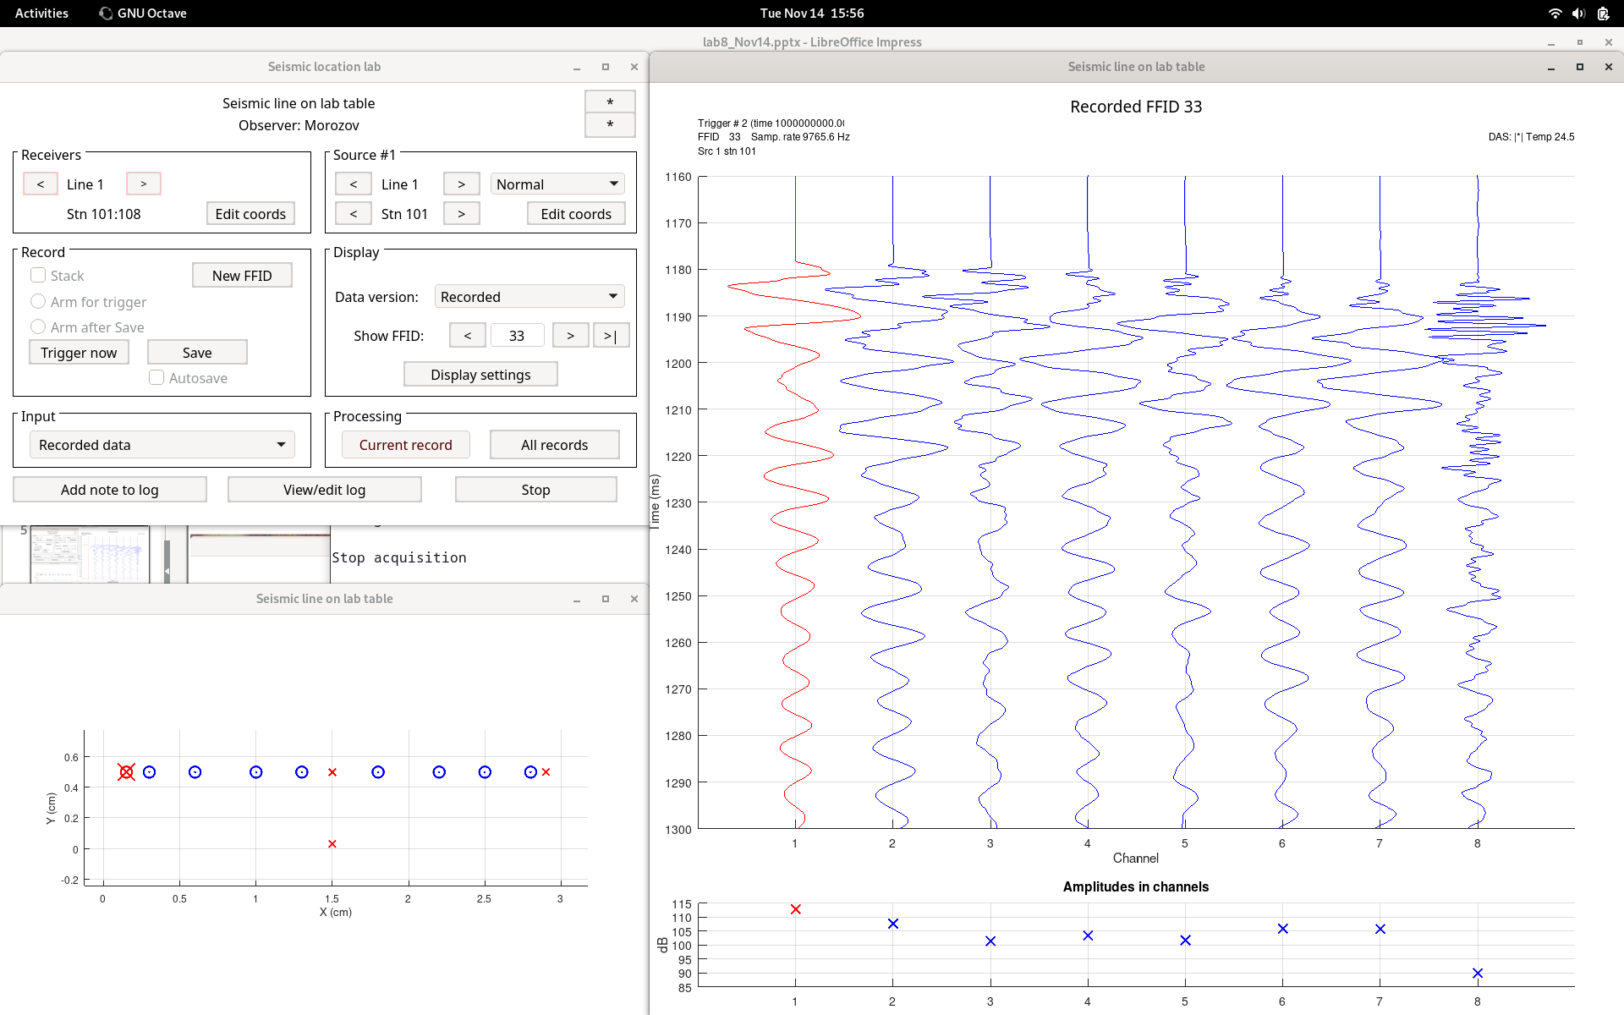
Hammer strike at source station 1

Slide 2
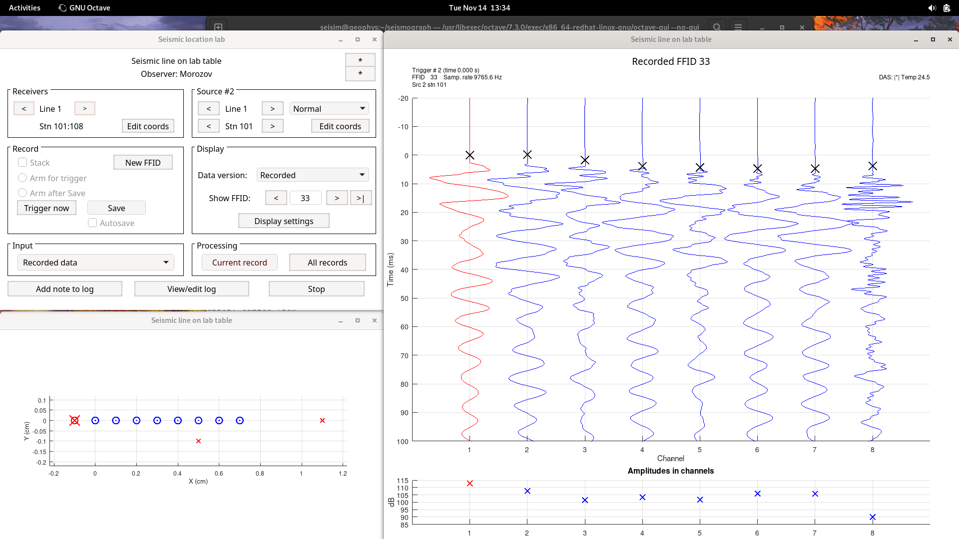
The same with STA/LTA picks of first arrivals
This layout plot is wrong. Refer to the plot on the next slide.

Slide 3
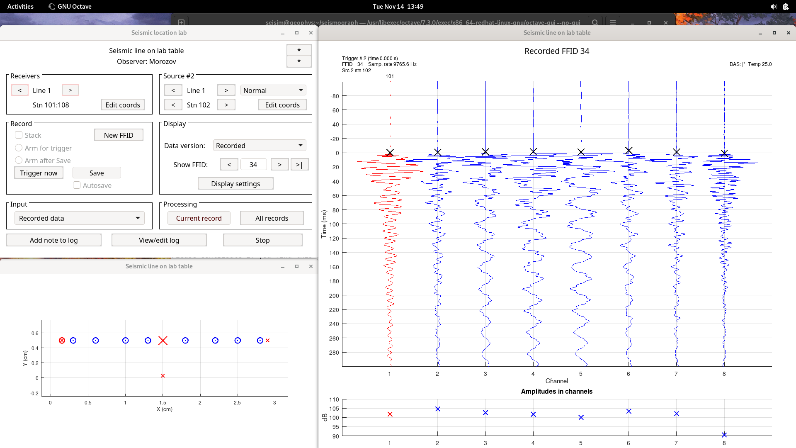
knuckles strike at source station 2

Slide 4
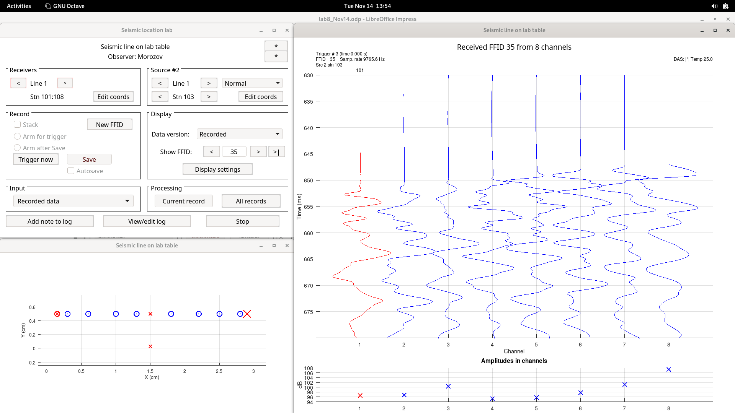
knuckles strike at source station 3

Slide 5
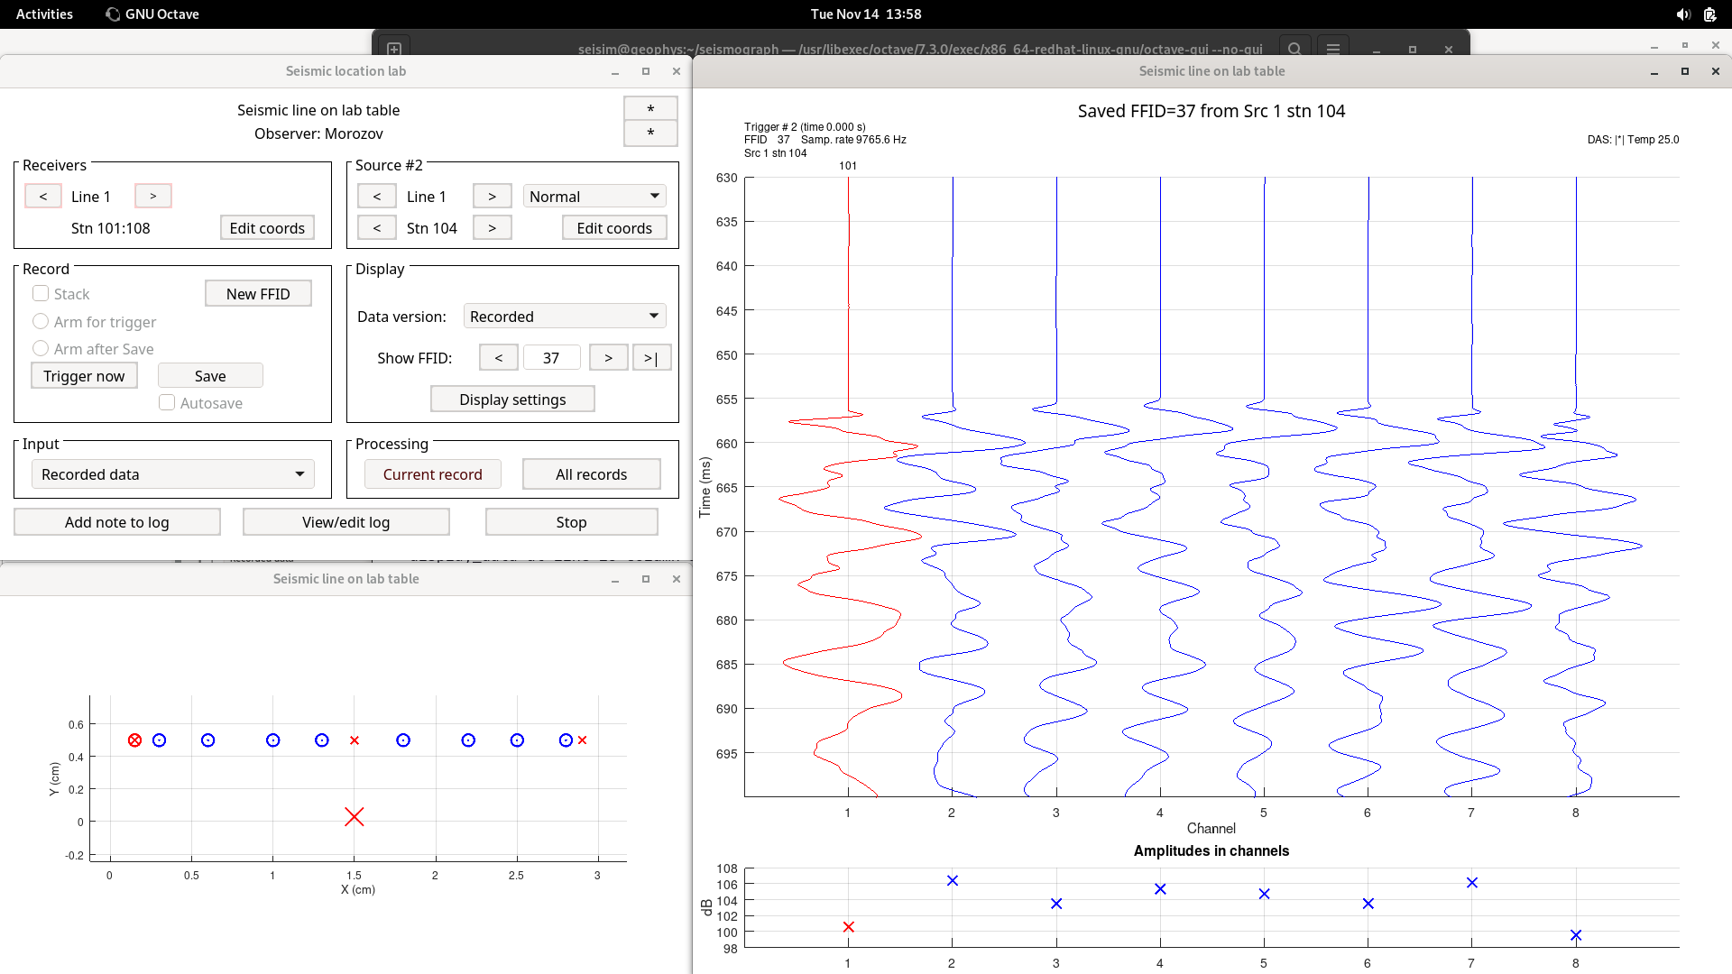
knuckles strike at source station 4 (broadside off-line)

Slide 6
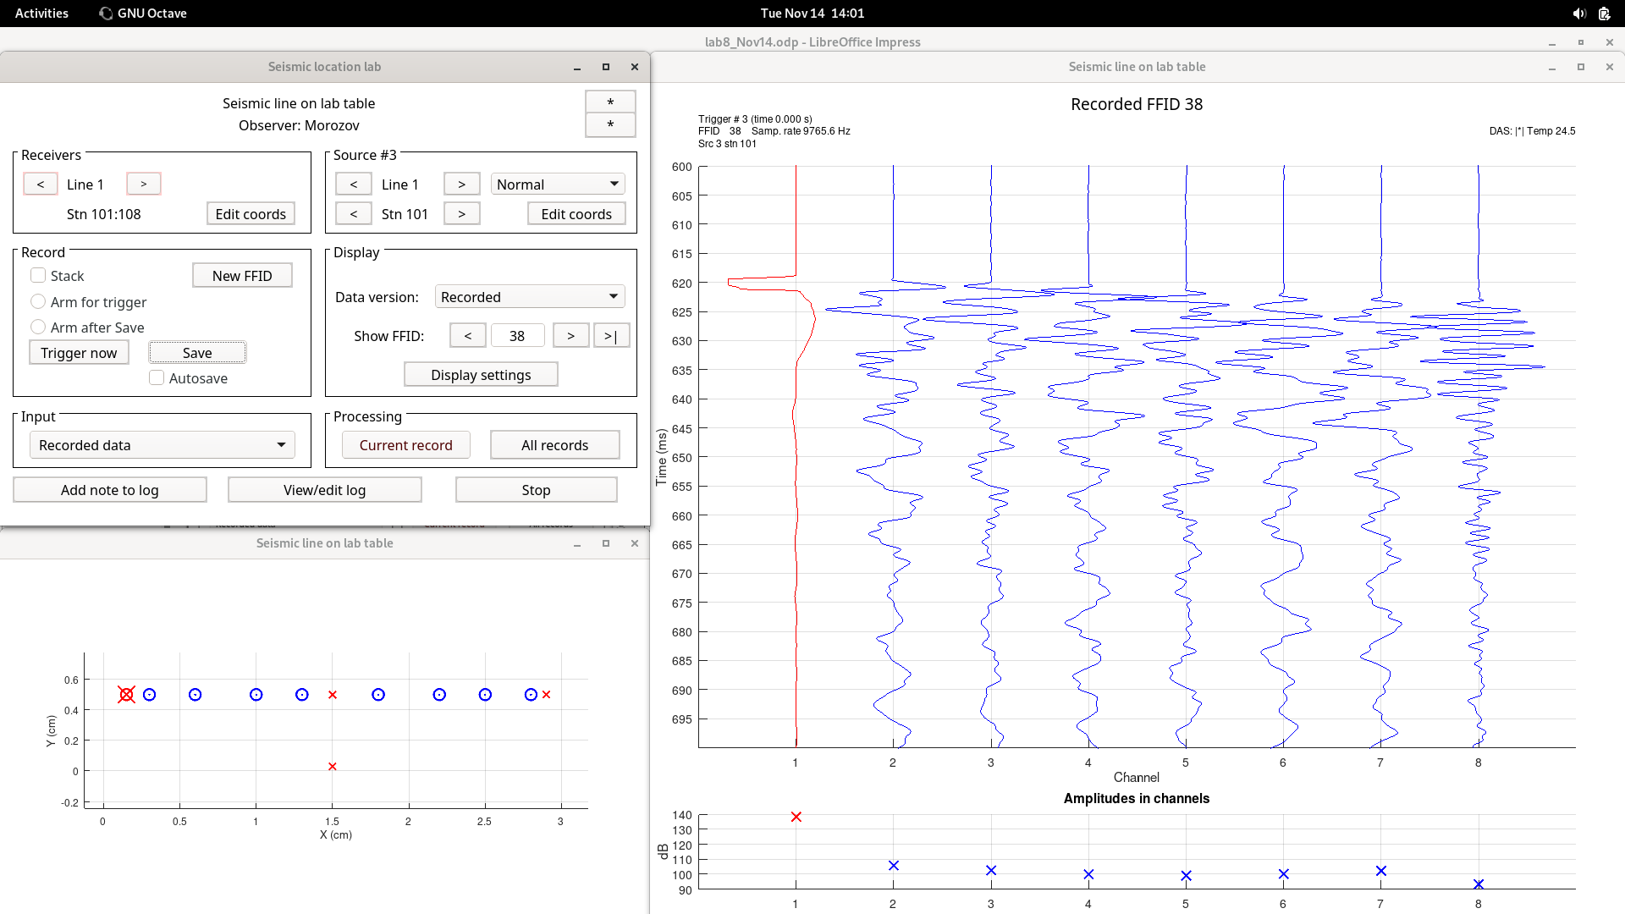
1st accelerometer used as source

Slide 7
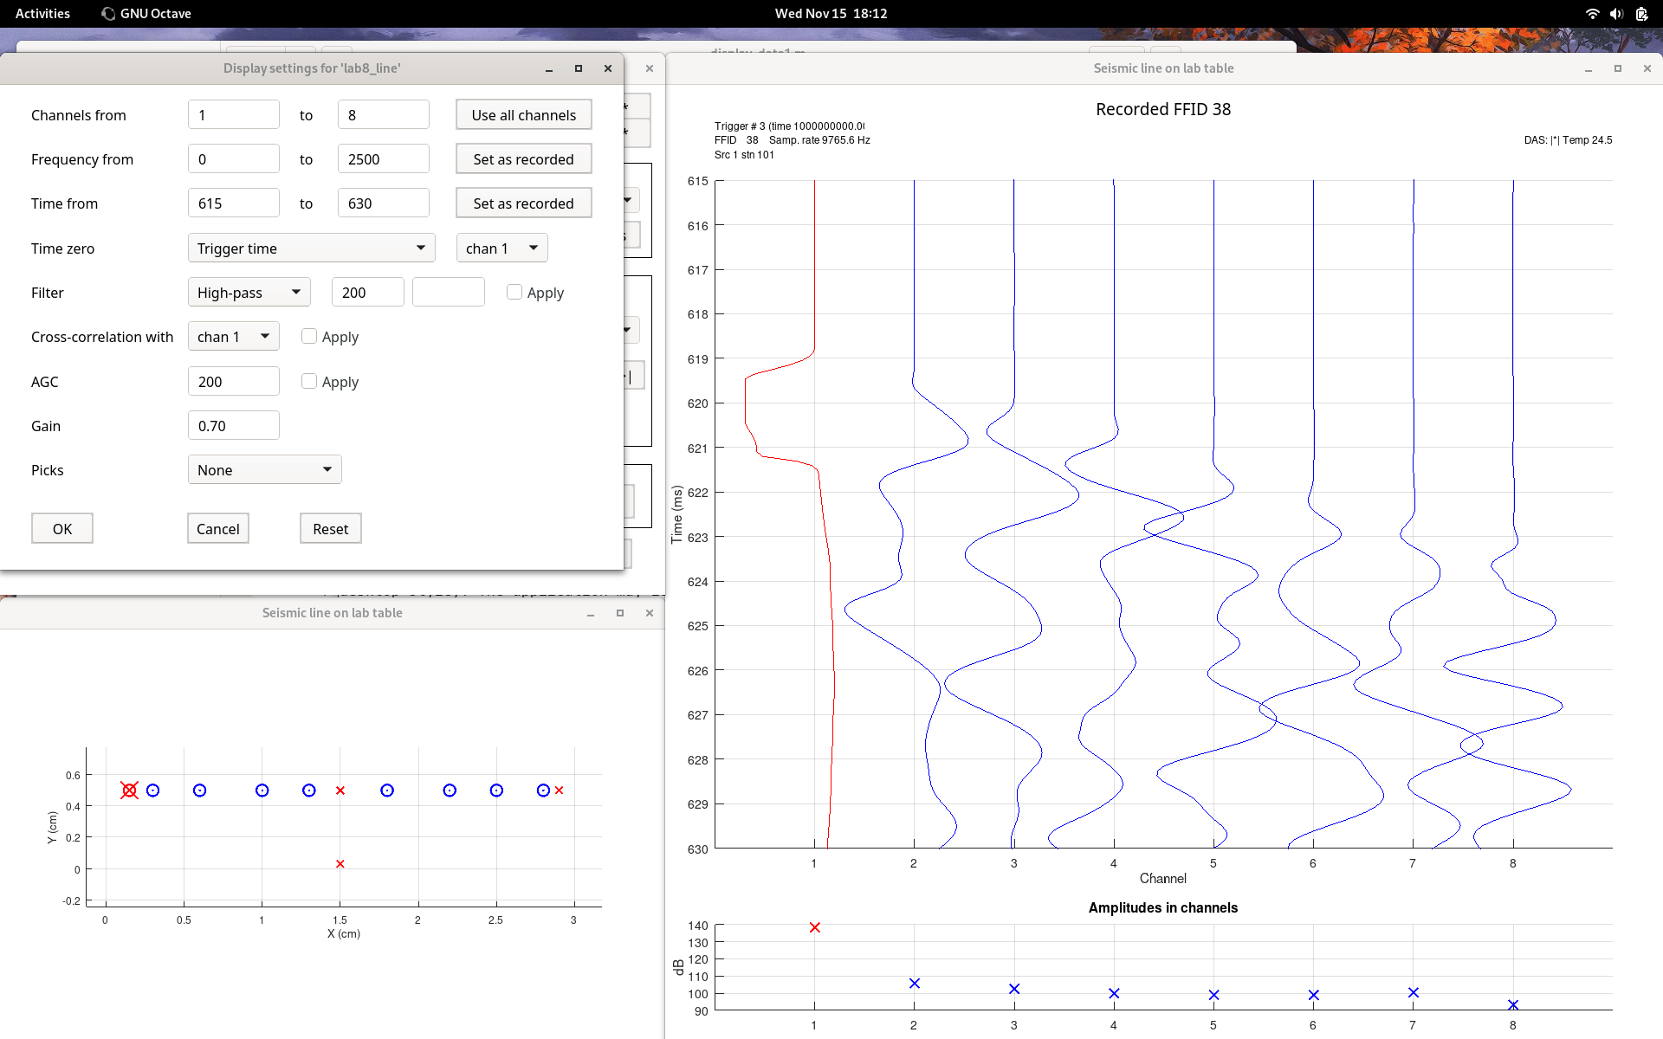

The same with real good zoom in for measuring velocity

Slide 8
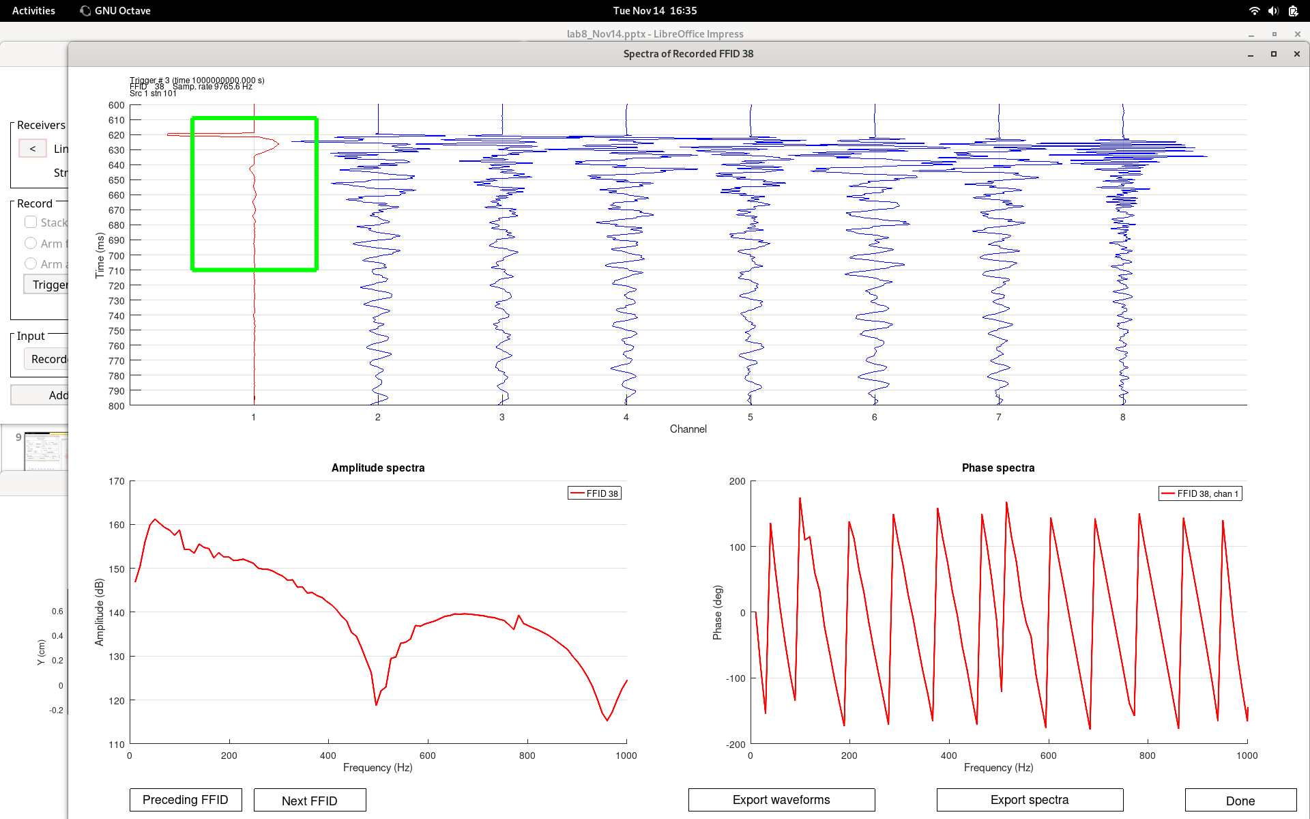
Spectra of the source record from this accelerometer drop

Slide 9
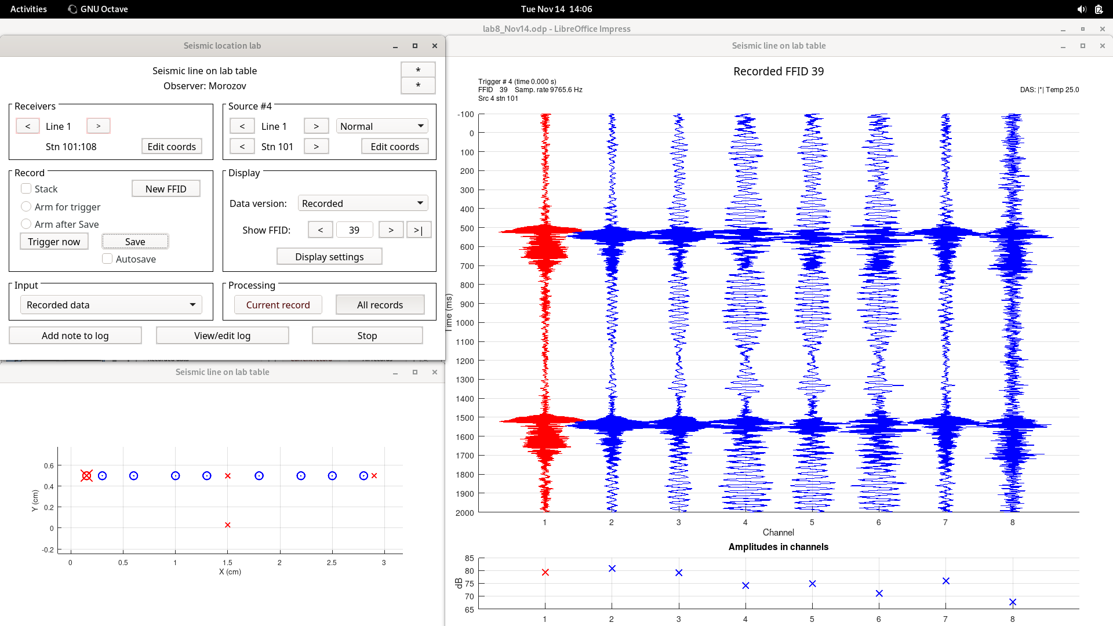
1-s 100-2000 Hz up-sweep at station 1

Slide 10
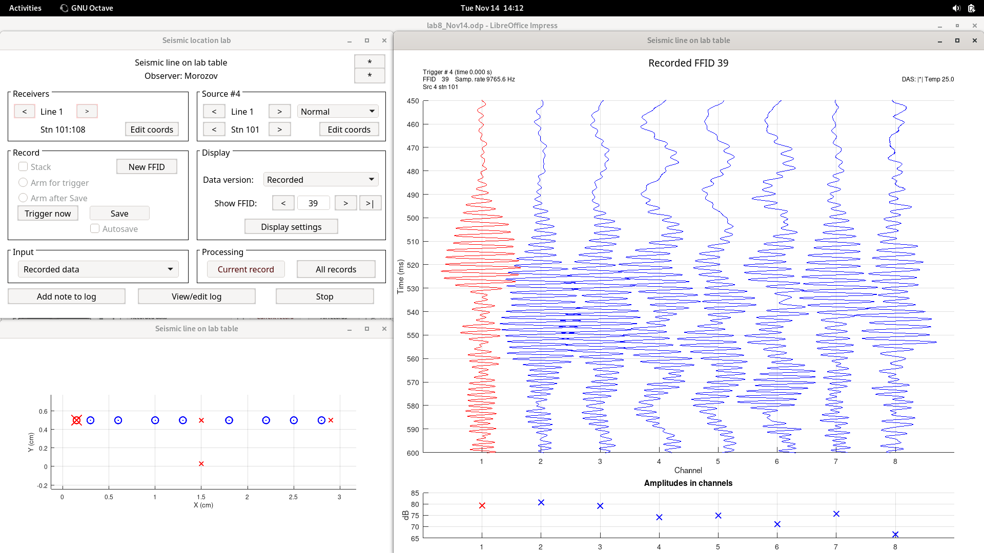
Zoom-in on the same

Slide 11
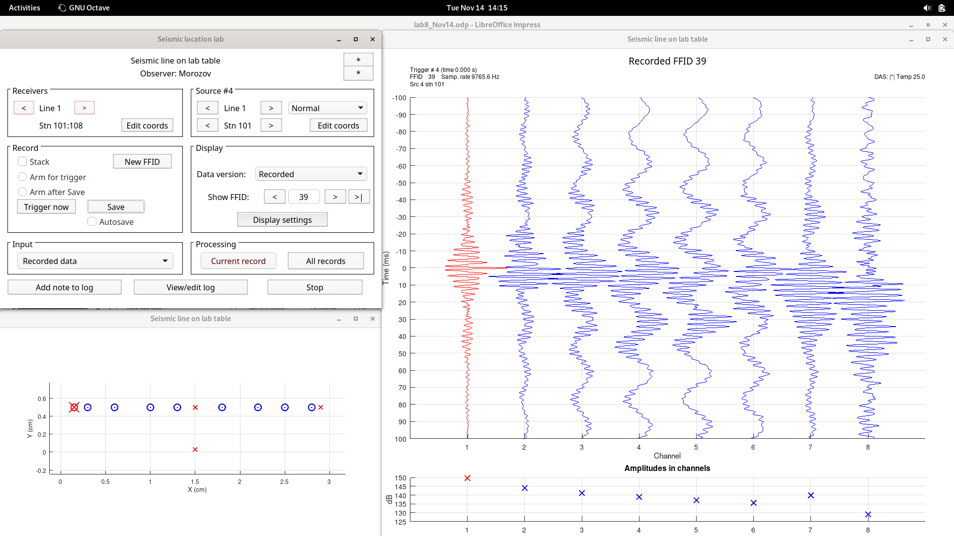
Sweep cross-correlated with chan 1 to create impulsive records

Slide 12
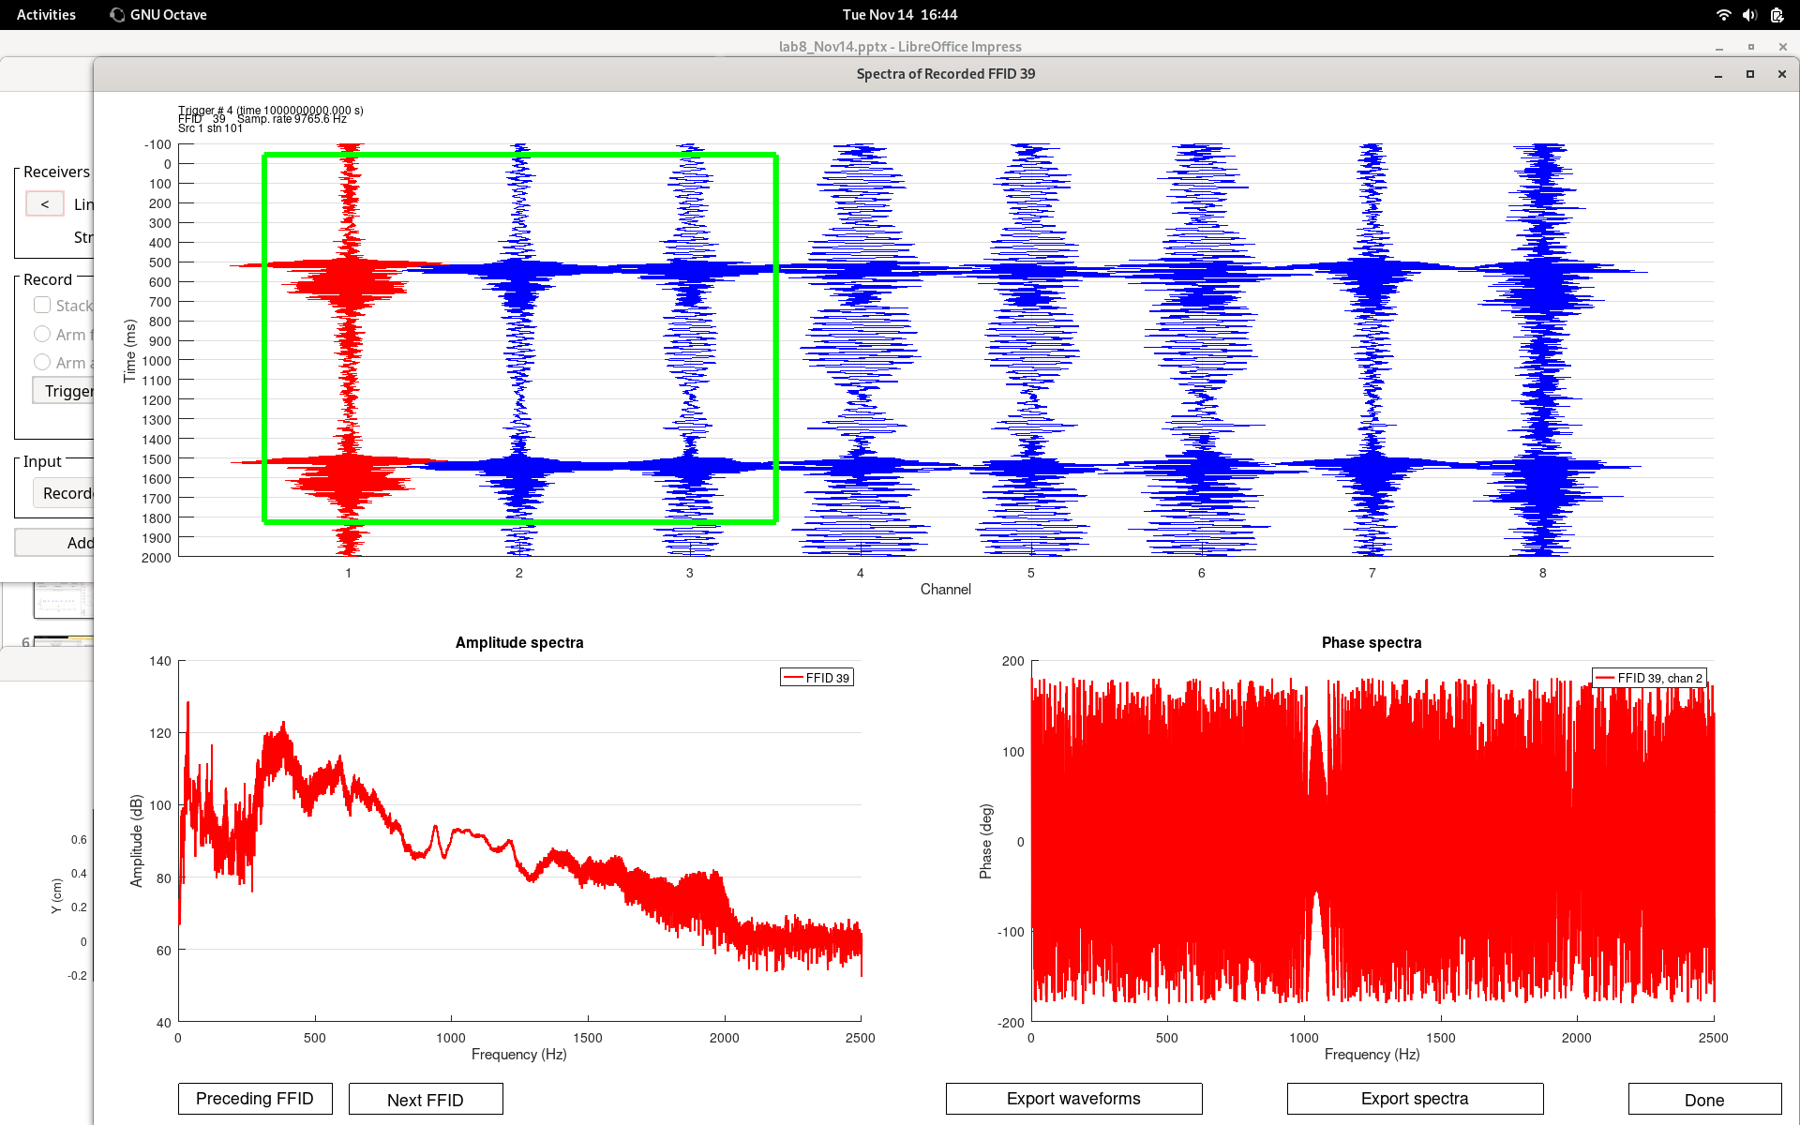
Spectra of sweep, near-source

Slide 13
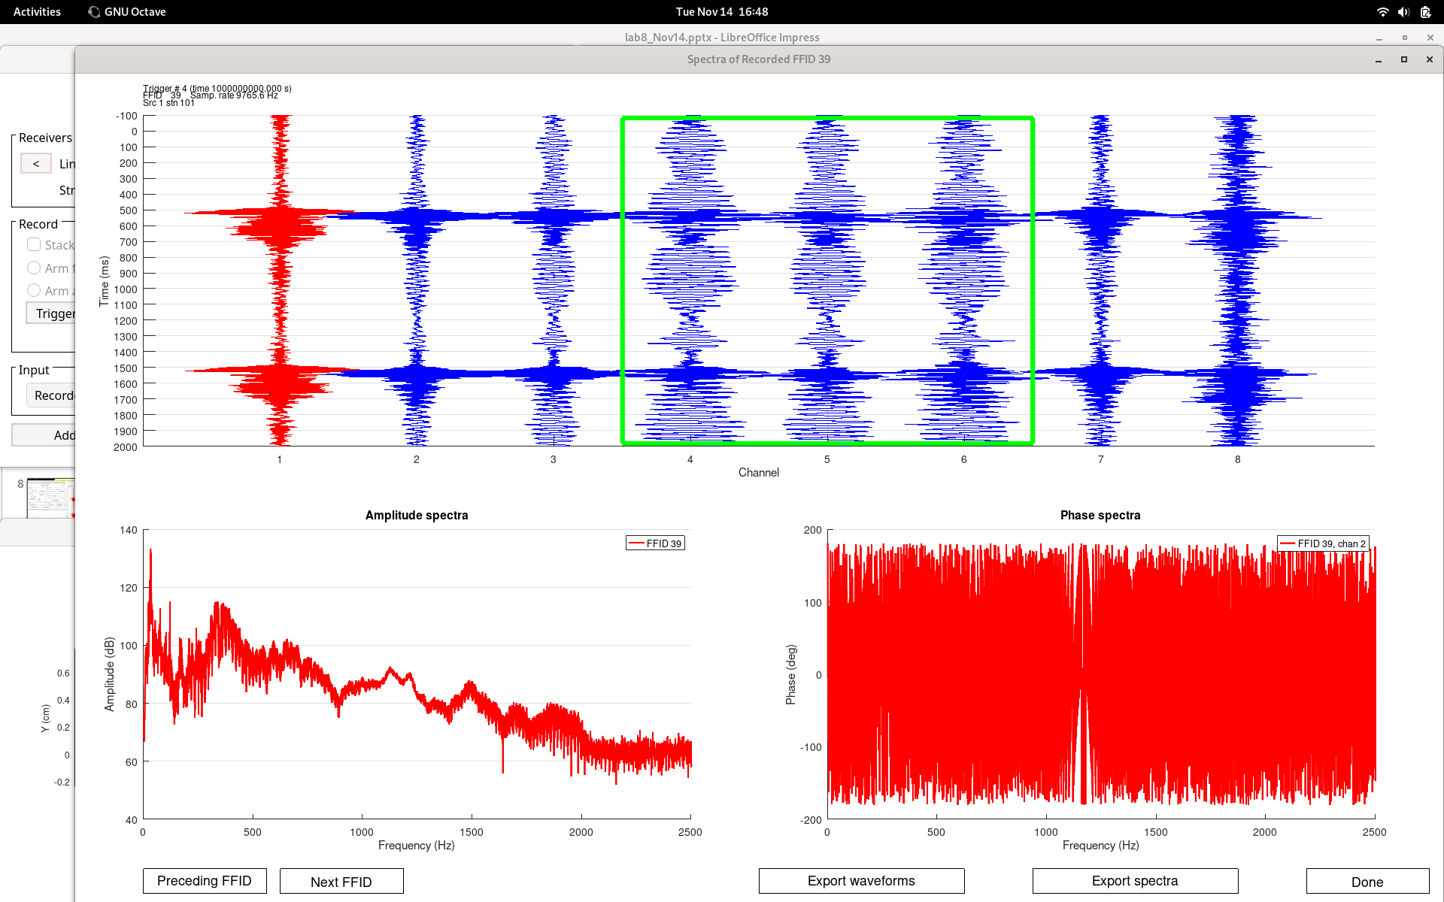
Spectra of sweep, middle of the table (note resonance)

Slide 14
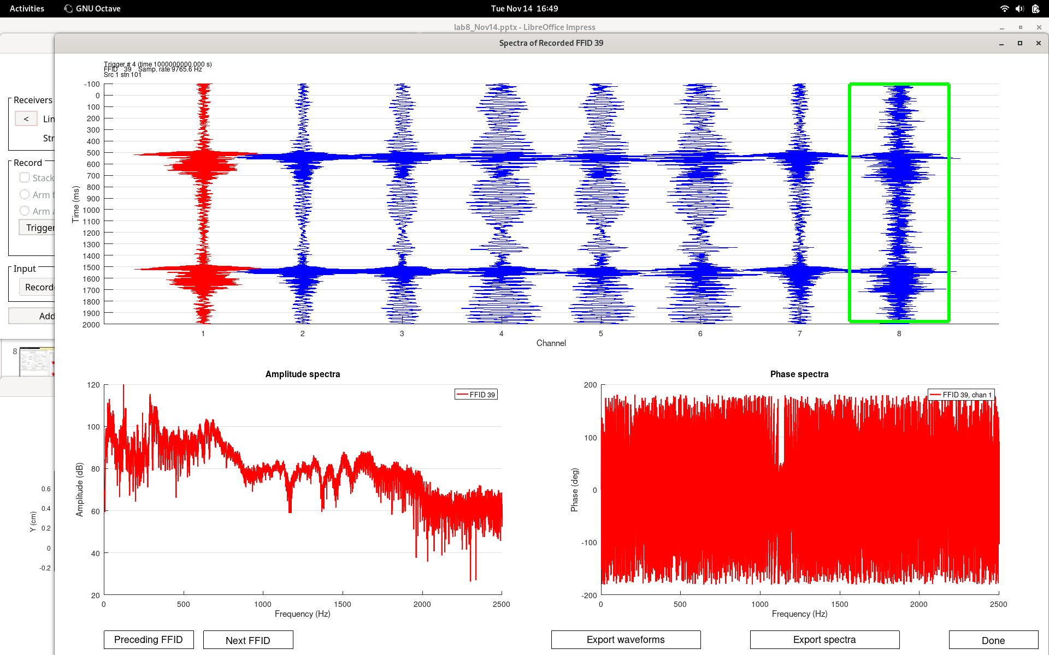
Spectra of sweep, noisy weak signal at the opposite end of the table

Slide 15
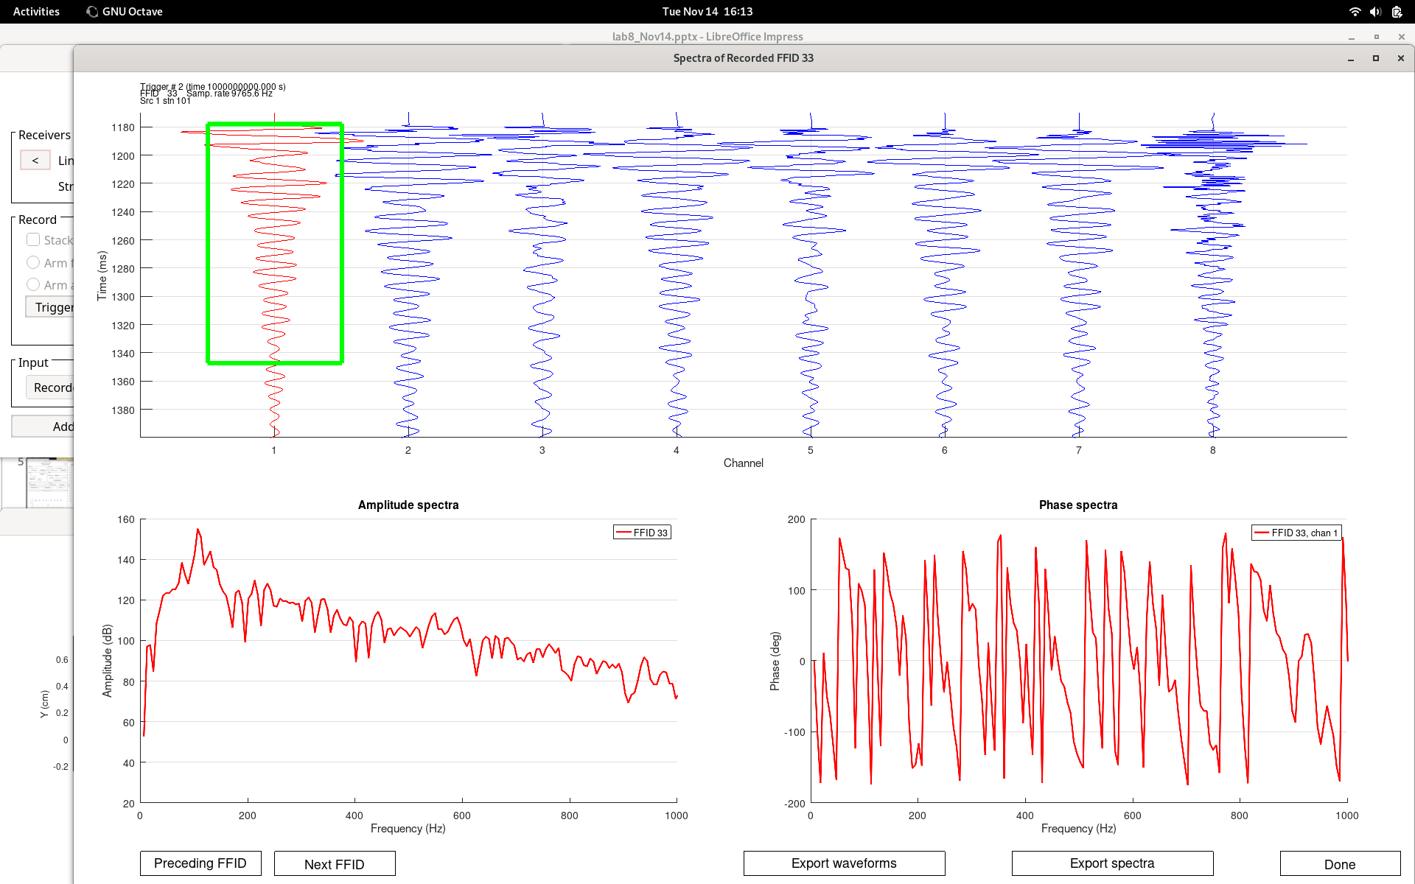
Spectra of chan 1 from the first strike

Slide 16
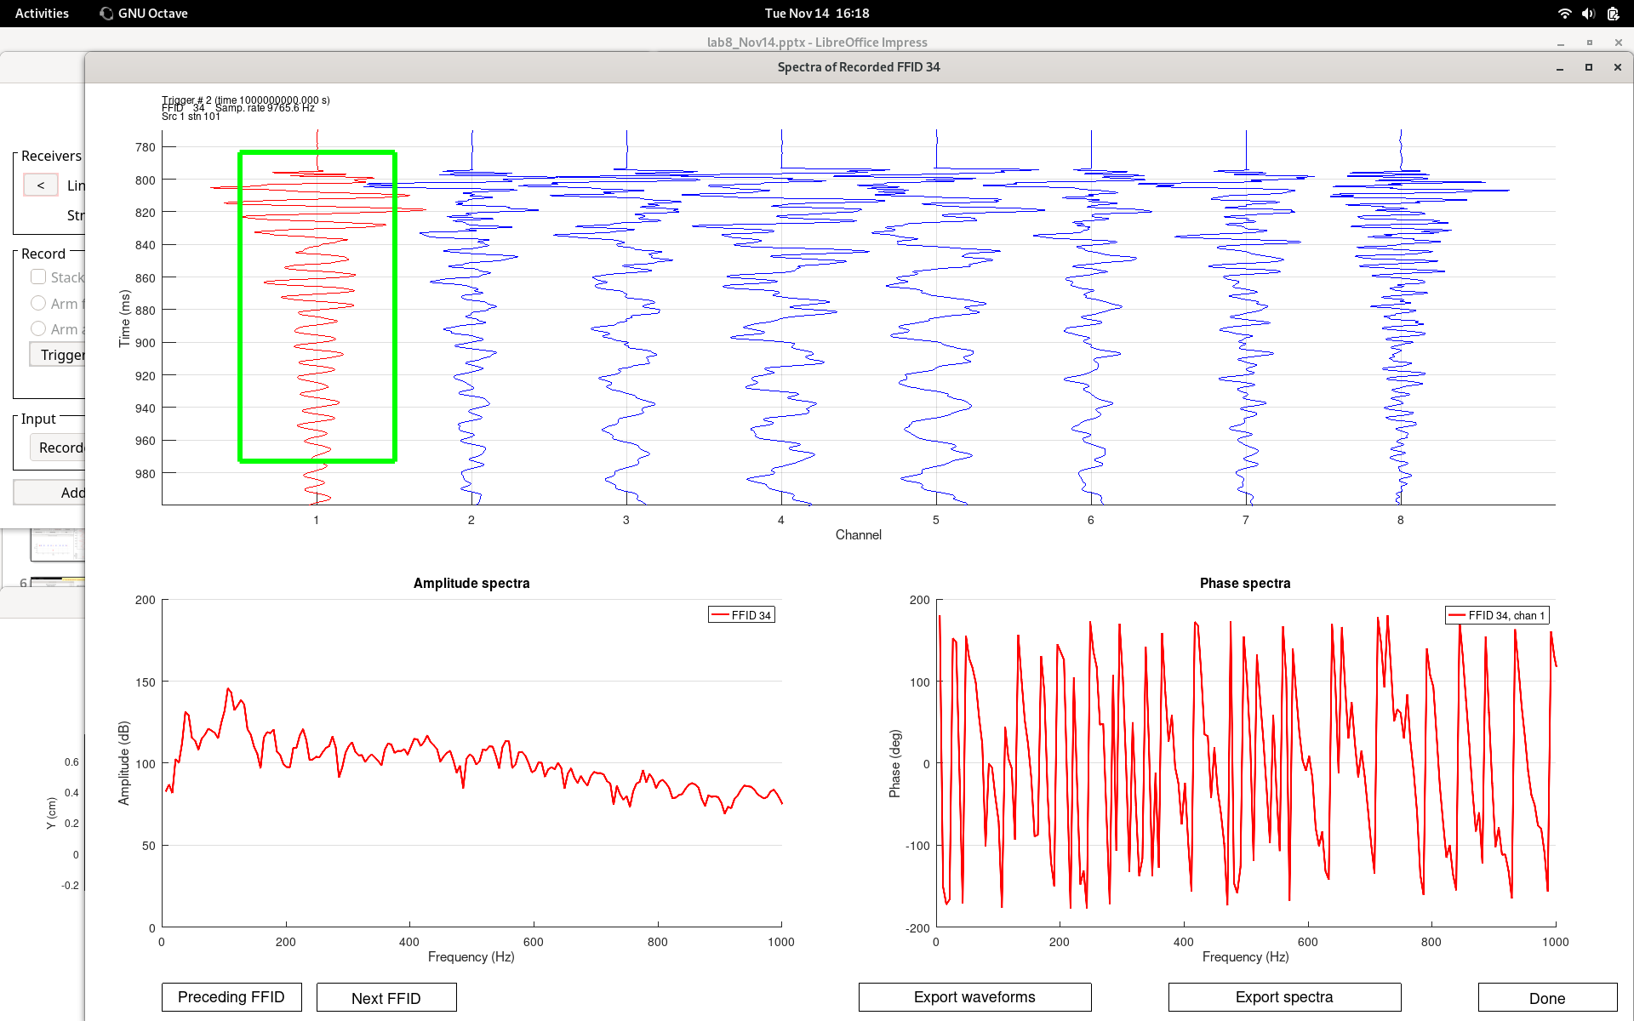
Spectra of chan 1 from the first ‘knuckle” strike

Slide 17
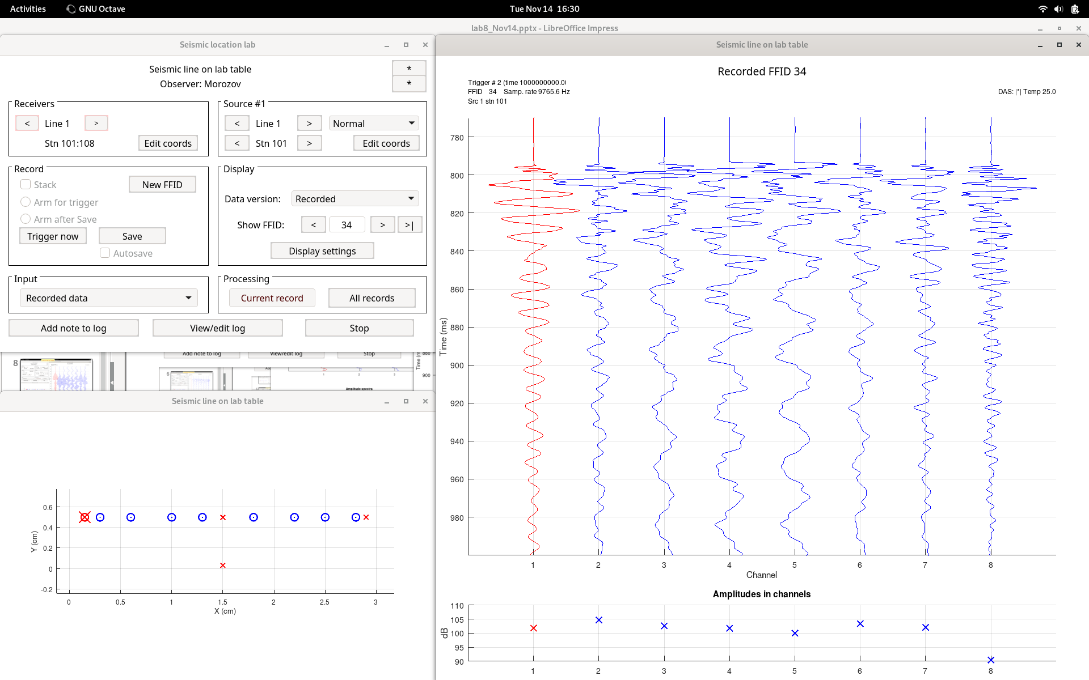
the first ‘knuckle” strike again

Slide 18
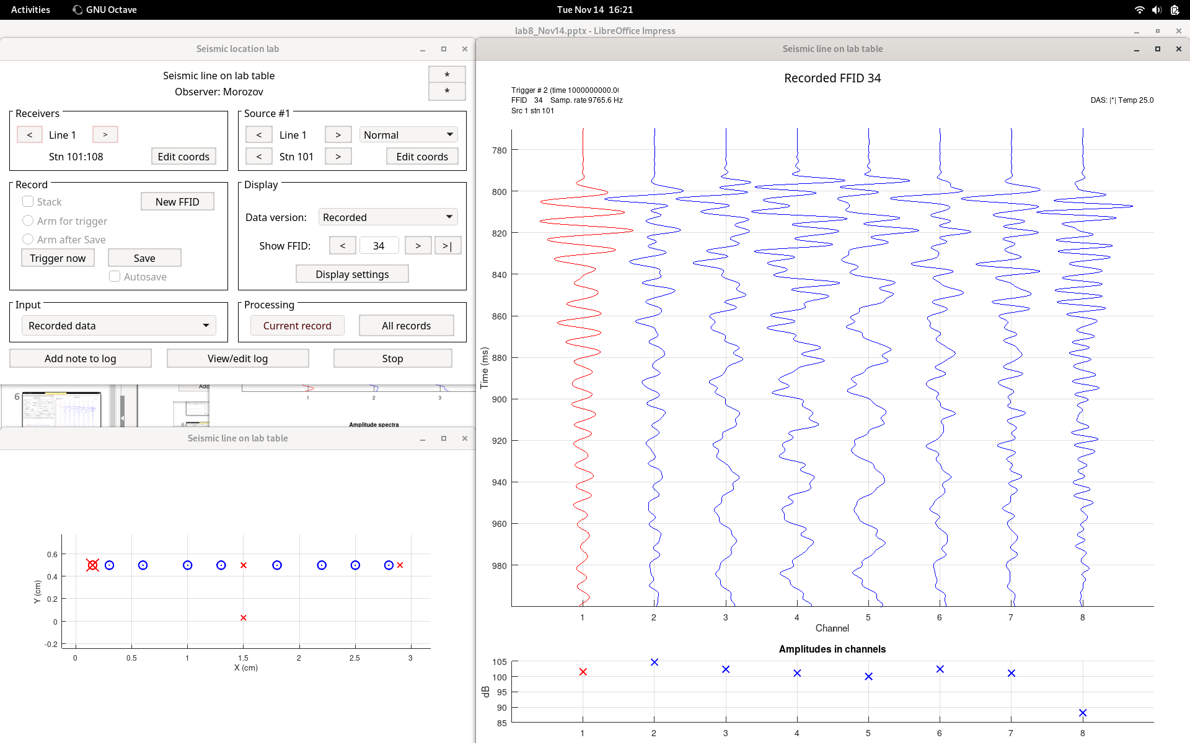
the first ‘knuckle” strike band-pass filtered below 200 Hz

Slide 19
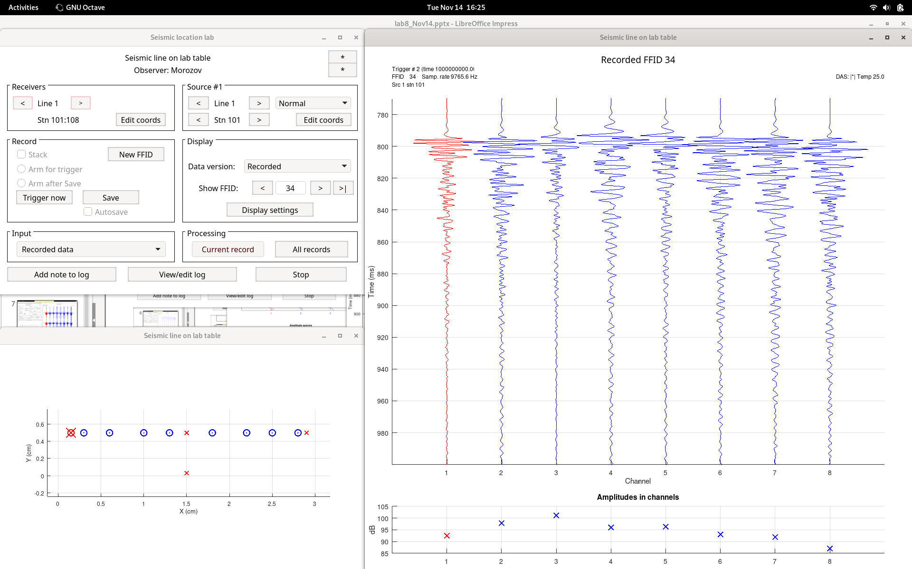
the same record band-pass filtered above 200 Hz

