Slide 1
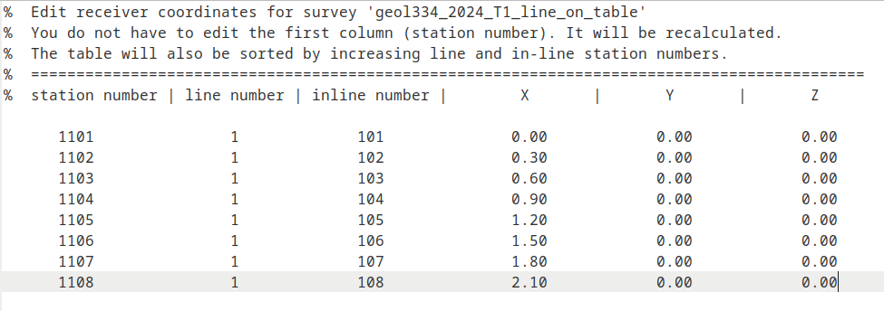
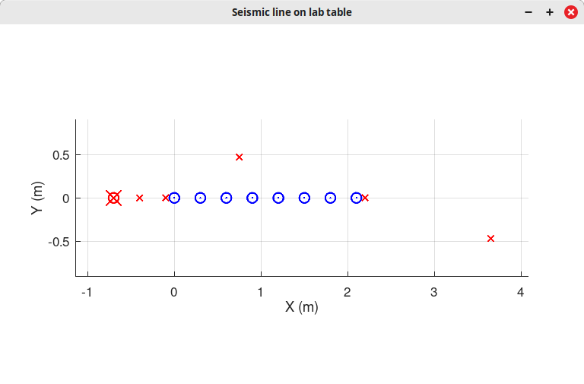
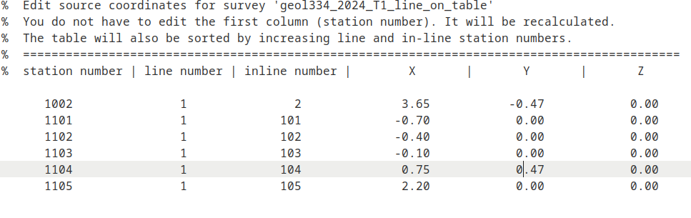
Receiver and source coordinates
Source station ‘1002’ is a spurious one I created by mistake.
We used inline numbers 101-105

Slide 2
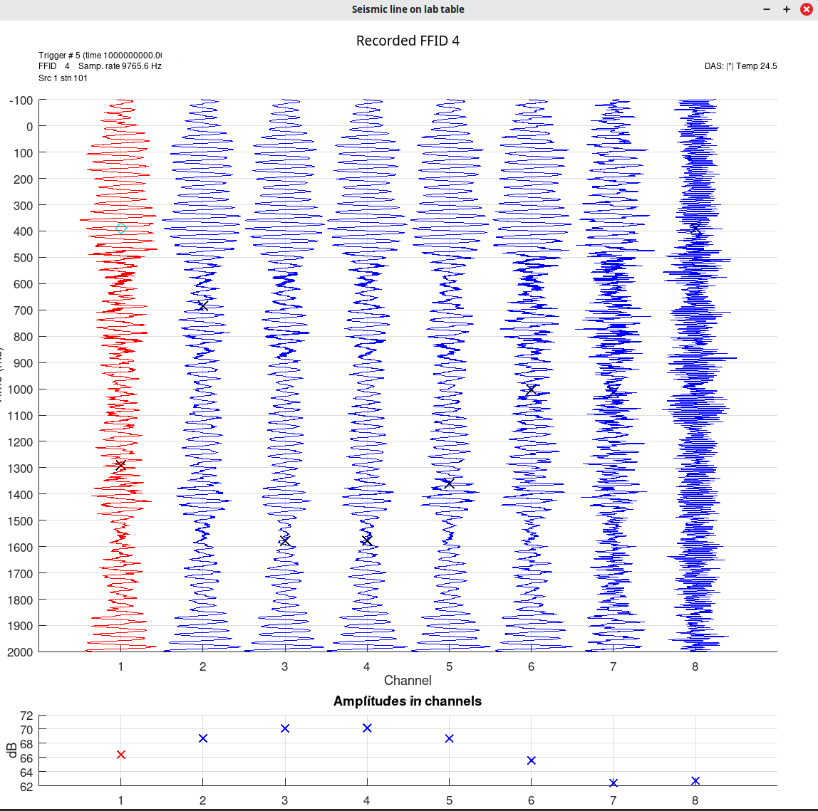
Trial 200-Hz sine function signal at shot point 1
Note the variations of amplitudes (bottom plot)

Slide 3
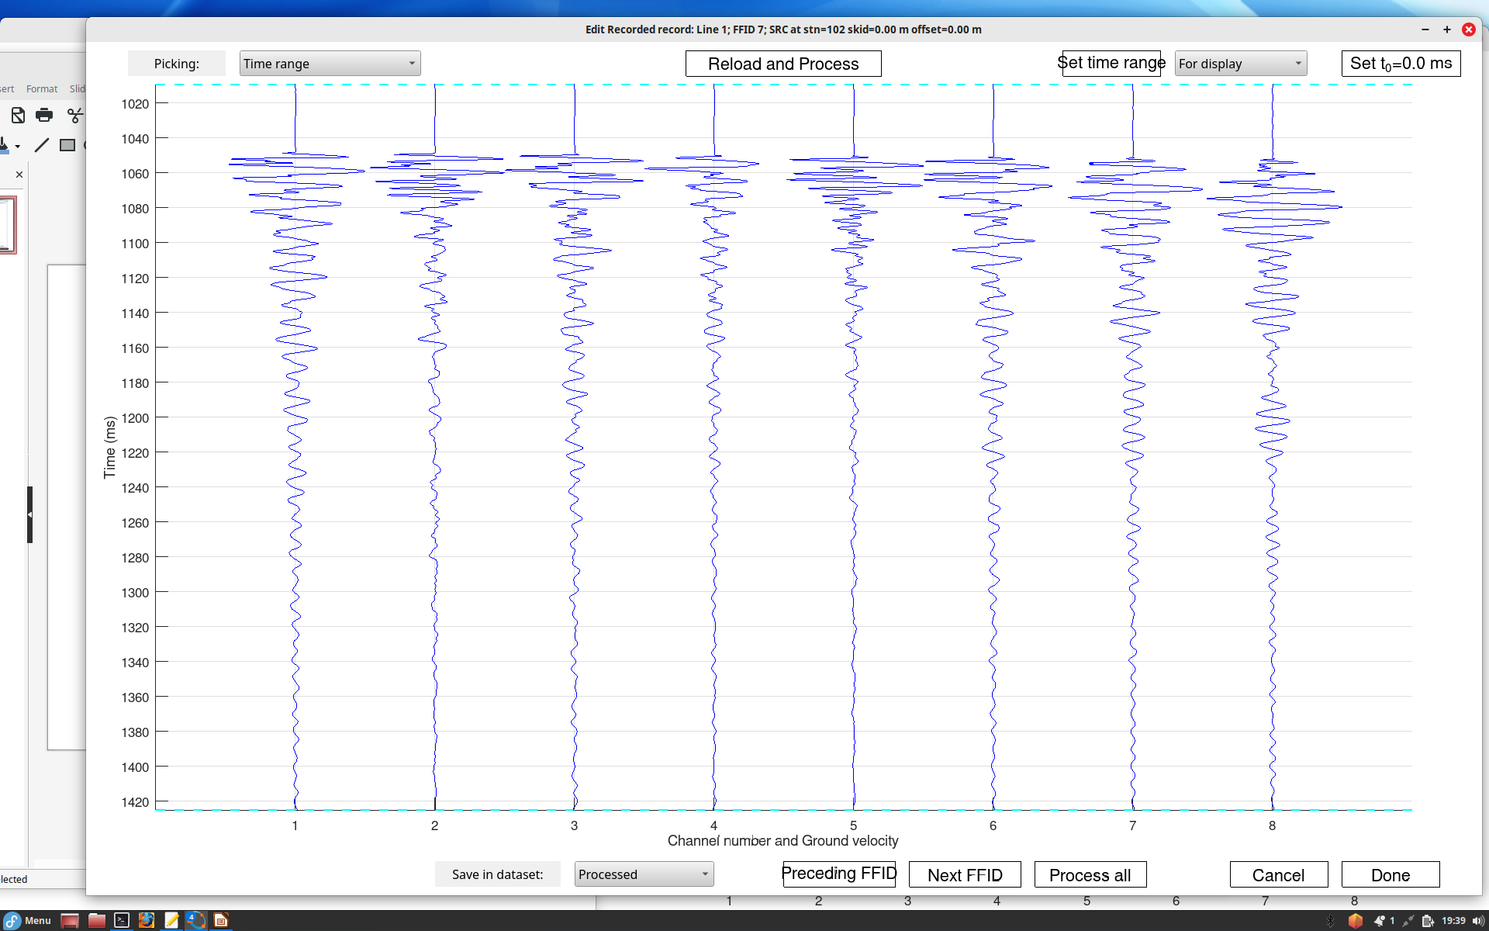
Shot point 1 on the left – general view

Slide 4
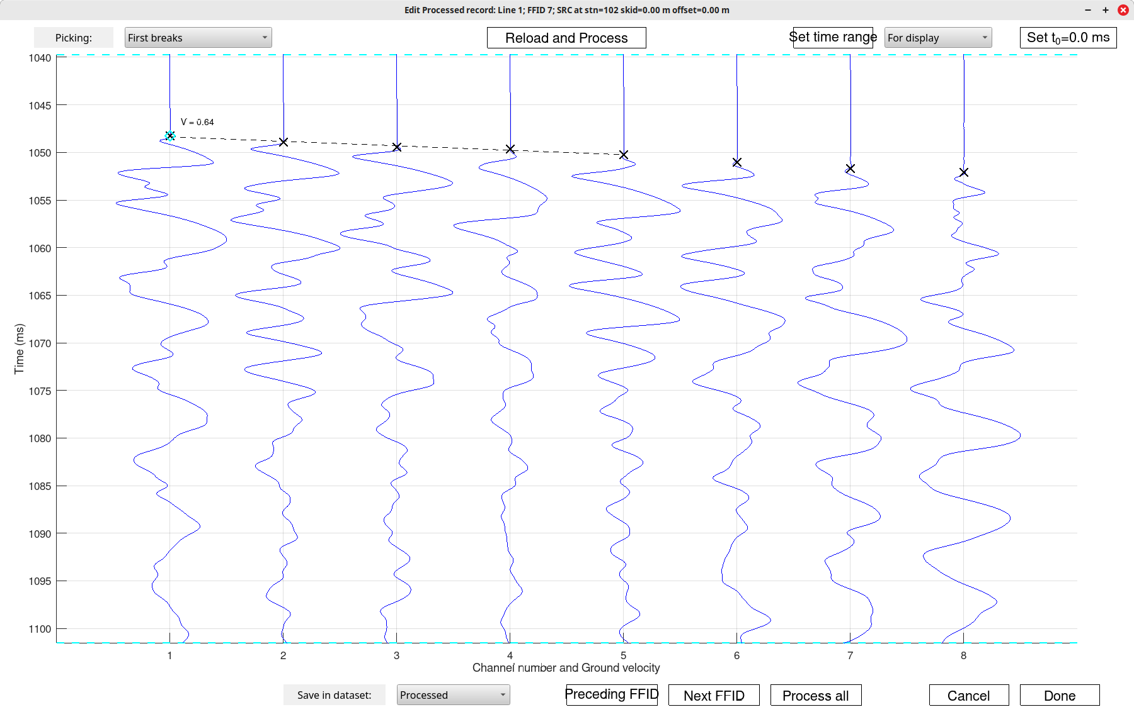
Zoom in of the same with first-arrival picks
Measure (rough) pulse width and frequencies of the swings you can see in the data
Channel 5 is perhaps the easiest

Slide 5
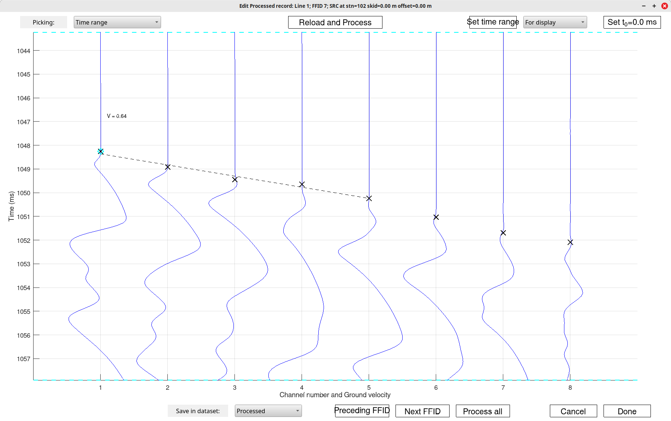
Strong zoom for measuring velocity
Draw a straight line approximating ALL 8 points and measure slope

Slide 6
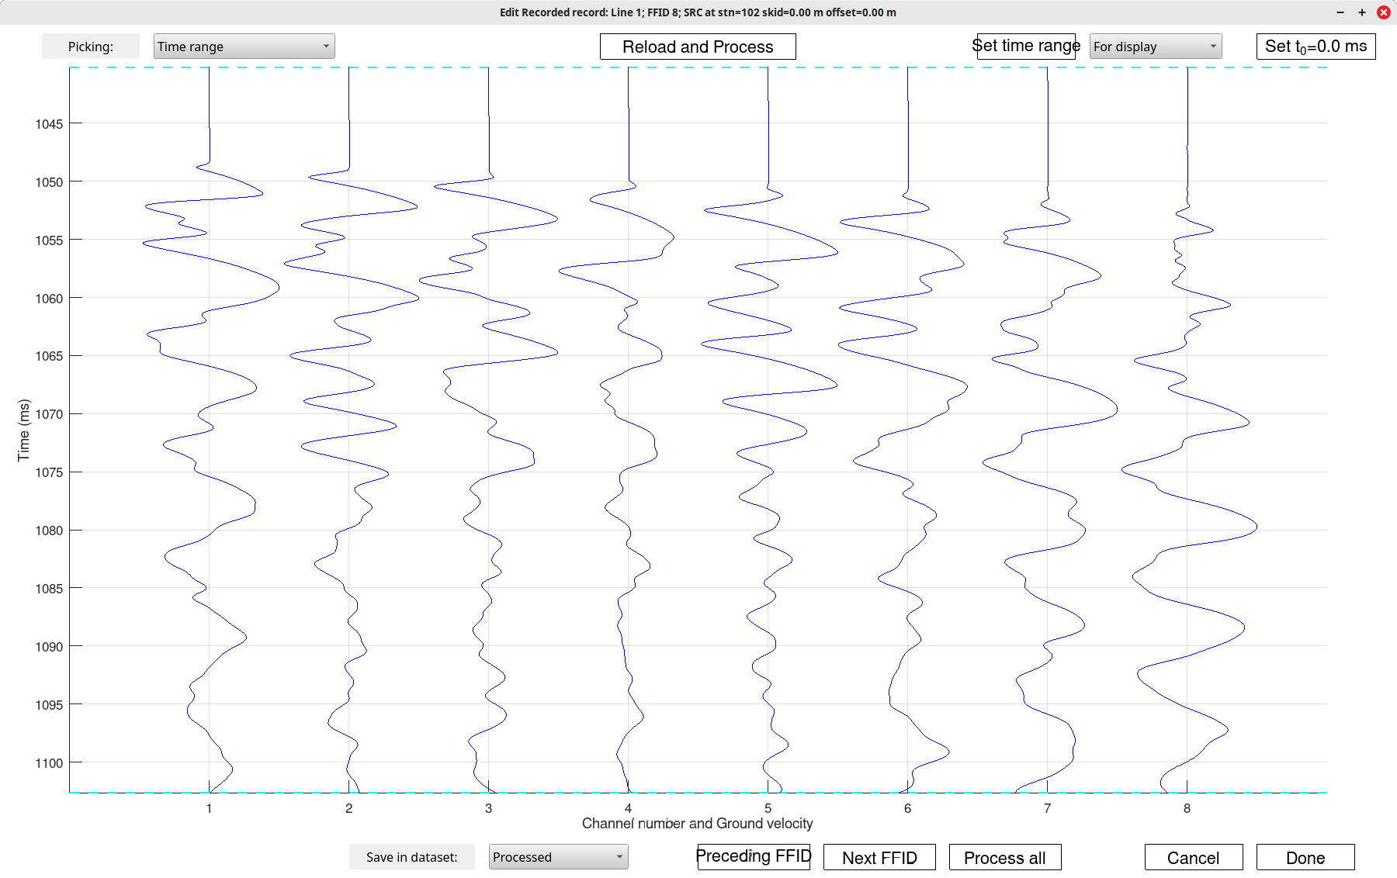
Different source (that eroded hook) at the same source point. Are the records much different?

Slide 7
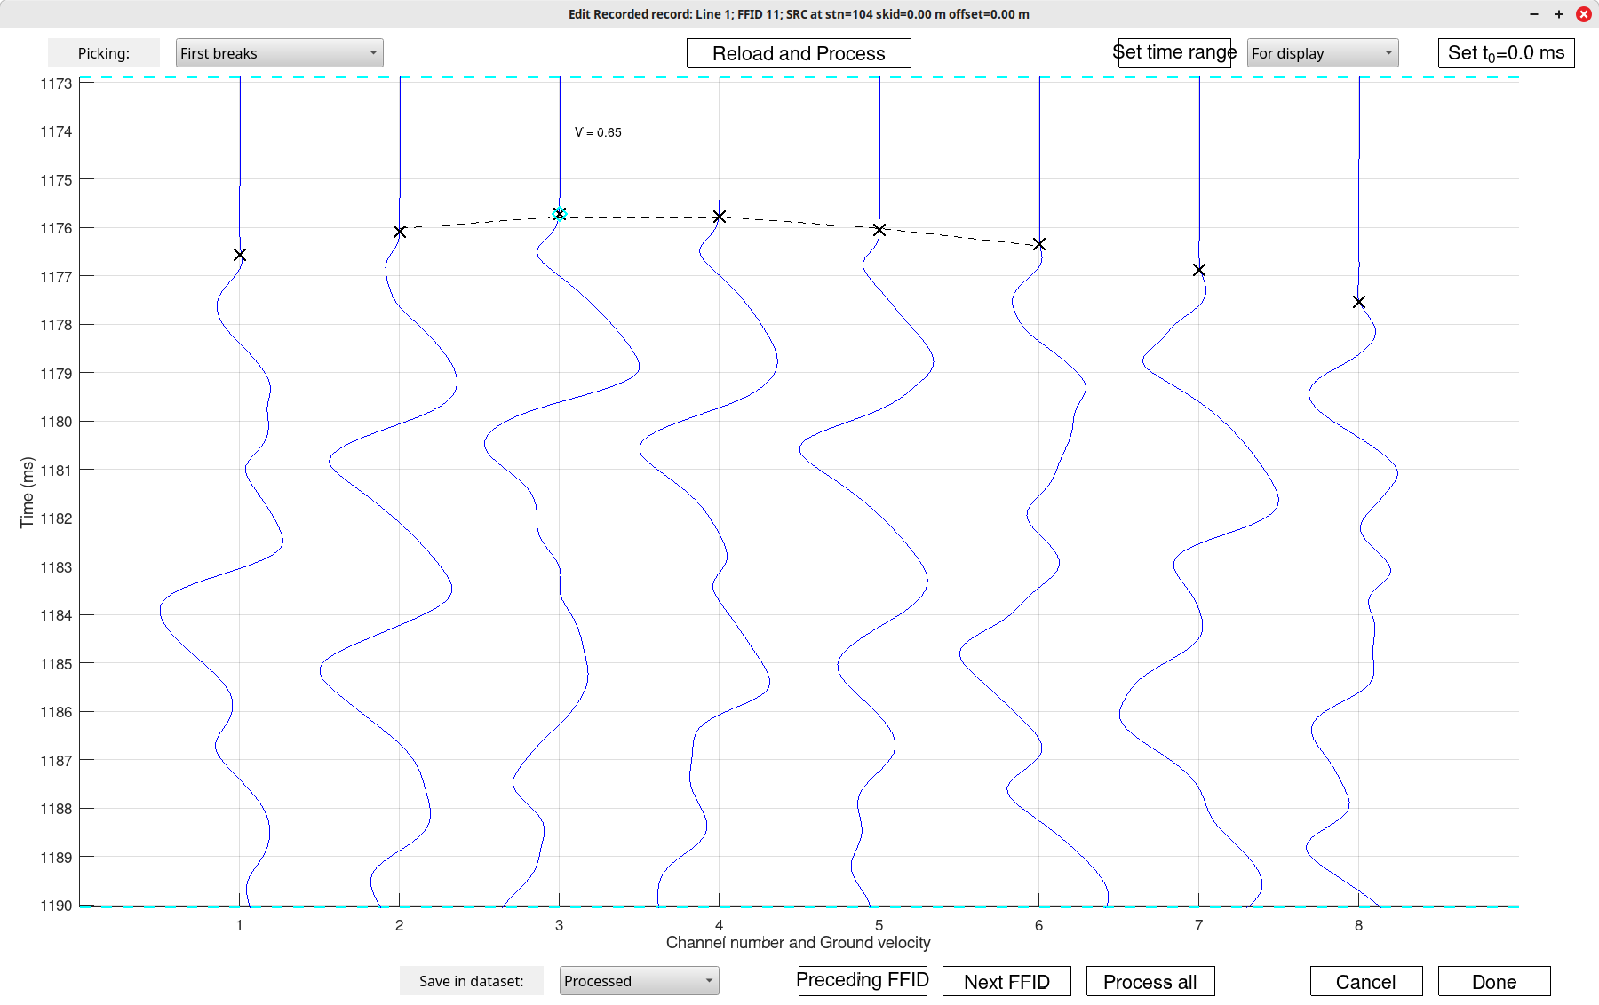
Source point 4 (on the side)
For a bonus, can you estimate wave velocity from this shape or travel-time curve (hyperbola)?

Slide 8
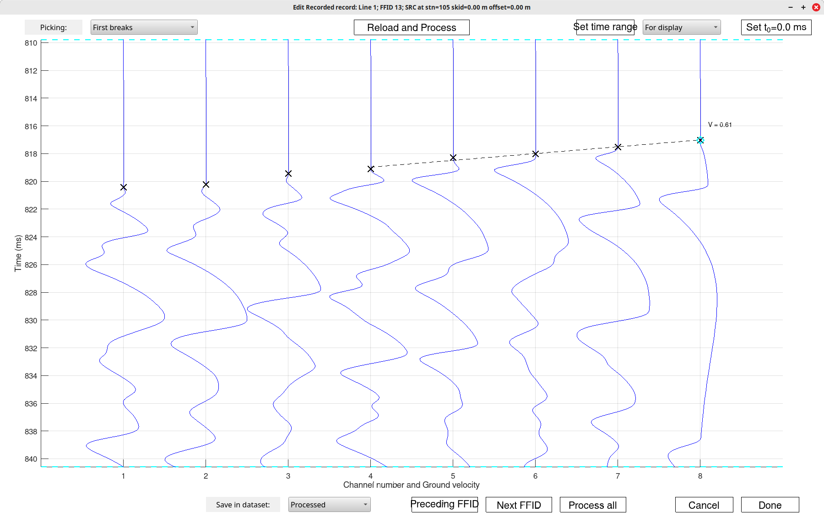
Strike on the right.
Measure the velocity again and compare to the one from the left

Slide 9
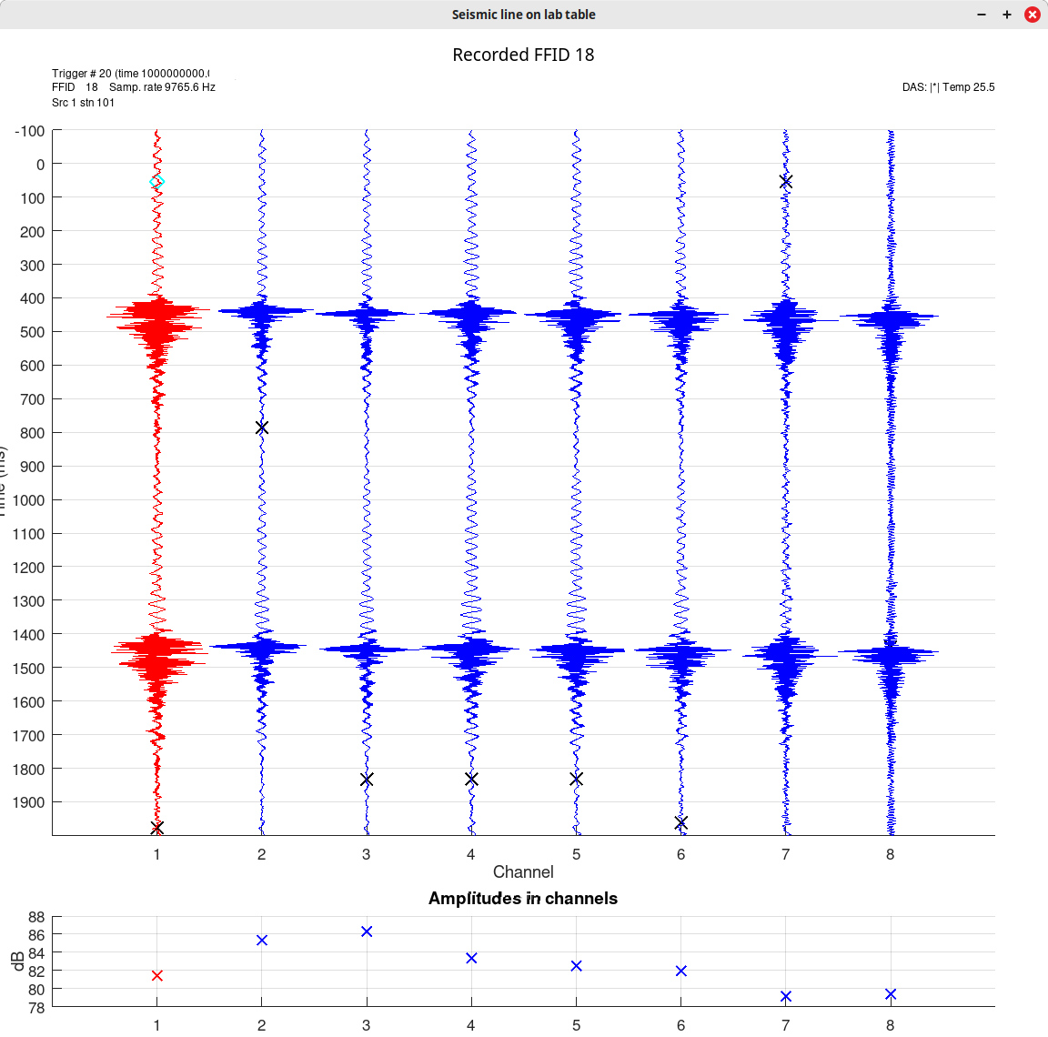
Vibrator signal near channel 1 ( 100 to 5000 Hz sweep in 1 sec)
Note that the strongest signal is near channels 2-5 (plot on the bottom)

Slide 10
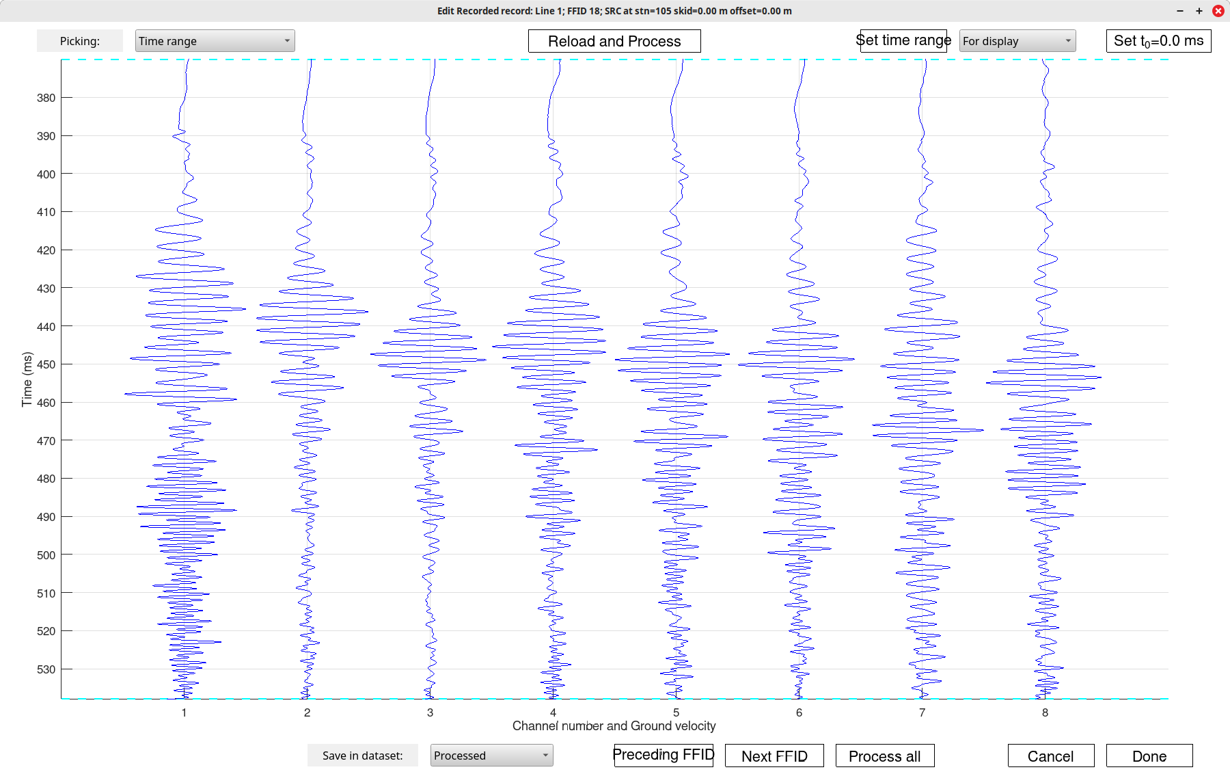
Zoom-in into the same sweep records

Slide 11
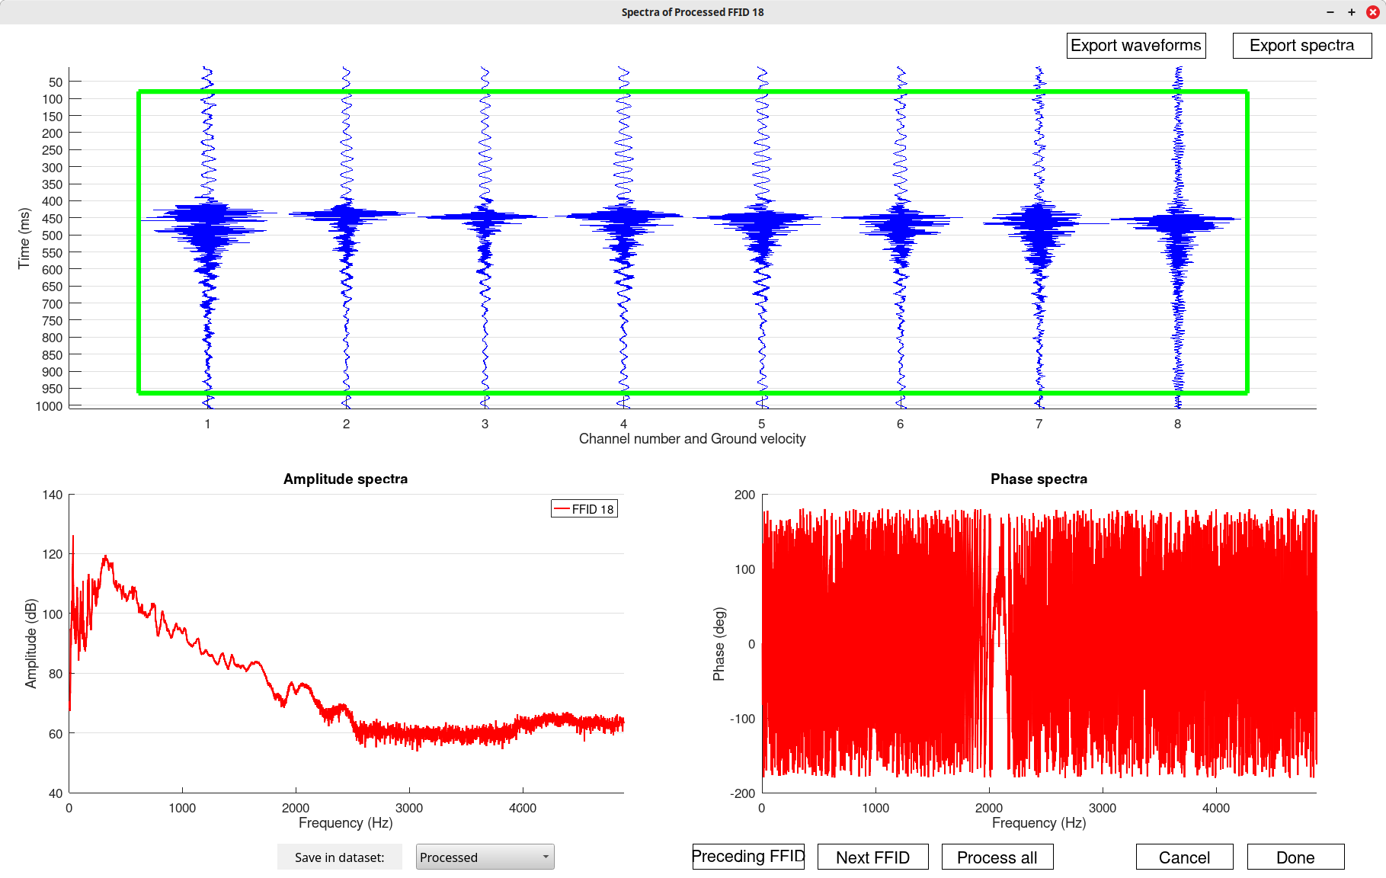
Spectra of the sweep signals (lower-left plot)
Have we really achieved 5 kHz frequencies on this table?
What frequencies are there?

Slide 12
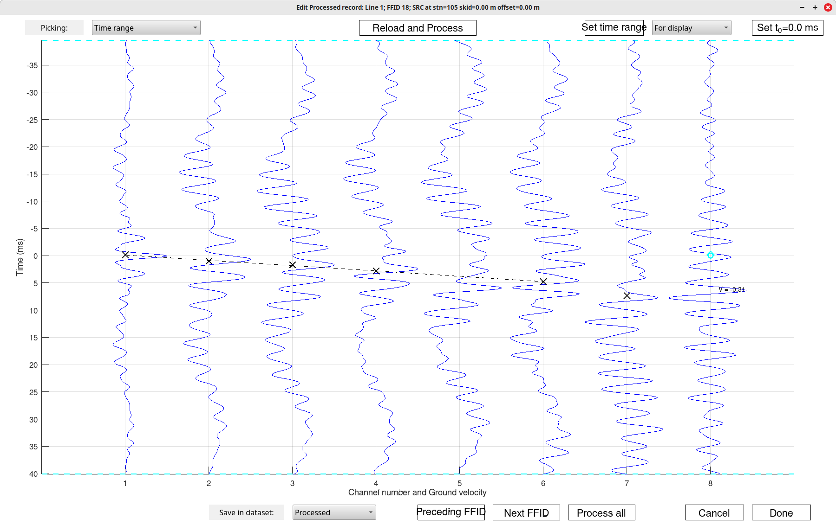
Sweep records after cross-correlating each channel with channel 1. This creates (imperfect here) pulses which I picked by ‘x’
Measure wave velocity using these ‘x’. Is it close to the one you had before?

Slide 13
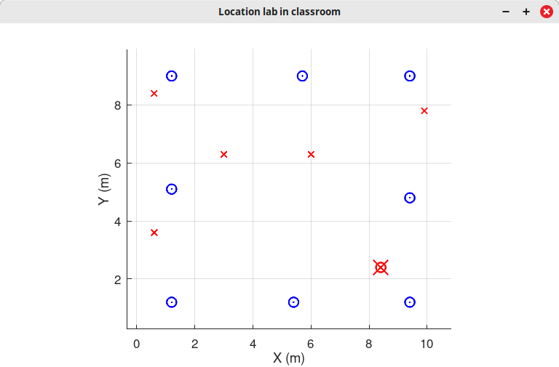
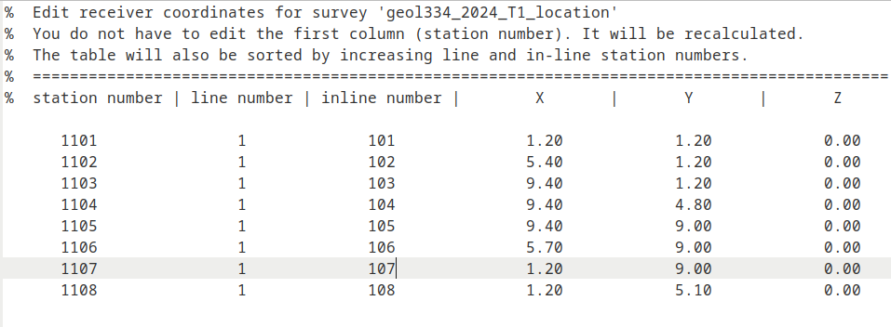
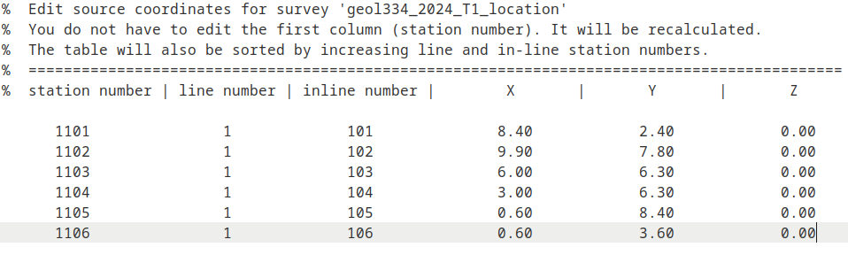
Starting location tests
Here is the map of actual locations
(all coordinates are multiples of 0.3 m)

Slide 14
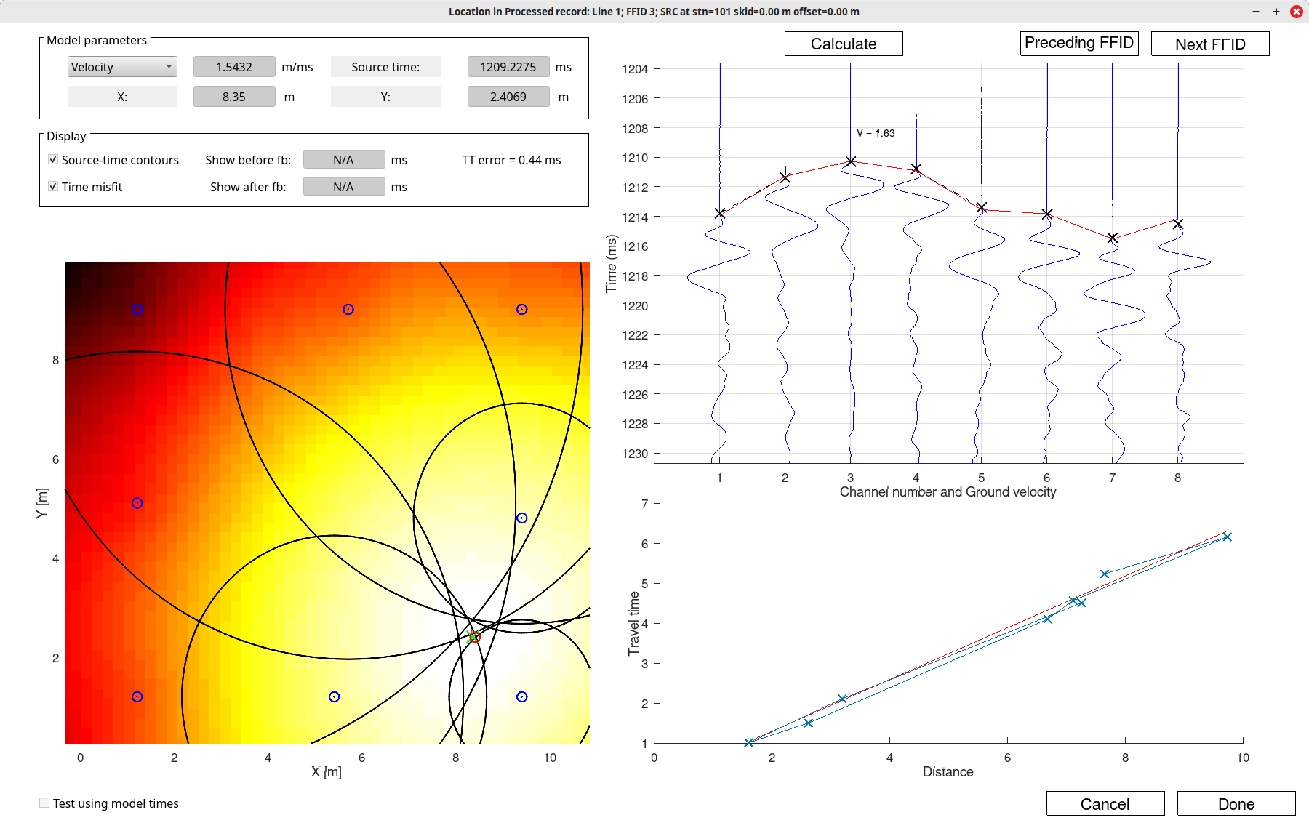
Location of strike #1 using travel times (crosses ‘x’) in the upper-right plot)
This plot shows measured wave-onset times (black ‘x’) and modelled times (red)
They look quite close?
Summary of results:
The inverted location is shown by green ‘x’ here
Color shows a sum of travel-time misfits (the smallest value is white, where the final location is)
Black circles are possible source locations FROM THE VIEWPOINTS of the individual stations.
The correct location is where all these circles intersect
This plot shows travel times vs. source-receiver distance. Slope of this red line gives velocity within the floor

Slide 15
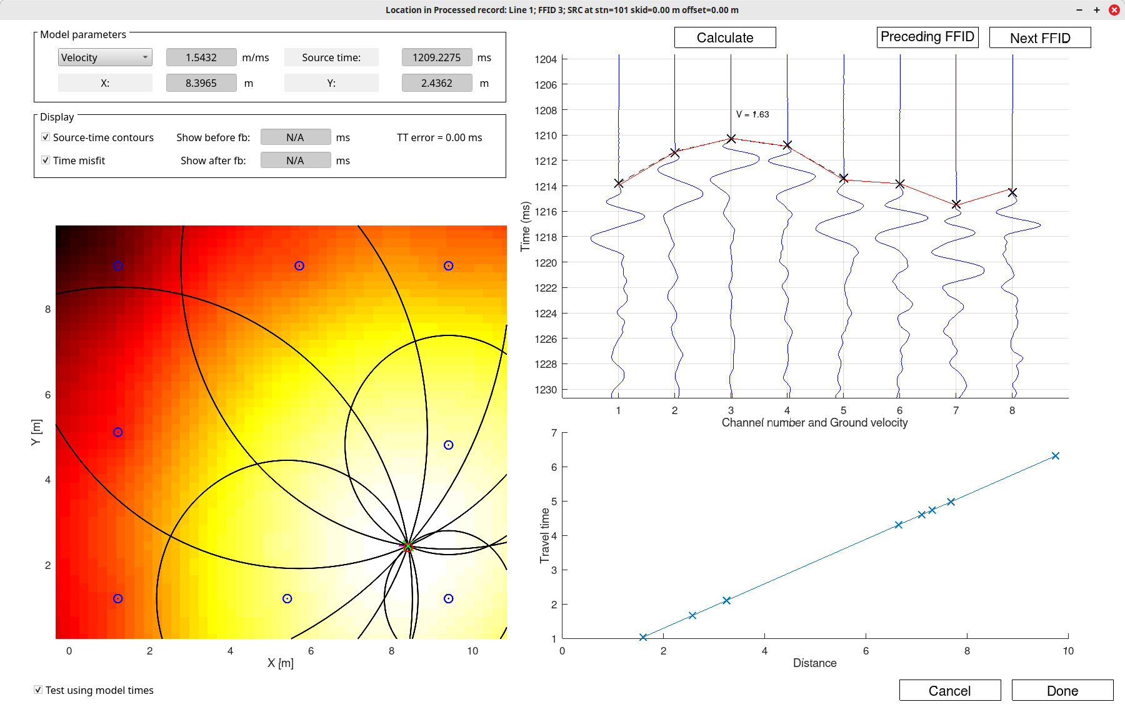
This is a test inverting not observed but MODELED travel times from source #1.
The location is PERFECT – all black circles intersect at the correct point, and all travel times are predicted accurately (red line on the upper-right)

Slide 16
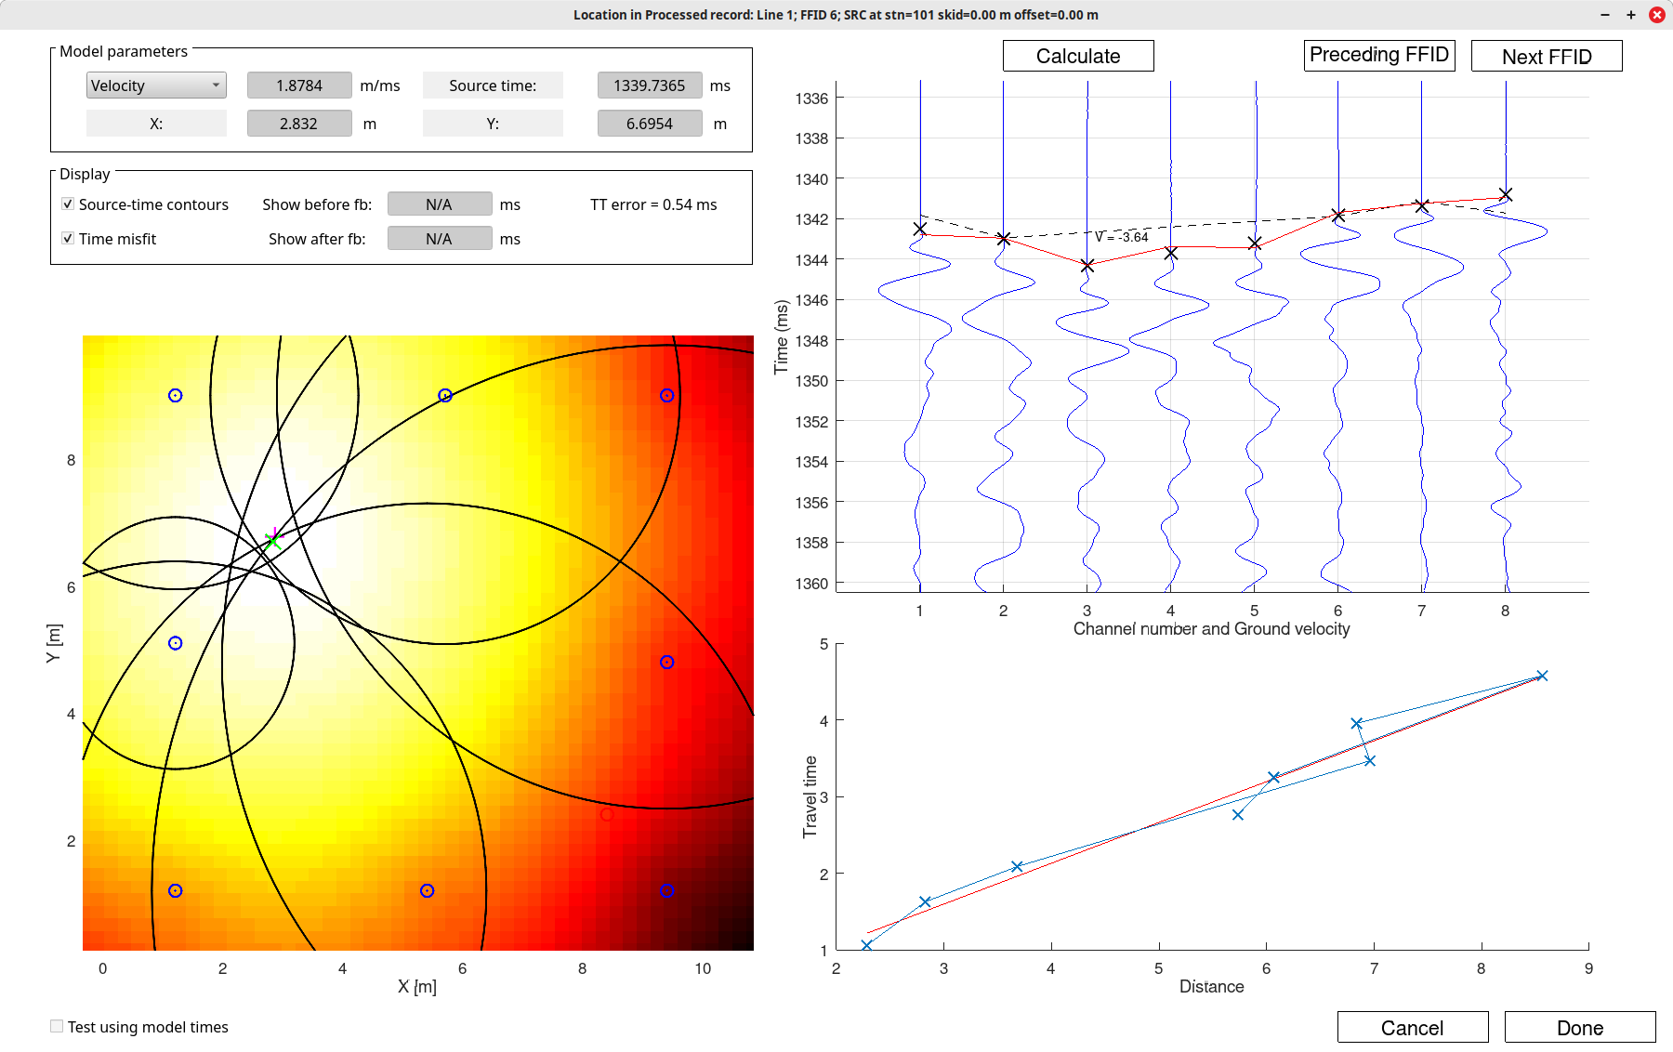
Another pretty good location, but maybe a little off (green cross).
Which source was it?
What is the location error?
Compare velocity values.

Slide 17
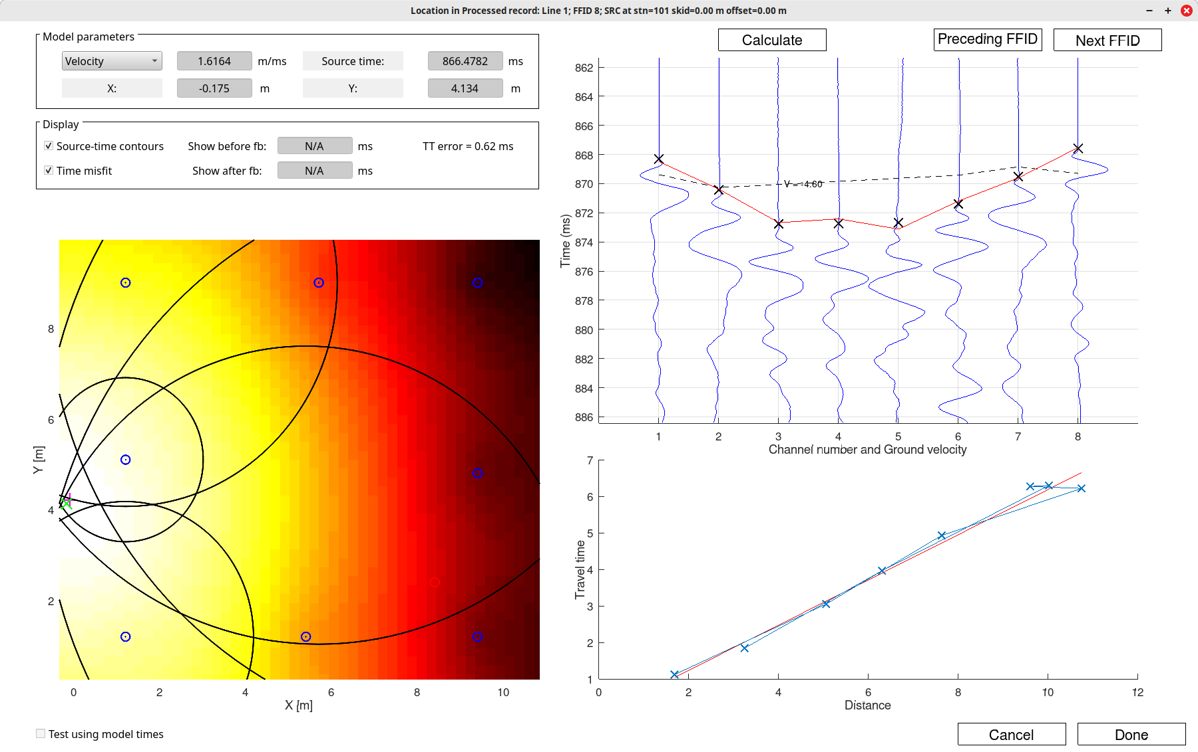
Another location, OUTSIDE of the area covered by receivers
Same questions as in the preceding slide?

