Slide 1
Lecture 1: Introduction
Problems and objectives
Scales: observational and of microstructure,
  Importance of the macroscopic scale, homogenization
Types of anelasic phenomena: transient deformations, oscillations, waves
Key concepts: characteristic times, empirical modulus, Q-factor, attenuation, dispersion
Two approaches to anelasticity:
  Conventional: the viscoelastic model
  Approach of this course: macroscopic (Lagrangian) continuum mechanics
Reading: Chapter 1 in the text
Website: http://seisweb.usask.ca/classes/UPC-2024/WWW/index.html

Slide 2
Objectives: “How Rock Deformation Works”
The goal is to describe phenomena occurring within rock during deformations
  Passage of a seismic wave, laboratory experiment (weak)
  Pore-fluid flow
  Tectonic or geotechnical impact on the reservoir (strong)
  Deformations with after-effect (continuing after the impact)
Explaining the data in any of these experiments empirically is usually not that difficult
  Creep laws
  Viscoelastic laws
  Darcy law, pipe flows, etc.
The problem is:
  To describe all of the above phenomena consistently
  To identify rock properties which can and should be measured
  To find the driving mechanisms, not just empirical relations
Knowledge of physics helps achieving these goals

Slide 3



General approach
Methods of theoretical physics are well established
They allow rigorously and completely solving all problems in rock physics and seismic waves
In this course, I illustrate some applications of the general principles of Lagrangian mechanics and thermodynamics to these problems

Slide 4
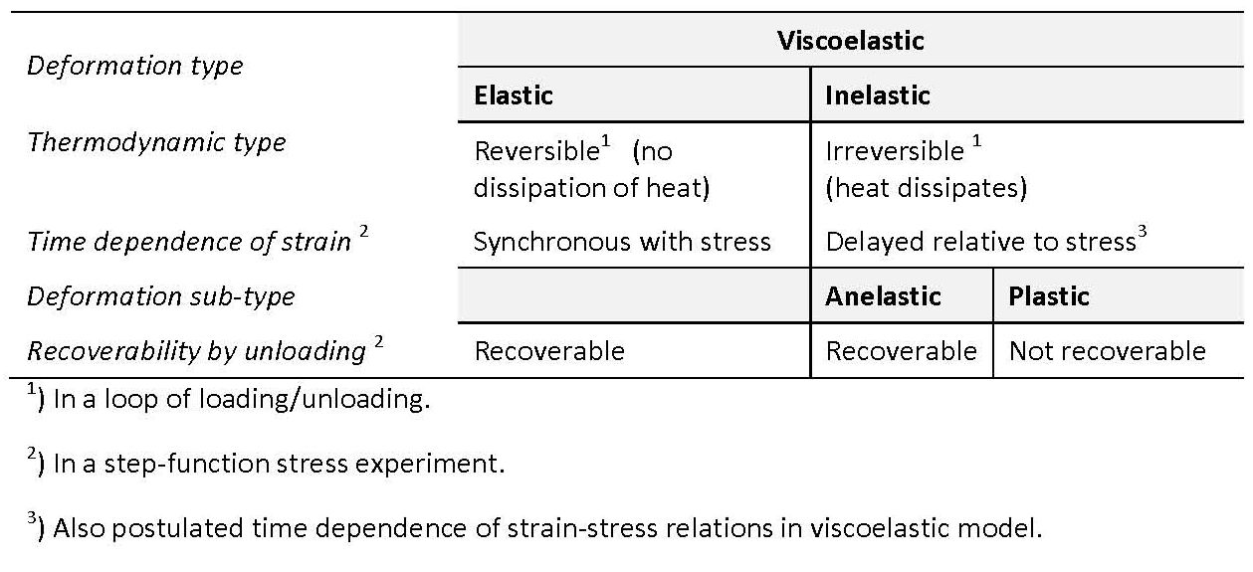
Types of deformations and terminology
Four deformation types are differentiated for rock: Elastic, inelastic, anelastic, plastic
These types are differentiated by studying the behavior of rock in several experiments
Usually, we need to pay attention to time dependencies of strain or stress, and dissipation of heat

Slide 5
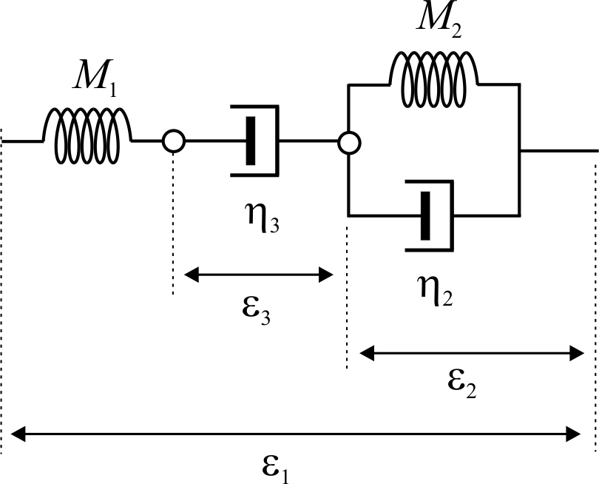
Elastic, anelastic, and plastic deformations
Anelastic
Plastic
Described by empirical behavior under load:
Burgers’ model contains examples of all three of the basic deformation types
  Elastic – the body instantly returns to the original state when load is removed
  Anelastic – the body restores its state after some time delay
  Plastic – the deformation can extend indefinitely
Note that different deformations are associated with some “internal variables”:
  Movements of groups of grains
  Pore fluid flows
  Heat flows, etc.
Elastic
Figure 1.1.
Burgers’ model of deformation. Stress σ is applied to the ends of this chaoin of mechanical elements and causes observed deformation ε₁. This deformation includes an anelastic part (involving both elasticity and viscosity, ε₂), plastic part (viscosity only, ε₃), and pure elastic part (the unlabeled deformation of the spring M₁).
Note that anelastic deformations always include movements of some internal degrees of freedom (white dots in this plot) which are not observed in the mechanical strain-stress testing experiment.

Slide 6
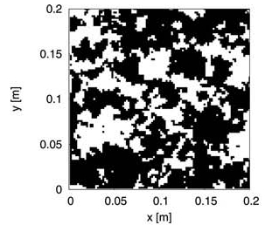
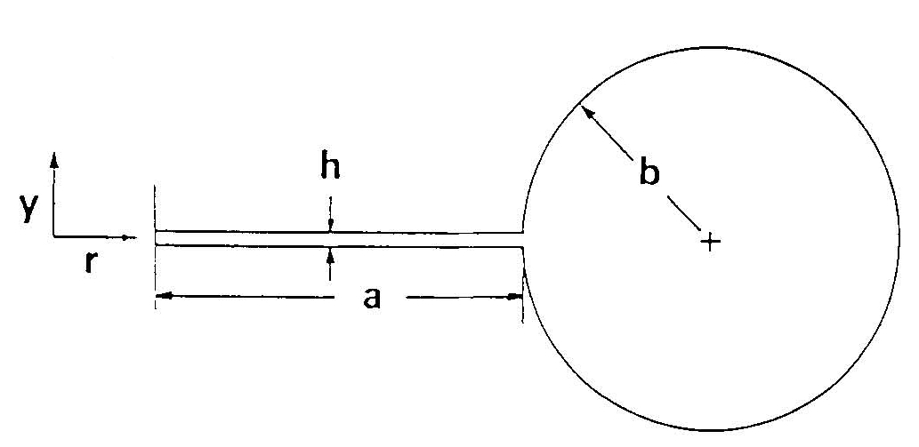
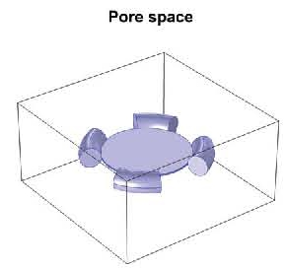
Porous rock
Popular models of pore space
Most work in exploration rock physics focuses on porous rock
Gassmann’s model is the simplest representation of porous rock:
  Fluid-filled pores are interconnected so that they have a common pressure
  Pore infills have zero shear rigidity
  Relatively slow deformations are considered: rock frame and fluid are at quasi-static equilibrium
Physically, this means a description of rock by only three macroscopic parameters:
  Two dilatations: of the whole rock and pore fluid
  One shear of the whole rock
  Gassmann’s equation (relation between four observed moduli K_{U}, K_{D}, K_{s}, and K_{f}) is an automatic consequence of having only three independent parameters
The microstructure is completely unimportant when considering static deformations
  All models should satisfy Gassmann’s equation for near-static deformations
Fractal structure with patchy saturation (Rubino and Holliger , 2013)
Soft pore (flat)
Microcrack with “squirt flow” (Murphy et al., 1986 )
Stiff pore (round)
Numerical model of connected pores (Alkhimenkov and Quintal, 2022 )

Slide 7
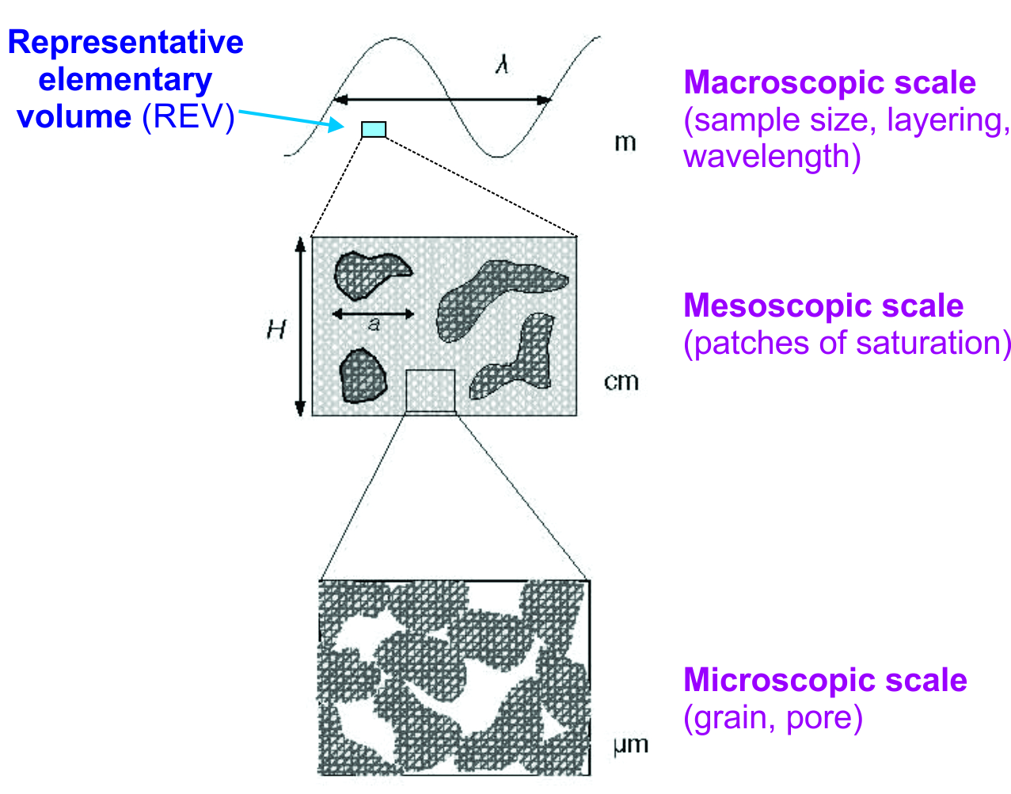
Scales
When considering non-static deformations like waves, more detail of microstructure is revealed. This detail is often characterized by the notion of spatial scales
Four characteristic spatial scales of investigation should be recognized:
  Microscopic, mesoscopic, and macroscopic scales of rock structure
    These scales correspond to characteristic times (or frequencies) of relaxation processes
  Observational scale at which the equations of deformation and motion are written
    This scale is given by the Representative Elementary Volume (REV) scale
At smaller scales, large numbers of parameters are needed to describe rock, for example:
    Sizes or shapes of pores, gas bubbles, patches of saturation
    Radii of capillary menisci
    Dimensions and aspect ratios of “squirting” microcracks
However, this detail is unobservable and unimportant in macroscopic experiments

Slide 8
Observation scale
Importantly, only the macroscopic REV scale is seen in practical observations in laboratory rock physics or in seismic waves
At this scale, we should only use averaged material properties:
  Porosity (scalar φ and porosity tensor α)
  Density
  Effective elastic moduli
  Permeability
  Thermal properties (specific heat, heat conductivity)
  Anisotropy
  Elastic wave speeds, impedance
  Other properties to describe anelasticity (which ones? This is the big question!)

Slide 9
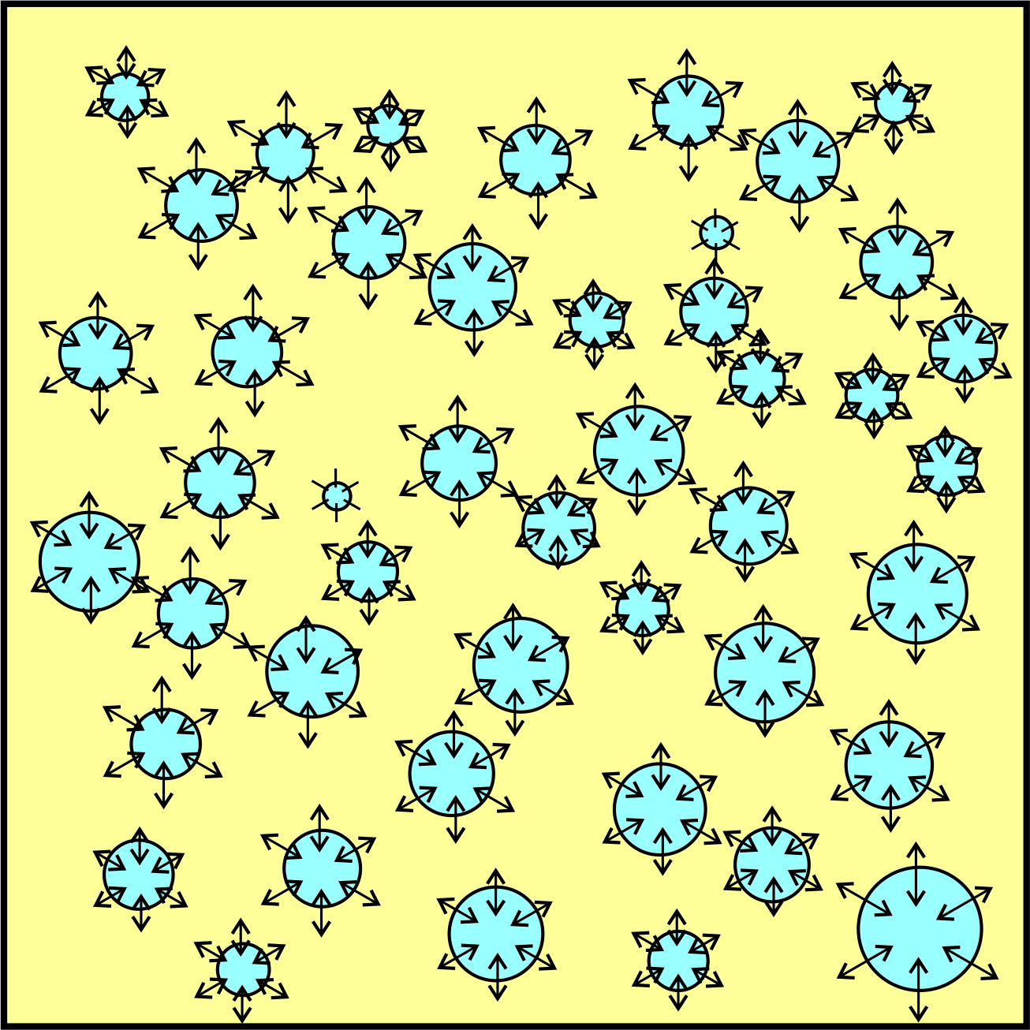
Rock-structure scales
Here is a model of a rock with spherical pores, subjected to oscillating pressure
Question 1: What is the scale of this microstructure?
  Answer: apparently “microscopic” – the size of the pores. However, there are many sizes of pores here (and more in real rock).
Question 2: What is the scale of this pore-fluid flow?
  Answer: the same microscopic, or “local”
Question 3: Is this Gassmann’s rock?
  Answer: In principle yes, but the “average” pore pressure has to be defined in an intricate way
  In Gassmann’s rock, pores should be identical or connected, so that they have the same pressure. In this model, smaller pores have larger pressures
Question 4: Is this Biot’s rock? Biot’s model is known as an example of “global” scale pore-fluid flow.
  Answer: No. Biot’s rock requires permeability of the whole REV
Note that this difference is a question of pore connectivity but not of scale

Slide 10
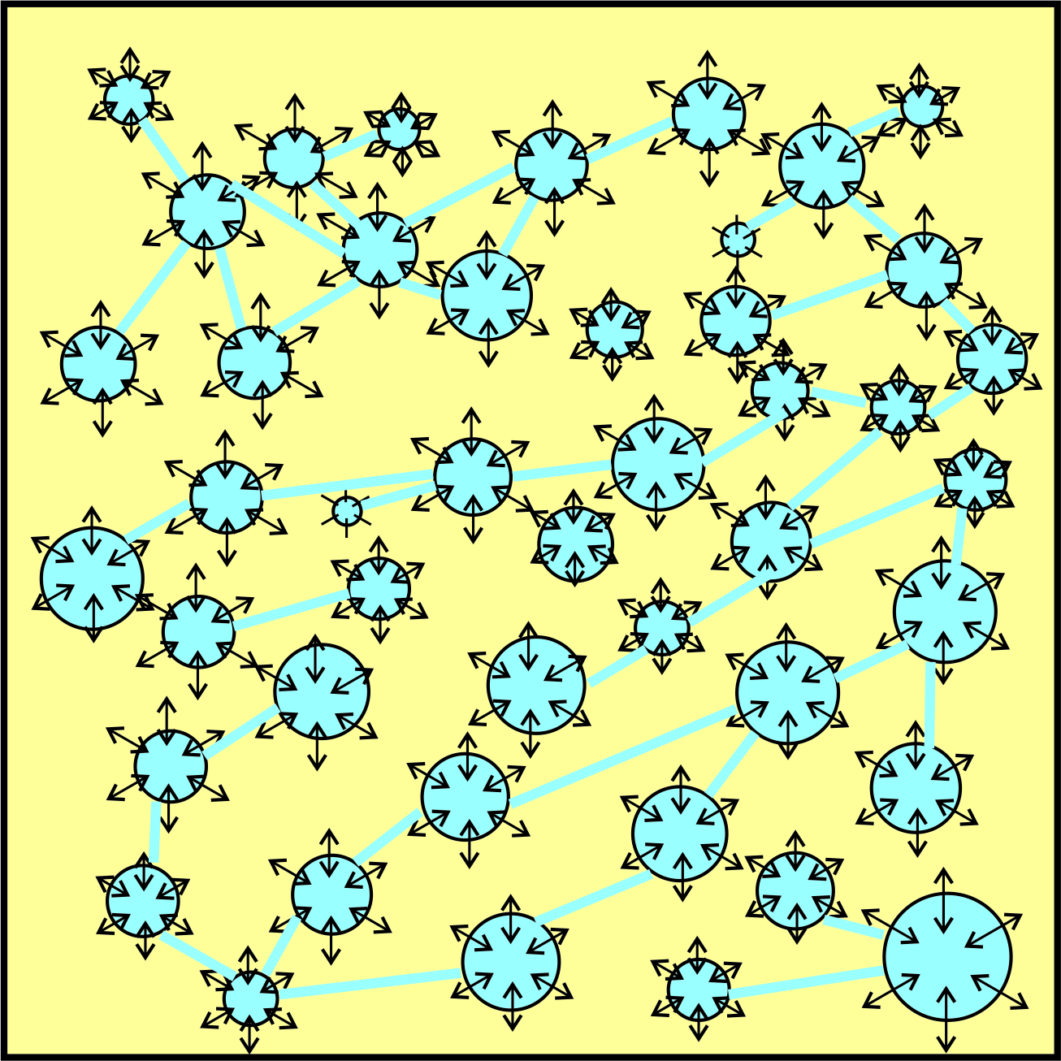
Pore-flow scales
Here is how the Biot’s model look like:
Note that the difference is not in pore shapes or characteristic flow scales but in pore connectivity
  The connectivity equalizes the pore pressure, as required by Biot’s model
Thus, the difference is really in the permeability of the rock
The pore-fluid flow is still principally “local” (black arrows; expanding pores of various sizes)
  Micro- and mesoscopic
  The difference in scales is not that important because it is complicated by variations of shapes and sizes of pores and other elements of structure
Question 4: So, where is the “global” (macroscopic) Biot’s flow in this picture?

Slide 11
“Global” Biot’s flow
Answer: There was no global flow in that model
The “global” flow would be observed in a different experiment:
  If a macroscopic-scale pressure gradient is imposed in some direction, a net flow is induced through the conduits between pores
  This results in a pore flow in the same direction (if the random microstructure is isotropic)

Slide 12


Deformation patterns, variables, and material properties
In reality, the difference between different deformation phenomena is not in their apparent scales but in different mechanical properties related to certain shapes of deformation
On the observational scale, these different patterns are described by different types of macroscopic variables:
  Deterministic flows are measured by net (average, observable) displacement vectors:
For random divergent movements, there is no net displacement, and the flows need to be measured by average strains (divergence or shear). These are basically scalar quantities:
The big question is what mechanical parameters can be selected to characterize the medium, and not just to describe the resulting flows
These parameters are not spatial scales of the flows but macroscopic mechanical properties. These material properties can be of only three kinds:
  Elastic moduli for each of the above forms of deformation
  Viscosities associated with these deformations
  Inertia of the flows
The question is how to identify these material properties.
This is what we try doing in this course

Slide 13
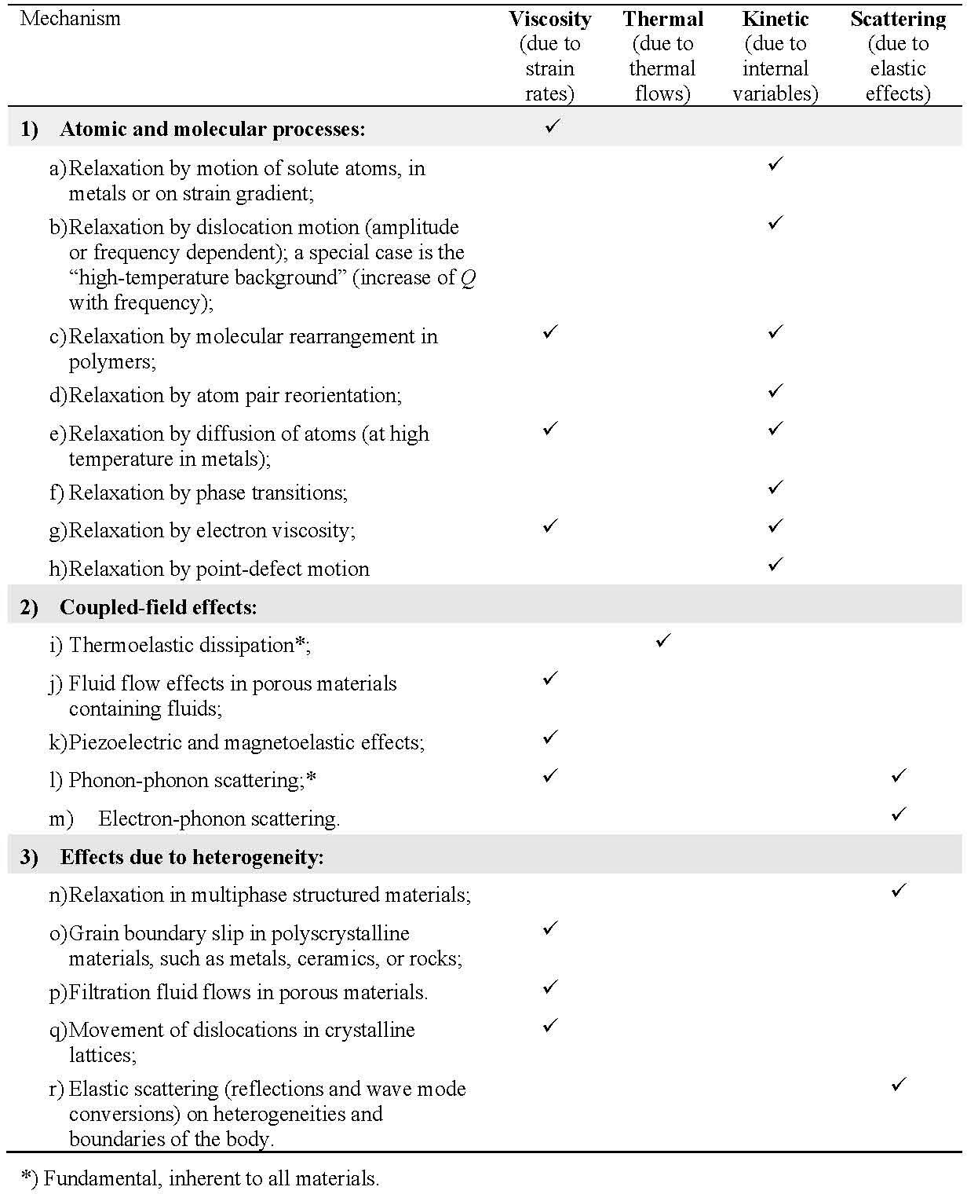
Deformations
Deformation of a material involves numerous microscopic-scale physical phenomena
By their macroscopic (observable) effects, they can be classified into four groups:
  Viscosity-type (mechanical friction)
  Thermal (involving temperature variations)
  Kinetic (like chemical interactions, diffusion)
  Scattering (“elastic”, without mechanical energy loss)

Slide 14
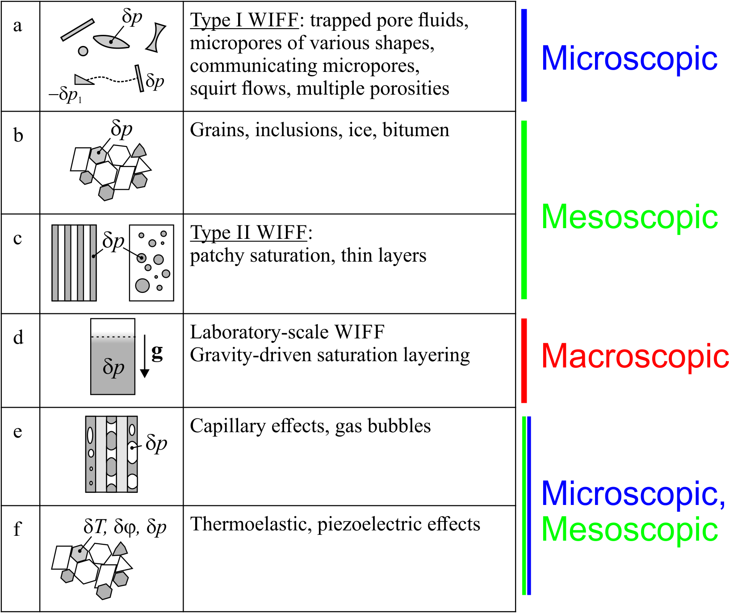
Wave-Induced Fluid Flow (WIFF)
One specific “coupled-field” mechanism (red box ‘j’ in the preceding slide) is particularly strong in porous rock containing fluids (brine, gas, oil)
This mechanism consists in interaction of porous solid frame with a relatively mobile fluid
  It produces the so-called “Wave-Induced Fluid Flows” (WIFF)
WIFFs can take on numerous forms and occurs on all three spatial scales (figure on the right)
  However, on the REV scale, the averaged effects of all these WIFFs are similar
  The different types of WIFF are differentiated by the characteristic times of relaxation processes

Slide 15
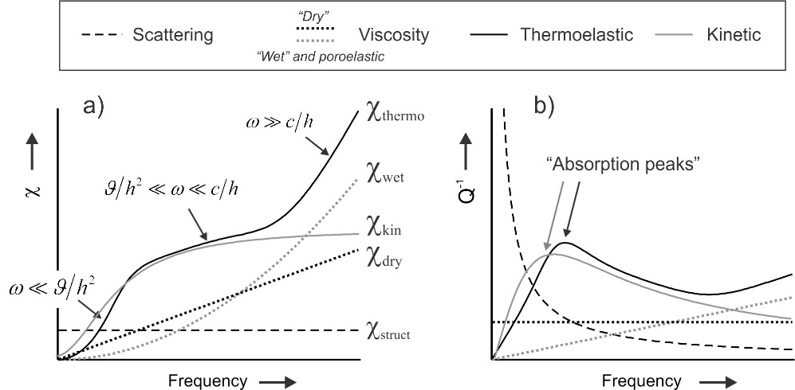
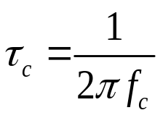
Characteristic times and frequencies
Different anelastic mechanisms (WIFF or other) are recognized by measuring the characteristic relaxation times τ_{c} associated with them
The times are measured by methods discussed a little later. The frequency-domain method is shown on the right
Note that different mechanisms lead to different dependencies of the attenuation coefficient χ(f) and inverse Q-factor Q⁻¹(f) on frequency f
Figure 1.4
Schematic frequency dependencies of wave energy dissipation for different mechanisms of anelasticity in a material without internal variables: a) temporal attenuation coefficient χ chapter 5), b) inverse quality factor Q⁻¹ . Scaling of the axes is arbitrary.
For viscosity, two functions are shown, corresponding to linear ‘wet’, gray dotted line), and nonlinear (‘dry’, black dotted line). The “wet” viscosity case also represents the saturated porous rock. Expressions in the labels in (a) indicate three different regimes of thermoelastic dissipation (chapter 6).

Slide 16


Relaxation time and rock viscosity
When stress is applied or removed, rock bodies often exhibit time-dependent responses with different relaxation times τ
  Currently, it is believed that the different times are related to different spatial scales of pore-fluid flows (WIFF)
  For example, relaxation of large patches of saturation occurs slower than relaxation of small pores
The time τ gives roughly the size of the part of the body (heterogeneity) responsible for this oscillation:
(c is the wave speed, and F is some formfactor related to the assumed average shape of the pores)
  This is how numerous models of WIFF are constructed (“squirt flow”, patchy saturation, etc.)
    They basically consist of derivations of factor F for some assumed shapes of the pore (sphere, “penny”, “wedge”, “digital rock” structure, etc.)
    However, both l and F are practically impossible to determine for real rock structure
  By contrast, in a general and assumption-independent way, the relaxation time simply indicates the characteristic viscosity of rock (without assumptions and approximations):
(Μ is the elastic modulus)

Slide 17
Observations of elasticity and anelasticity
Having considered the structure and properties of materials, let us now consider observations which help us recognize these properties
There are three groups of commonly used observations of rock anelasticity:
  Time-domain measurements in the lab: Transient (time-dependent) deformations
  Frequency-domain in the lab: Deformations of rock samples by sinusoidal (harmonic) oscillating forces
  Frequency-domain in the field: Frequency-dependent observations with seismic waves
We will consider each of these groups separately

Slide 18
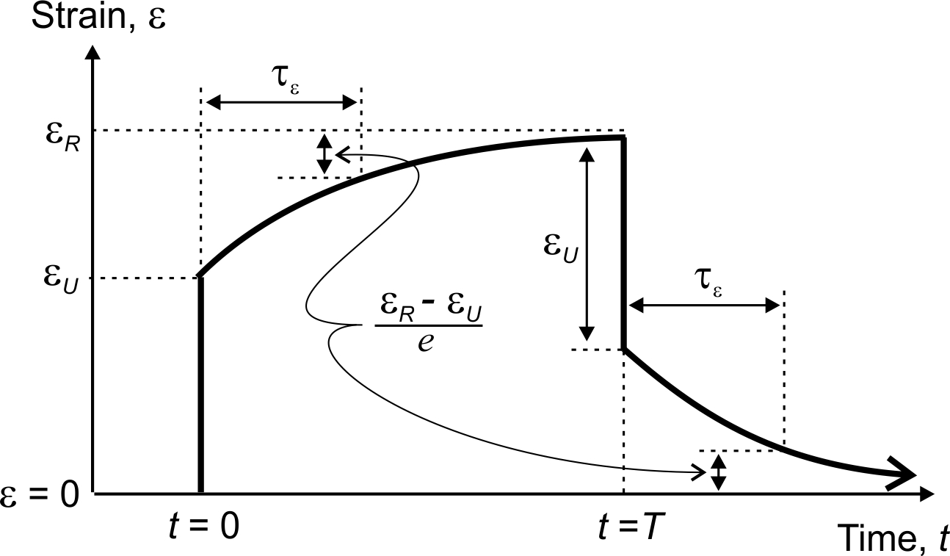
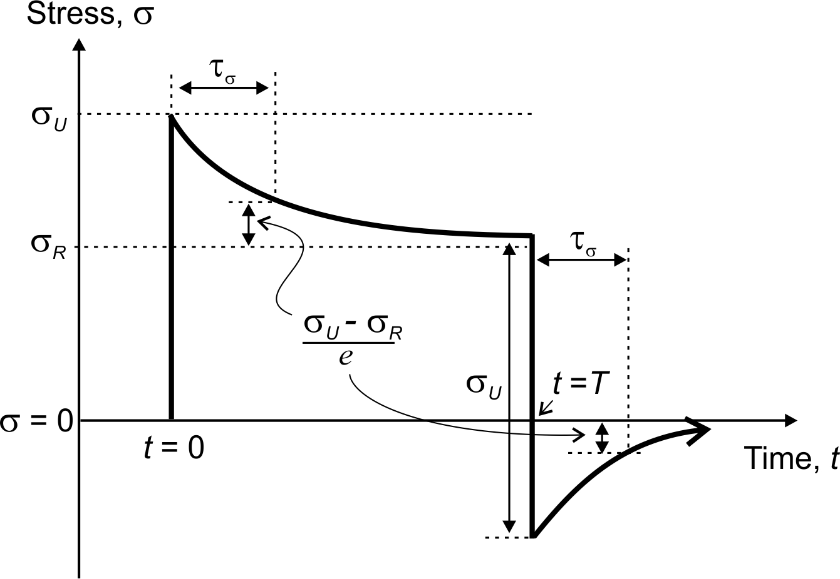
Observation 1: Transient deformations
Figure 1.5
Linear relaxation of strain in a rock sample. After a step in stress σ is applied at time t = 0, the initial strain becomes ε_{U} (‘unrelaxed’), and it gradually approaches the ‘relaxed’ strain at t → ∞. After the loading stress is removed at time t = T, the relaxation process is repeated in the opposite direction.
Note that with periodic loading and unloading, the pattern of strain lags behind the stress. This is an indication of the stress-strain phase delay for periodic processes.
Figure 1.6
Linear relaxation of stress in a rock sample. After a step in strain ε is applied at time t = 0, the initial stress ‘overshoots’ the equilibrium value and becomes σ_{U} (‘unrelaxed’). With time increasing, the stress gradually reduces to the ‘relaxed’ (equilibrium) stress at t → ∞. After the strain is removed at time t = T, the stress relaxation process is repeated in the opposite direction.

Slide 19
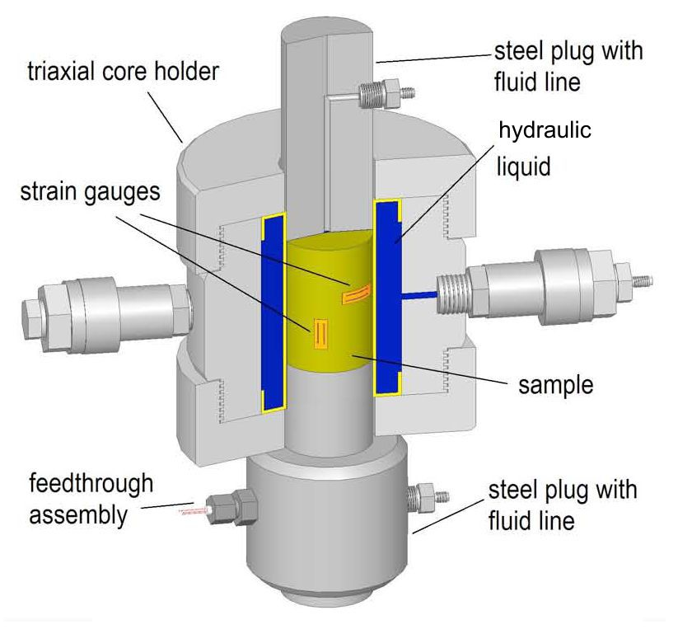
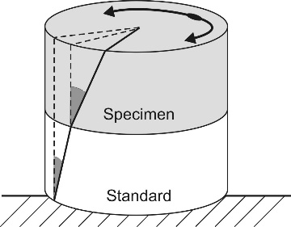
Observation 2: Forced harmonic oscillations
Figure 1.7
An apparatus for Young’s modulus measurements (from Mikhaltsevitch et al., 2015). A jacketed cylindrical rock core (yellow) is placed in a column with an aluminum cylinder (standard), so that they receive a common vertical pressure oscillating in time. The resulting axial and transverse strains are measured by a strain gauges attached to the sample (yellow) and also to the standard. Confining pressure (may also be oscillating) is applied using hydraulic fluid surrounding the sample (blue). Pore-fluid pressure is regulated via the fluid line(s) connected at the end(s) of the sample.
Principle of torsional phase-lag Q measurements for shear deformation (Jackson and Paterson, 1993). From the two shaded angles, the ratio of strains in the sample and the aluminum standard element is determined. Because the torque within the specimen and standard is the same, the shear strain of the standard and its shear modulus can be used to determine the stress/strain ratio within the specimen.

Slide 20
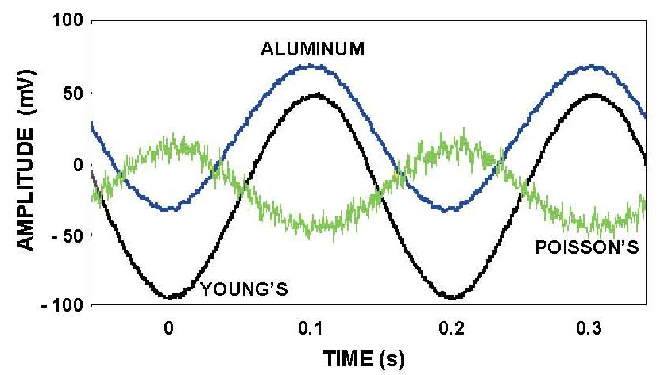
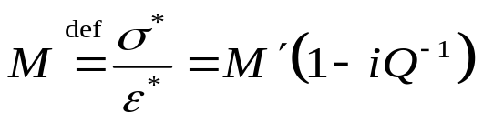
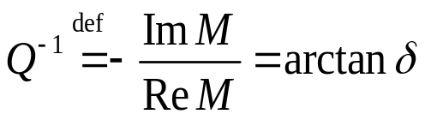
Forced harmonic oscillations
Data (ratio of the strains of the sample and aluminum standard)are presented as “effective modulus” M(f)
  Young’s or shear moduli in the preceding slide
This ratio is a complex value:
Real part M ′ is the ‘empirical modulus’ and argument is the strain-stress phase lag δ
Arctangent of this phase lag is called the inverse Q-factor:
Figure 1.8
Subresonant measurements of Young’s modulus (from Batzle et al., 2001) A sinusoidal axial pressure at frequency 5 Hz is applied to a column consisting of an aluminum standard and the rock sample. Vertical strain gauges (Figure 1.7, left) measure Young’s modulus deformation (black and blue curves), and horizontal gauges give the Poisson’s ratio (green). Note the slight phase lag of the black curve relative to the blue one – this is the measured Q⁻¹ (equation on the left).

Slide 21
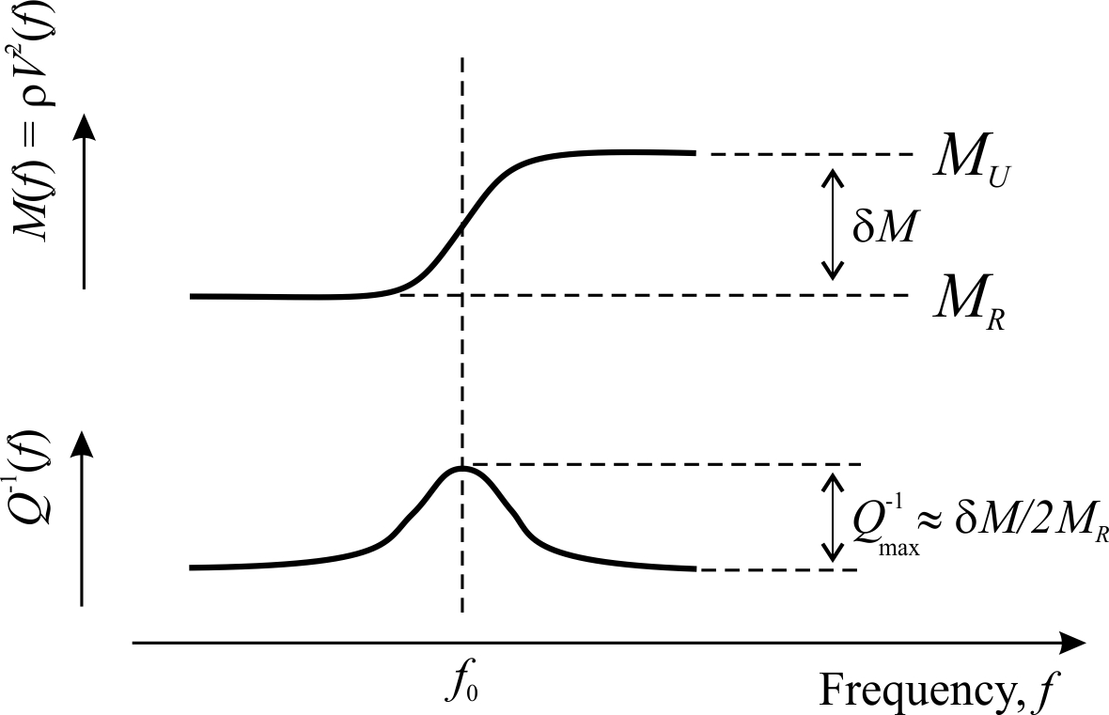
Dispersion and attenuation of empirical modulus
The experiment is repeated at multiple frequencies, and observations like shown in this figure are often made:
  The modulus (real part of the complex modulus M(f)) shows an increase at some frequency f₀. This increase is called ‘modulus dispersion’
  Q⁻¹ shows a peak at the same frequency. This peak is called ‘attenuation’ because mechanical energy is dissipated when Q⁻¹ is large
However, note that the peak value of Q⁻¹ only depends on the elastic moduli M_{R} (‘relaxed’) and M_{U} (‘unrelaxed’)
  This follows from the “Kramers-Krönig relations” (explained later)
Frequency f₀ is the only true ‘attenuation’ observation
  For example, it reduces when more viscous fluid in placed in rock pores
Figure 1.9
Schematic modulus dispersion and attenuation spectra observed in experiments with seismic waves and rock samples. The dynamic modulus M undergoes a step (“dispersion”) by some amount of “modulus defect” δM near frequency f0, and the attenuation factor Q⁻¹ shows a peak of height proportional to δM/M at the same frequency. These particular shapes of the dispersion transition and attenuation peak can be modeled by the standard linear solid (Zener) model (Lecture 2; chapter 5).

Slide 22
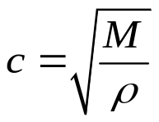
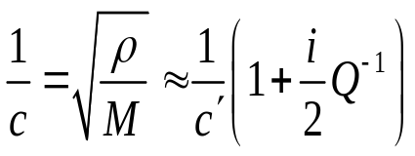
Observation 3: Waves
For a seismic wave, the effective modulus M is related to wave velocity c as
(ρ is the density)
Because of the complex-valued M(f), c(f) is also complex-valued and has a similar frequency dependence with a Q-factor responsible for imaginary part of slowness:
(slowness)
What does this Q⁻¹ mean for a wave? (see next slide)

Slide 23
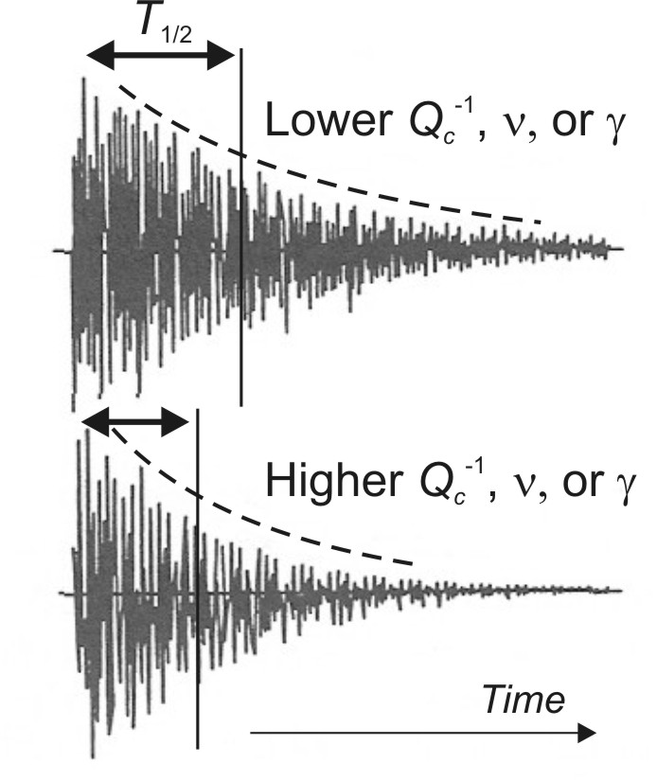
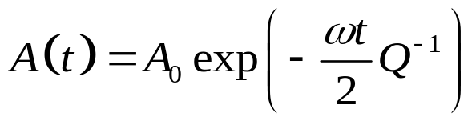
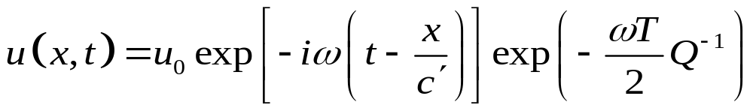
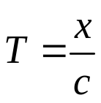
Q for waves
The Q⁻¹ is seen somewhat differently when looking at time and distance dependencies of waves
For time-dependent waves (like free oscillations and seismic coda):
  However, A₀ may depend on time too…
For distance-dependent traveling waves, Q⁻¹ describes the decrease of amplitude with distance x:
Figure 1.9
Schematic seismograms showing seismic coda waves from an earthquake, with lower and higher attenuation. This is about what you see in an Acoustic Emissions experiment.
Higher apparent attenuation is recognized from shorter duration of the coda T_{1/2}, which can be described by larger values of Q⁻¹, ν, or γ (parameters ν and γ describe the geometrical spreading; I do not discuss them in this course).
where
is the travel time

Slide 24
Theories of relaxation (anelastic) phenomena
There are two general approaches to explaining the anelastic phenomena described above:
Conventional and very broadly used: The heuristic viscoelastic model.
  The key idea is that the time-dependent creep seen in transient experiments and frequency-dependent and phase-delayed responses in harmonic-oscillation experiments are inherent in the material
  This approach easily explains the above experiments but has problems with physical meanings of material properties and nonphysical wave solutions
  Also has difficulties with porous rock
Less known, maybe more difficult, but correct and much more powerful approach: Classical continuum mechanics
  It has multiple forms. We will use the Lagrangian form
  It is based on time- and frequency-independent material properties which are not so obvious from observations
  All interactions are local and instantaneous but depend on gradients and time rates of deformation
This will be described in Lecture 2
We will study this later in the course

