Slide 1
Lecture 2: The Viscoelastic Model (VE)
Mathematical principles:
  Boltzmann’s after-effect
  Correspondence principle
Phenomenology: creep, modulus and velocity dispersion, Q
Integral and time-differential strain-stress relations
Causality and Kramers-Krönig relations
Kinetic equation
Zener’s and related equations
Commonly used ‘linear solids’ models
  Time-domain responses and empirical-modulus and attenuation spectra
Interpretation of frequency-dependent attenuation and dispersion spectra
Problems, limitations, and applicability of VE model
Reading: Chapter 2 in the text

Slide 2
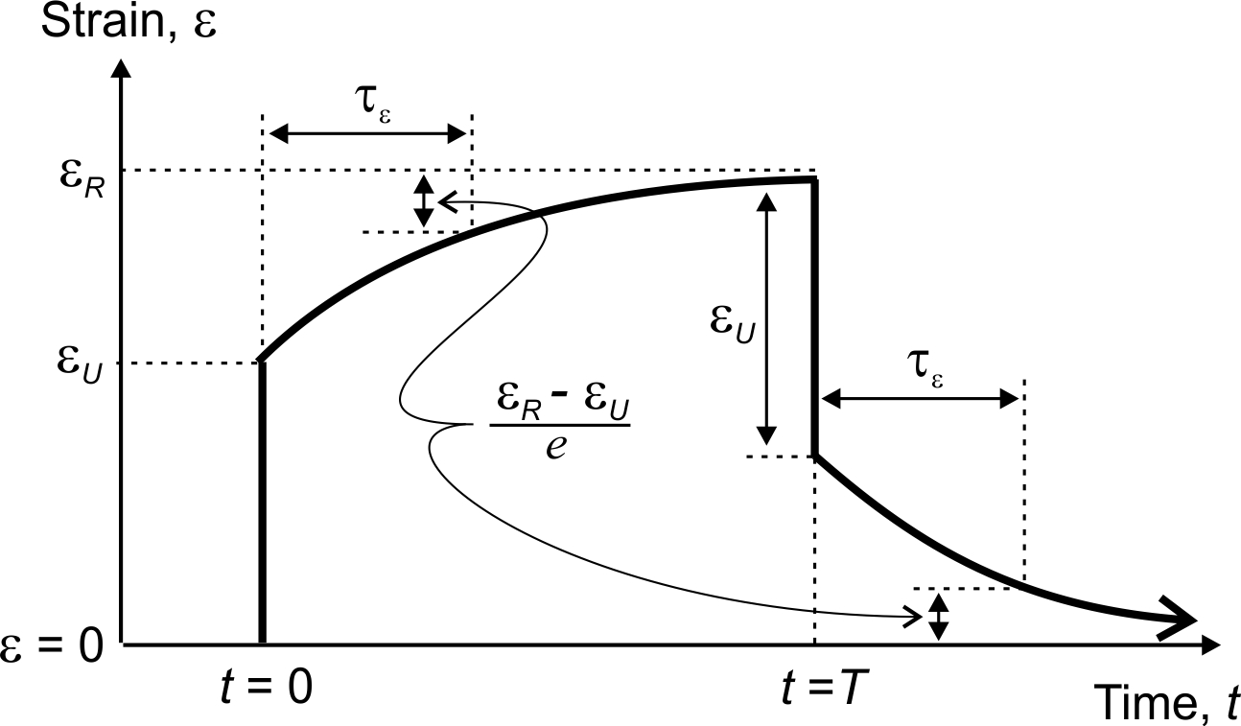
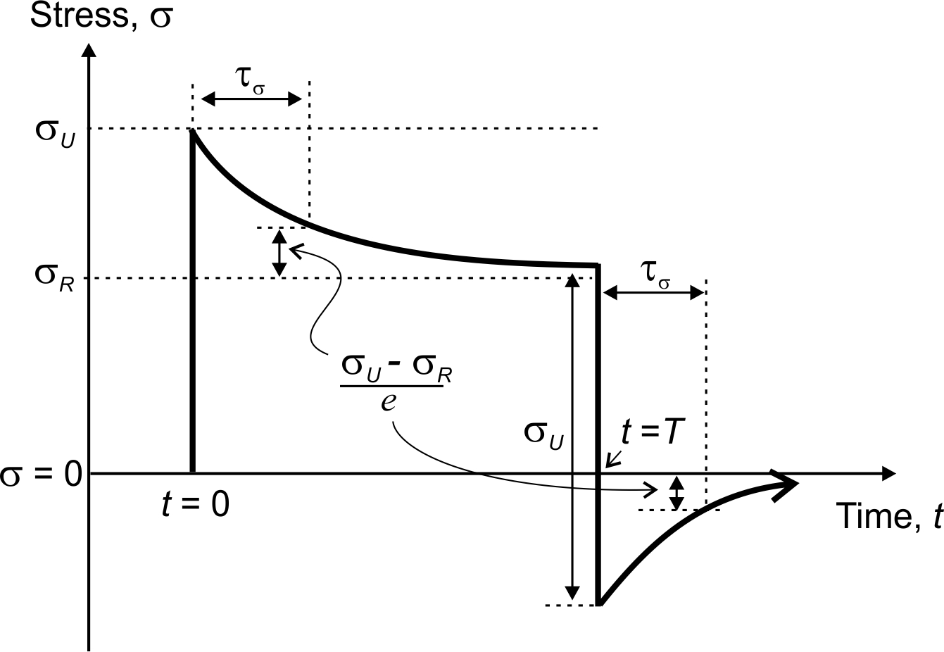
The problem
The goal of the viscoelastic model is to provide equations describing linear relaxation experiments for stress and strain shown below (plots from Lecture 1)
This goal is achieved by constructing phenomenological stress-strain relations dependent on time. They describe the behavior of deformation (variation of strain and stress with time) without considering the physics of deformation.
This means that the stress-strain relations are obtained from pure mathematical principles and without consideration of physics
  Later, I will criticize this model for this lack of physics, but now, let us just consider it

Slide 3



Mathematical principle #1: Boltzmann’s (linearity) principle
Boltzmann’s principle is simply a linear relation between strain and stress time functions
This principle means that if measure a time-dependent stress σ(t) and strain ε(t) in some deformation, then one of these time functions can be derived from the other, and vice versa
Linearity means that if we have two experiments in which we measure strain functions ε₁(t) and ε₂(t) and the corresponding stress functions σ₁(t) and σ₂(t), then arbitrary linear combinations of these functions also give valid experiments:
and

Slide 4

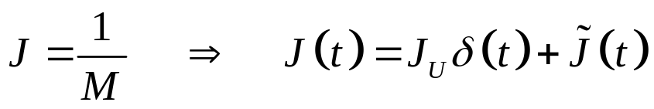
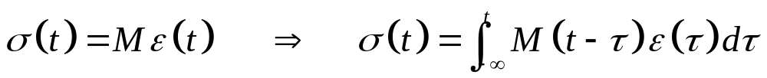
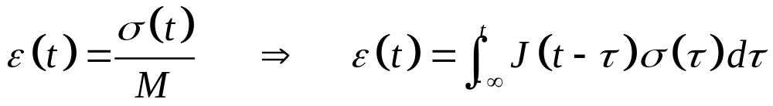
Mathematical principle #2: Correspondence principle
What is the difference between an elastic and anelastic material?
The correspondence principle answers this question in the following way:
  When anelasticity is “turned on”, the elastic modulus and compliance become functions of time:
  Instantaneous stress-strain relations become convolutional relations containing all preceding times:
However, note that this transition ‘⇒’ is actually impossible to achieve or verify.
There exist no ‘elastic’ analogs for real anelastic materials.

Slide 5


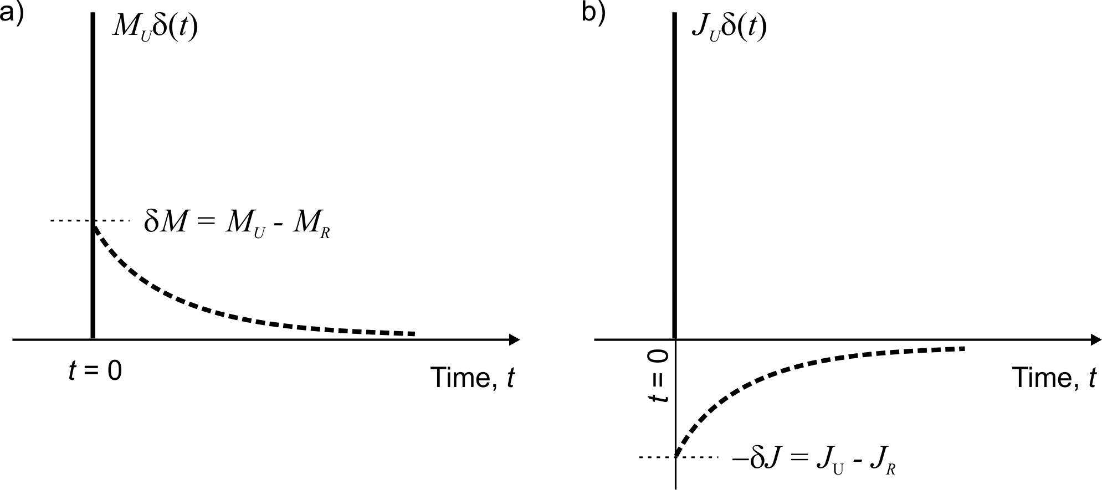


Modulus and compliance functions
The VE modulus M(t) and compliance function J(t) consist of a singular (instantaneous, elastic) response at t = 0 and extended “memory” responses at t ≥ 0
The memory functions interpolate between the “unrelaxed” response at t→ 0 and “relaxed” response at t→ ∞
Memory

Slide 6
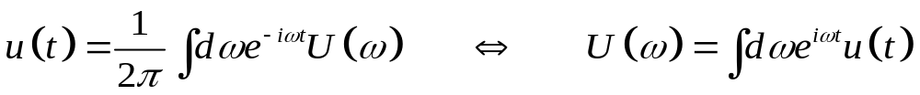
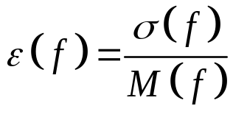

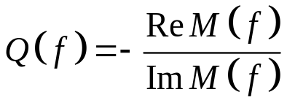
Frequency domain
Fourier transform presents the signal u(t) by a superposition of harmonic oscillations:
(inverse)
(forward)
In the frequency domain, convolutional strain-stress relations are simple (ω = 2πf):
and
Q-factor is one of the most important measured quantities. It only exists in the frequency domain:

Slide 7


Phenomenology
There are two types of observations which are explained by the viscoelastic model (VE):
  Time-domain – creep (transient deformation)
  Frequency-domain – modulus (or wave velocity) dispersion and attenuation
The key observation is that in rock deformation, there is always some characteristic delay (“relaxation”) time τ or some characteristic frequency f = 1/τ
For example, note the delay times τ_{ε} (strain relaxation time) and τ_{σ} (stress relaxation time) in static loading experiments discussed before:
Note that the overall periodic variation of strain is delayed relative to stress

Slide 8
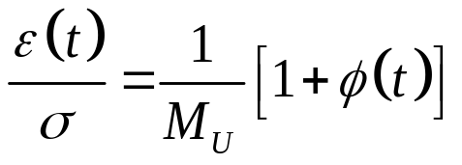
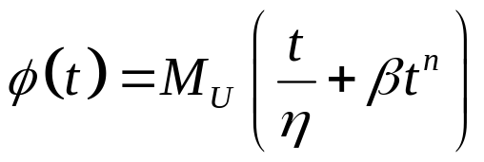
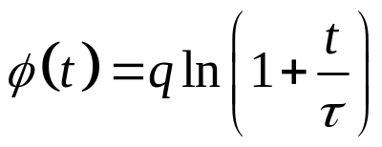
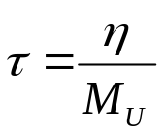
Phenomenology #1: Creep
The basic phenomenology addressed by the viscoelastic model is creep, which is the time-delayed deformation observed in static loading experiments
  The viscoelastic theory simply assumes that this transient behavior is also contained in all other types of deformation
Creep is usually described by giving the time-dependent creep function φ(t). This function is the relative deviation of strain from elastic deformation, measured in an experiment with static stress loading σ = σ ₀θ(t):
Examples:
Andrade law
Characteristic time (for small t):
Lomnitz’s model
From this model, the idea of Q-factor for materials seems to have started

Slide 9
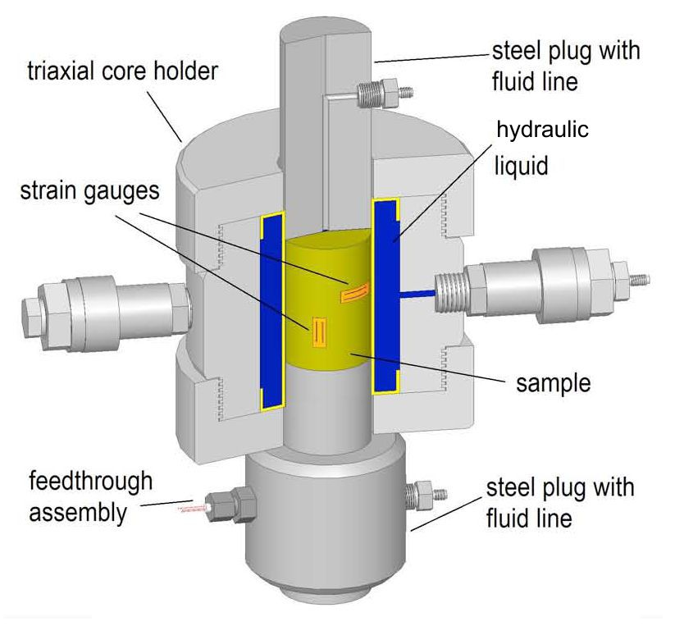
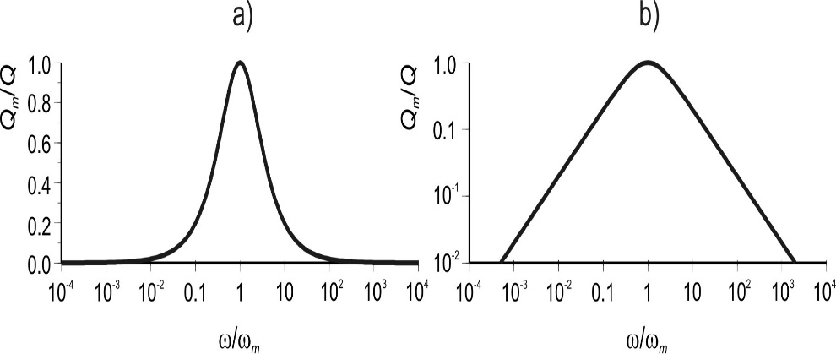
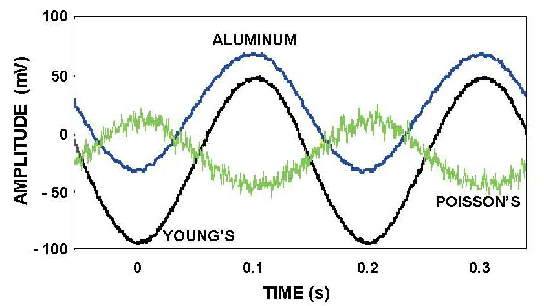

Phenomenology #2: Absorption (phase-lag) peak or band
The typical observation is the “absorption peak” and “modulus dispersion band”
The typical absorption peak predicted by the VE model (“standard linear solid”, or “Zener’s body”) looks like this:
(linear scale in Q⁻¹)
(logarithmic scale in Q⁻¹)
Note that for f << f_{peak}, Q⁻¹ ∝ f, and for f >> f_{peak}, Q⁻¹ ∝ 1/f

Slide 10
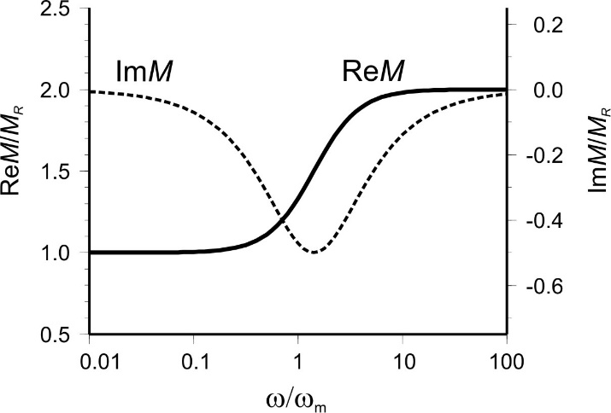

Phenomenology #3: Modulus dispersion
The frequency band of increased Q⁻¹(f) also “modulus dispersion band” – the measured modulus changing from M_{R} (“relaxed”) to M_{U} (“unrelaxed”)
The typical modulus dispersion (in “Zener’s body”) looks like this:
M_{U}
M_{R}
Note that the shape of ImM(f) is close that of Q⁻¹(f)
This is because

Slide 11


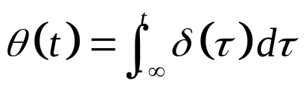
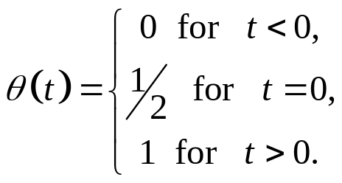
Causality
Regardless of the physical mechanisms, the data measured in any of the above mechanical experiments must satisfy causality constraints
This requirement means that the data (even sine functions recorded in a frequency-domain experiment) represent a record obtained from some impulsive source
  For example, modulus M(t) recorded after a pulse of strain, or compliance J(t) recorded from a pulse of stress:
  This should be the case for any mechanical system like rock-physics apparatus
The causality requirement simply means that M(t) = 0 and J(t) = 0 for all t < 0. The response cannot appear before the source at t = 0.
Mathematically, this condition is written as: and
  where θ(t) is the Heaviside step function:

Slide 12
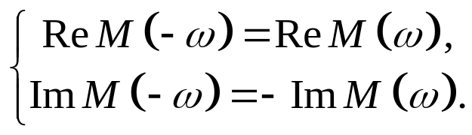
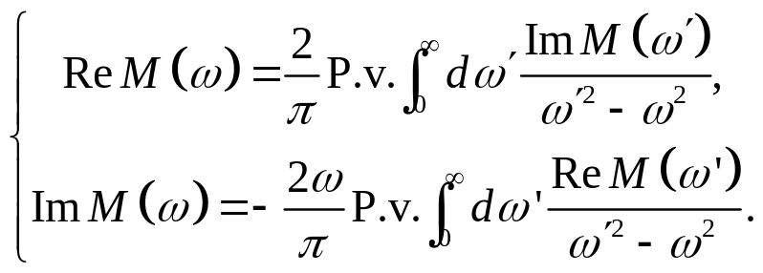
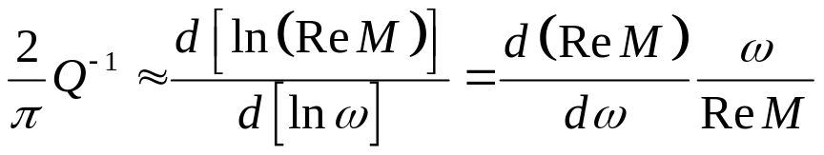
Kramers-Krönig (causality) relations
Simple time-domain properties of recorded signals have somewhat more complex forms in the frequency domain:
The time-domain signal is real-valued. In frequency domain, this means the following symmetry of the real part of the complex spectrum and anti-symmetry of the imaginary part:
Causality ( M(t < 0) = 0 ) means the integral Kramers-Krönig relations between the real and imaginary parts of M(ω):
For spectra with band-limited attenuation (ImM), the integral Kramers-Krönig relation can be approximated by a differential one:
‘P.v.’ means the “Cauchy principal value” of the integrals taken at point ω′ = ω

Slide 13


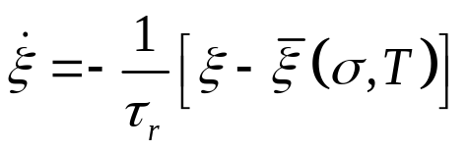
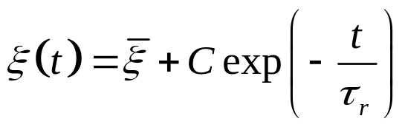
Kinetic equation
Now let us look for a phenomenological differential equation that can describe the shapes of relaxation processes like ε(t) again shown on the right:
A simple and general law of this kind is given by the kinetic equation
  This equation is commonly used to describe diffusion, heating, or variations of concentrations of elements during chemical reactions
For a given (thermodynamic) variable ξ (such as strain), assume that there exists some equilibrium (‘relaxed’) value depending on some external factors like σ (stress) and temperature T:
Then, if ξ is currently shifted from this equilibrium, then the kinetic equation expresses its rate of change:
  which means that ξ(t) approaches the equilibrium at a rate proportional to the deviation from it.
If stays constant with time, then this approach to the equilibrium is exponential:
Note the characteristic time τ_{r}

Slide 14





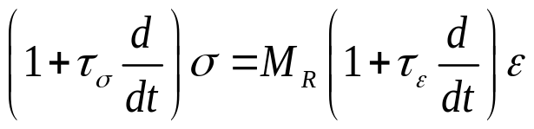


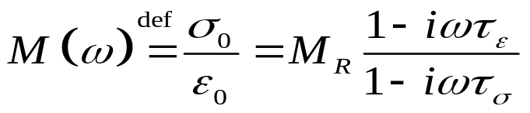
Zener’s (Standard Linear Solid) equation
The kinetic equation can also be written as:
Zener’s equation generalizes this relation to ξ being strain and stress:
  With constant stress ( ), this is a kinetic equation for strain (taking ), with relaxation time τ_{ε}
  Vice versa, with constant strain , this is a kinetic equation for stress σ(t), with relaxation time τ_{σ}
Another useful way to write this equation is by using differential operators:
For a harmonic oscillation with and , this equation becomes very simple and directly gives the complex modulus:
We will look at the graphs when discussing “Zener’s body” later

Slide 15
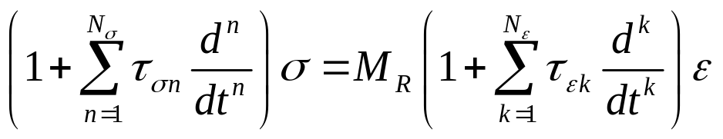
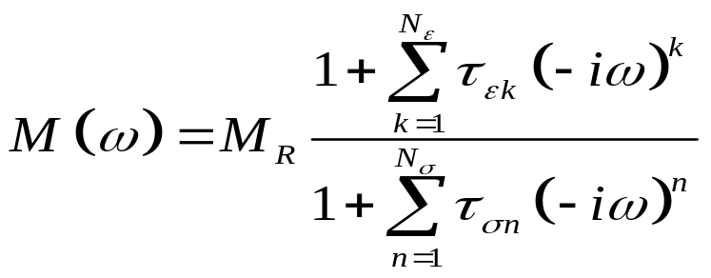
Generalized Zener’s equation
Zener’s equation can be generalized using additional time derivatives:
  … and the derivatives can be further generalized as fractional (non-integer orders)…
These equations describe “viscoelastic bodies” with spectra M(ω) being (almost) arbitrary rational functions of (-iω) with real coefficients:

Slide 16
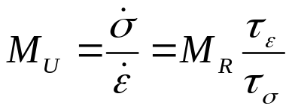
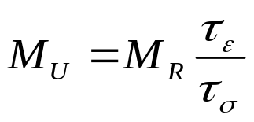
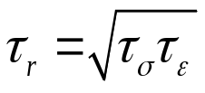
Interpretation of M_{R}, M_{U}, τ_{ε}, and τ_{σ} in Zener’s equation
As you see, it is often useful to first write the most general equation and then look for the meanings of its parameters. The same approach will be taken in Lagrangian mechanics.
What are the meanings of “material-property” parameters in Zener’s equation?
  M_{R} is the relaxed modulus (modulus observed at equilibrium, when both and )
  The unrelaxed modulus is “hidden” but still present there. If we consider very fast deformations, then the time-rate terms will dominate, and therefore the unrelaxed modulus
  Therefore, M_{U} is contained in the ratio of the two taus:
Note that therefore always τ_{ε} > τ_{σ}
  And so, it turns out that Zener’s equation contains only one characteristic relaxation time:

Slide 17
Spring-dashpot diagrams
Graphical spring-dashpot diagrams give a convenient way for representing equations of the kinetic or Zener’s type
The elements are combined to achieve:
  Desired low-frequency response (M_{R})
  Desired high-frequency response (M_{U})
  Desired frequency (or a broader band) of transition from M_{R} to M_{U}

Slide 18


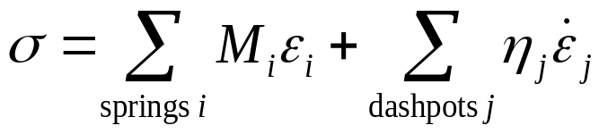
Rules for spring-dashpot arrangements
For elements connected in series, the stress is common to all of them. Therefore, the stress can be used as an independent variable, and the strains derived from it.
For elements connected in parallel, the strains are equal, and they can be used for parameterizing the deformation.
For a spring element, the strain and stress on it are related by
For a dashpot element, the strain rate and stress are related by
Therefore, any stresses is generally represented by linear combinations of strains and strain rates in the various elements:
Let us consider several standard diagrams known as linear bodies (or linear solids)

Slide 19
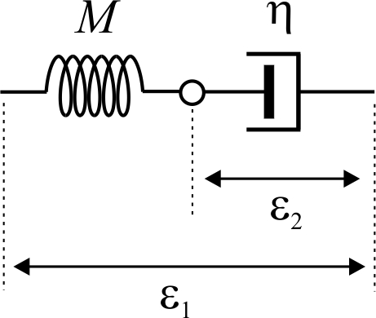
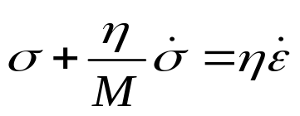
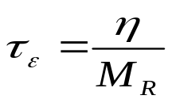
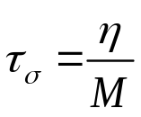
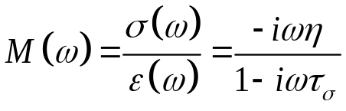
Maxwell’s body
Maxwell’s body consists of a spring and a dashpot connected in series:
Using σ (common to both elements) as an independent variable, Zener’s type equation for this body is obtained (try this!):
Thus, comparing to Zener’s equation:
  M_{U} = M
  M_{R} → 0 (plastic deformation)
  Strain relaxation time → ∞ as
  Stress relaxation time
  Complex modulus

Slide 20
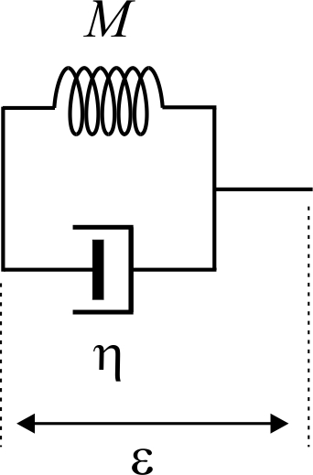

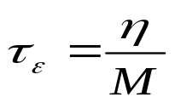

Kelvin-Voigt’s body
Kelvin-Voigt’s body consists of a spring and a dashpot connected in parallel:
The strain ε (common to both elements) can be used as an independent variable, and Zener’s type equation for this body is (verify this!):
Comparing to Zener’s equation:
  M_{U} = ∞
  M_{R} = M (elastic deformation)
  Strain relaxation time is finite:
  Stress relaxation time τ_{σ} = 0
  Complex modulus

Slide 21
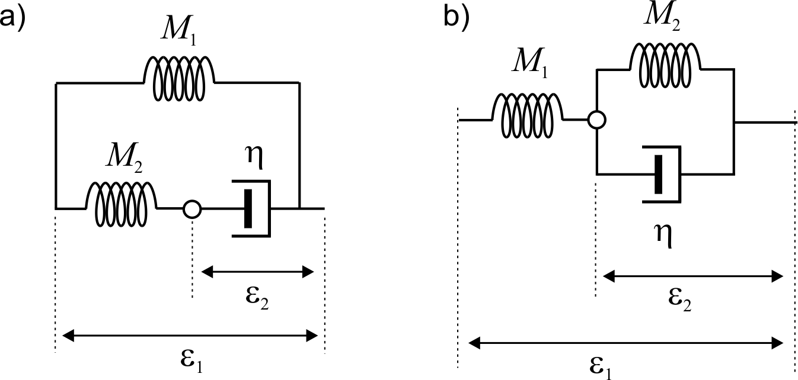
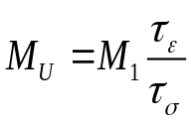
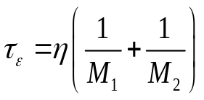
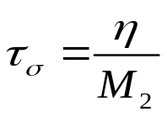
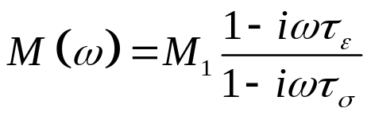
Zener’s body (Standard Linear Solid, SLS)
The Zener’s body has two graphical forms:
Both forms lead to the same Zener’s equation for the observed strain and stress:
  …but different relations for internal variables
For diagram a):
  (from basic relation and τ_{ε} and τ_{σ} below)
  M_{R} = M₁ (only this spring is deformed in relaxed state)
  Strain relaxation time:
  Stress relaxation time
  Complex modulus

Slide 22
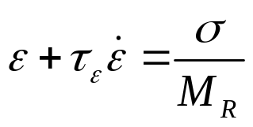
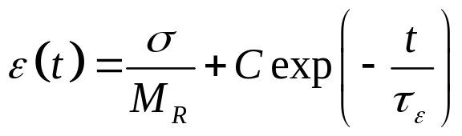
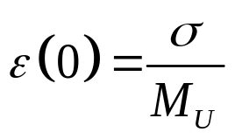
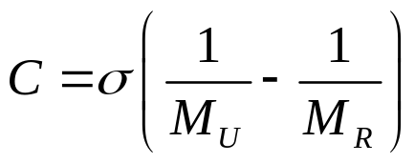
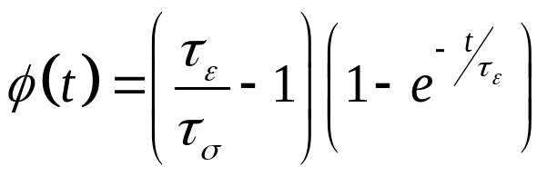
Properties of the Standard Linear Solid
Let us write the Zener’s equation with constant stress σ at t ≥ 0:
This is a kinetic equation (see above), with solution:
Constant C here is selected so that the initial strain is “unrelaxed”:
and therefore: (note that C < 0)
Creep function (defined by ) is then:

Slide 23
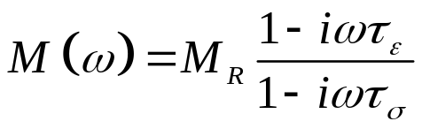


Properties of the Standard Linear Solid (cont.)
From the complex modulus spectrum:
Attenuation factor:
where the angular frequency of the peak in Q⁻¹(f):
Note that the peak frequency is inversely proportional to η
Thus, frequency of the peak is a true indicator of viscosity (internal friction).
The magnitude (height) of the Q⁻¹(ω) peak is an elastic property (next slide, and recall the Kramers-Krönig relations)

Slide 24




Interpretation of M(f) and Q⁻¹(f) data
The elastic and anelastic parameters of a rock can be obtained by approximating the measured ReM(f) and Q⁻¹(f) spectra by the spectra of an SLS and estimating M_{R}, M_{U}, τ_{ε}, and τ_{σ} :
  Plateaus in the ReM(f) spectrum give M_{R} and M_{U} (elastic properties)
  From M_{R} and M_{U}, you can obtain the ratio of τ_{σ} and τ_{ε} (convenient to denote by β²):
  Then, verify that the height of the SLS Q⁻¹(f) peak equals
  The frequency ω₀ = 2πf₀ of the peak in Q⁻¹(f) gives τ_{ε} and τ_{σ} (only one anelastic property):
(so, the height of the peak does not add much to the interpretation!)
Young’s modulus dispersion and attenuation (Q⁻¹) measurements in glycerol-saturated Berea sandstone at three temperatures
and their approximation by an SLS (lines)
To improve data fitting, nonlinear models can be used (Cole-Cole, etc.)

Slide 25


Dispersion and attenuation spectra
Normalized ReM(f) and Q⁻¹(f) spectra for the three basic linear bodies
  Frequency scaled to make f₀ = 1 for SLS (Zener)
  ReM scaled to make the average
    in this plot, with β = 1.5
  Viscosity η in Maxwell’s and Kelvin-Voigt (K-V) bodies taken the same as in the SLS
  M_{R} in K-V body is taken the same as in the SLS
Q⁻¹ here is multiplied by 0.01 for Maxwell’s and Kelvin-Voigt’s bodies

Slide 26

Cross-plots
Complex plane of M
Cross-plot of Q⁻¹ with ReM

Slide 27



Burgers’ body
This is a Zener’s body with an additional dashpot connected in series for plastic deformation:
This system contains two internal degrees of freedom and therefore does not reduce to Zener’s equation
  Example of the “generalized Zener’s equation”
Complex modulus can be simply obtained by viewing this system as a Maxwell’s and Kelvin-Voigt bodies connected in series:
Note that this M(ω) is a ratio of second-order polynomials of (-iω):
Second-order polynomials because of the two internal variables

Slide 28

Exercise
Write a Matlab or Octave program to plot the spectra of ReM(f) and Q⁻¹(f) for Burgers body using this equation:

Slide 29


Generalized Linear Solids
These systems are constructed to provide broad attenuation (Q⁻¹(f)) and dispersion frequency bands
  Broad bands are achieved by using multiple internal variables
  Each of these variables is activated (starts moving) at different characteristic frequency ω_{c} = k/η (k denotes moduli M in this figure)
Generalized Maxwell solid
(with η = 0, this is also the Wiechert, Generalized Standard Linear Solid, or Generalized Zener body)
Generalized Voigt solid
Attenuation spectrum is a superposition of peaks for individual modes

Slide 30
Problems of the Viscoelastic model in seismology
The VE model is broadly used and considered good for describing real media (rock samples, subsurface, Earth’s mantle, and the whole Earth!)
  It reasonably well explains most data
  It works well for quasi-homogeneous media or for whole rock samples tested in the laboratory
However, as a theory of seismic waves, this model suffers from several important problems:
  In physics, there exists no definite strain-stress relation. Equations of physics are for acceleration, not for strain rates like in kinetic or Zener’s equations
  Also specific problems summarized in the next slides:
    The VE model is quasi-static, and so it is designed only for slow deformations of samples in the laboratory. It is therefore unknown how accurate this model is for seismic waves.
    It replaces effects of heterogeneity with those of time dependences, which is not always sufficient;
    It does not include body-force friction (only surface stress was denoted σ above and called “stress”). Such body forces come, for example, from primary-pore fluid friction;
    It disregard boundary conditions between internal variables;
    It is also known to produce some nonphysical wave solutions in layered media.

Slide 31
VE problem #1: Quasi-static character
The VE model attributes zero mass to the internal variables, like the one shown by the white dot in Maxwell’s body here
  This results, for example, in the absence of additional wave modes in media with complex structures, such as the Standard Linear Solid
However, in physics, all components of materials (matter) must have mass
  Additional wave modes should also appear in media with internal structures
  The internal masses can be small, but this is not guaranteed
  For example, in porous rock, there exists the so-called (Biot’s) secondary P wave. This wave disappears when the rock is approximated by a VE model

Slide 32
VE problem #2: Time dependence instead of Heterogeneity
  The viscoelastic model was originally designed for explaining quasi-static deformations with negligible spatial variations, such as creep of the whole rock sample in a lab experiment (preceding section). In this case, the time is the only significant independent variable, and there exists only one complex-valued function M(t) or J(t) describing the whole system.
  However, in physics, heterogeneous deformations are always driven by spatial gradients of pressure, which lead to multiple types of waves and material and heat flows.
    For example, stress σ at point x and time t is affected by the deformations of adjacent points at earlier times, and not by the earlier strain values at the same point x.
    At time t after an application of stress, the strain at point x is affected by boundaries and material-property contrasts at distance ct from this point, where c is the wave or some flow velocity within the medium.

Slide 33

VE problem #3: Non-surface stress forces
Dispersion and attenuation effects can be caused by “global” pore-fluid flows within rock
An example of a “drained-to-undrained transition” is shown here. This transition is caused by pore fluid flowing across the entire sample and into the tubes of the measurement apparatus (“dead volume”)
Effects of this flow lead to body-force friction which is not described by a stress tensor σ
  Therefore, they cannot be described by the VE theory
  Nevertheless, the shapes of the observed M(f) and Q⁻¹(f) are generally close to those of Zener’s body
  But this body is the whole apparatus
Pimienta et al. (2015)

Slide 34

VE problem #4: Missing boundary conditions
Imagine two layers of rock in a welded contact, for example two layers of brine-saturated and oil-saturated sandstone. Let us approximate each of these layers by an SLS (Zener’s) rheology (figure on the right)
Question: Do there exist mechanical elements connecting across the boundary? In particular, elements connecting the internal-variable points (red here)?
  This is the big question. The VE model contains no connections like this and assumes all internal variables quasi-static and non-interacting.

Slide 35
VE problem #5: Nonphysical wave solutions
Another serios problem with application of the viscoelastic model to seismic waves is in producing nonphysical wave solutions in layered media, or upon reflection from interfaces. Such nonphysical solutions have to be avoided by special mathematical conventions. For more on this subject, see, for example, Ruud (2006), Krebes and Daley (2007), and Vavryčuk (2010).

Slide 36

Thus, to what cases can the VE model be safely applied in seismic applications?
This question is not easy to answer
To model laboratory experiments in which only a single pair of or relations needs to be explained
  However, these relations may be different for the same rock in in-situ conditions
To model waves in heterogeneous rock in situ under certain conditions. These conditions should ensure that the material can be viewed as locally homogeneous, and the non-VE wave modes are weak:
  The scale of observation L_{REV} >> L_{structure} (scale or micro- or meso-structure of the rock)
  Simultaneously, distance from any boundaries D >> λ_{non-VE_waves} (lengths of secondary waves not accounted for by the VE model, such as Biot’s slow waves)
    However, this conditions is difficult to satisfy in practice (~20-m long waves, ~10-cm scale layering)
  “Global” pore-fluid flows (unidirectional or divergent pore flows across the entire REV are insignificant
    This condition may also be difficult to enforce in laboratory experiments with “dead volumes” of pore fluids outside of the sample

