Slide 1
Lecture 3: Introduction to Analytical Mechanics
Variational approach: presenting differential equations as an optimization problem
Principles of analytical mechanics:
  D’Alembert principle (virtual work)
  Hamiltonian principle (stationary action)
Generalized coordinates
  Also the corresponding generalized forces, momenta, energy
Lagrangian and pseudo-potential (dissipation function)
Euler-Lagrange equations
Conservation laws
Spatially-dependent variables (fields)
Reading: Chapters 3 and 4 in the text

Slide 2
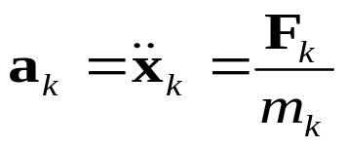
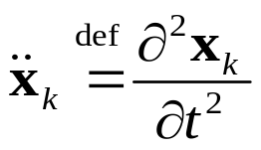
Mechanics
In classical mechanics, a system of any complexity is described as a collection of point masses m_{k} located at points x_{k}. Force vectors F_{k} are applied to these masses
Under the action of these forces, the acceleration of each mass equals (second Newton’s law)
Notation:
This gives a (possibly large) number of equations for vectors x_{k}(t) for N_{p} particles. The forms of these equations change if we use, for example, spherical or cylindrical coordinates instead of Cartesian ones, etc.
How to write all these equations in just one equation, and independently of the specific selection of the coordinate system?
The answer is: use a variational principle. Formulations of mechanics based on mathematical variational principles are called analytical mechanics
  Probably the best and most elegant one is based on “differential forms”, but this may be too much for us

Slide 3


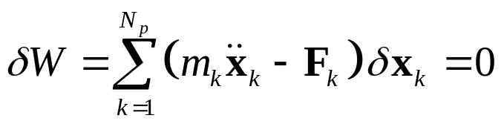
D’Alembert’s principle
To obtain a variational formulation, we need to first make an equation with the right-hand side equal zero:
  This equation is sometimes called “conservation of momentum” in modeling literature, which I think is not a very good idea. There is no momentum here (yet).
  More precisely, this equation simply means the balance of the external and inertial forces applied to each particle in its own frame of refence
Now, let us perform arbitrary infinitesimal (called “virtual”) perturbations of the trajectory of each particle:
…and evaluate the virtual work of all of the above forces:
This is the d’Alembert principle: the correct trajectories x_{k}(t) are such that the total virtual work is stationary : δW = 0 for arbitrary perturbations δx_{k}(t)

Slide 4
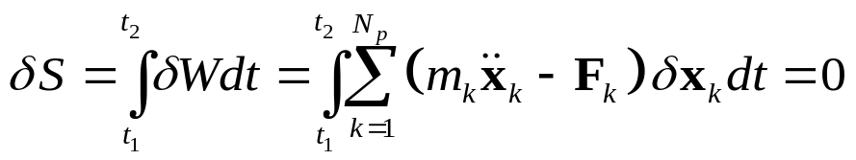
Hamiltonian principle
The d’Alembert principle is called quasi-variational, because the virtual work δW is not a variation of any ‘functional’
  ‘Functional’ means a function (some real value) attributed to the whole collection of trajectories (functions) x_{k}(t) taken at all times
To obtain a functional of trajectories x_{k}(t), we can integrate δW over time t and sum over all particles:
  This summation gives a scalar function (‘functional’) of all trajectories x_{k}(t): S{x_{k}(t) }
  This functional S is called the Hamiltonian action
  All Newton’s equations of motion are then contained in the requirement that δS = 0 for an arbitrary perturbation of trajectories δx_{k}(t)
This is the true variational principle of stationary Hamiltonian action
Note that unlike the ‘correspondence principle’ in the viscoelastic model, this principle is not a phenomenological hypothesis but a very general form of Newton’s laws

Slide 5
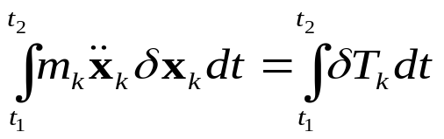
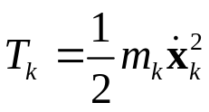

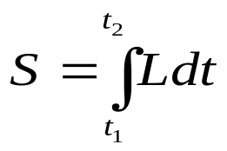
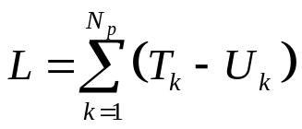
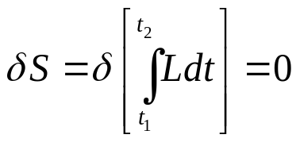
Lagrangian
For each particle, the two terms in the variation of action are:
where
is the kinetic energy
and , where U_{k} is the potential (elastic) energy
Therefore,
where
is called the Lagrangian function of the complete mechanical system
Therefore, for an arbitrary mechanical system, all equations of motion are contained in a single variational equation:
for arbitrary deviations δx_{k}(t) from the true trajectories

Slide 6
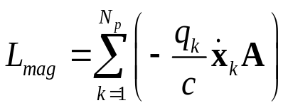

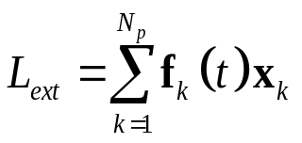
Lagrangian
The Lagrangian is usually the difference of the total kinetic and elastic energies: but it does not have to be only that
For example, for electric charges q_{k} in a magnetic field (nonconservative, forces are not gradients of a potential function), the corresponding part of the Lagrangian is
where Α is the vector electromagnetic potential and c is the speed of light
Note that the Lagrangian depends on particle velocities instead of coordinates
The Lagrangian can also be time-dependent
  For example, in the presence of an external force f_{k}(t):

Slide 7
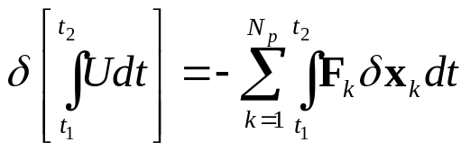

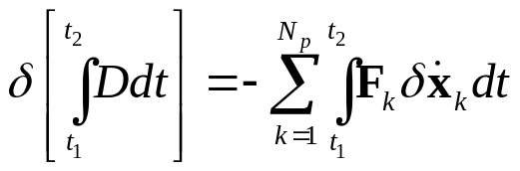

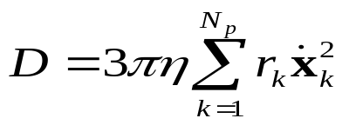
Dissipation function (pseudo-potential)
In the variational approach, all elastic forces can be found by evaluating the perturbation of the elastic-energy part of the action. By making arbitrary infinitesimal perturbations of δx_{k}(t), the time integral of the elastic energy varies as
This factor in front of δx (variational derivative) is the force
Similarly, the forces of friction can be obtained by variation of another functional, but with respect to perturbations of velocities :
The integrand D here is called the dissipation function, or pseudo-potential
For example, if each of the bodies is a spherical particle of radius r_{k} moving through fluid with viscosity η, then it will experience a viscous friction force (Stokes’ law), and the dissipation function for the system is:
Note that D often looks like kinetic energy

Slide 8

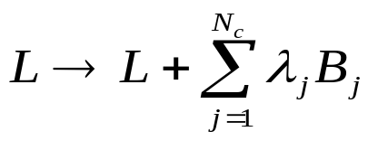
External forces and constraints
Often, it is required that the system satisfies additional constraints
  For example, such constraints can be boundary conditions at the free surface or open or closed conditions for pore-fluid flow across various boundaries
Let us denote the constraint by equation (**)
Then, we need to find the extremum of action
  not for arbitrary functions δx_{k}(t) but only for those satisfying eqs. (**). This can be done by adding constraint terms to the Lagrangian:
λ_{j} is called the Lagrange multiplier. It has the meaning of external force required to hold the variables at the constraint surface B_{j} = 0
Then, variations of δx_{k}(t) can again be considered as arbitrary, and parameters λ_{j} selected to make the solution satisfy eqs. (**)

Slide 9
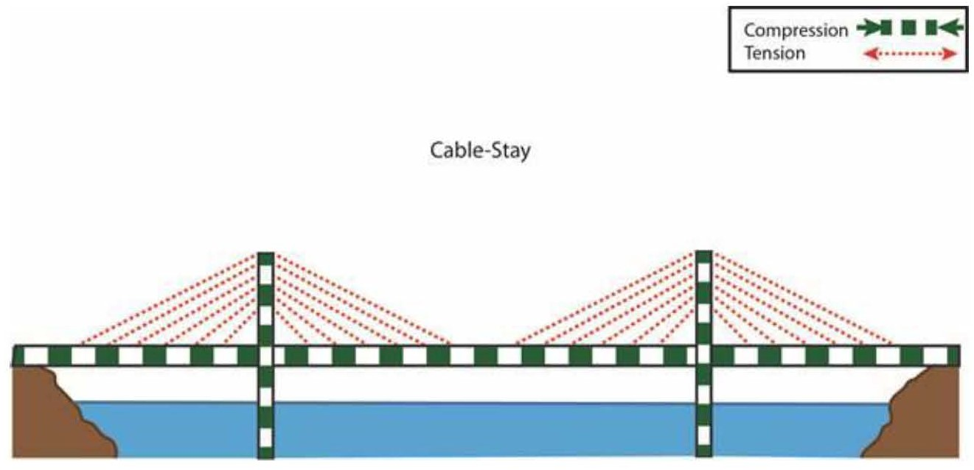
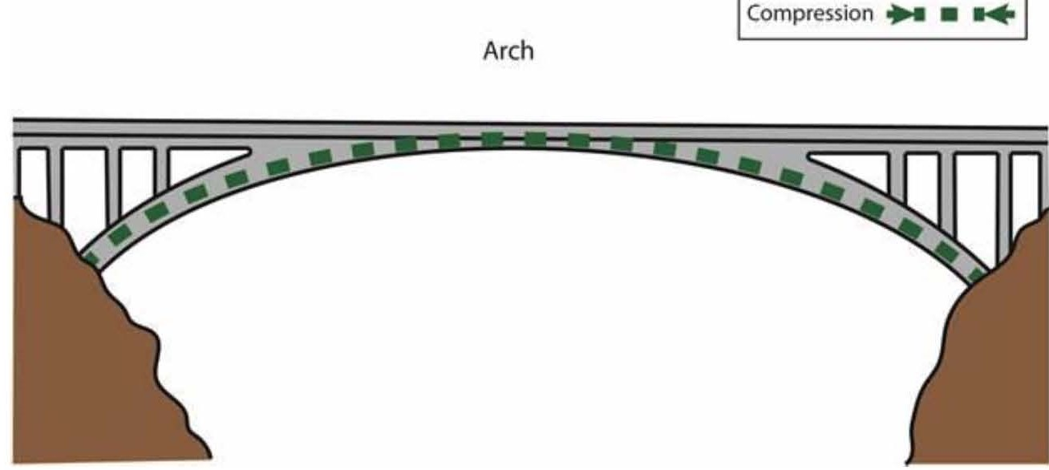
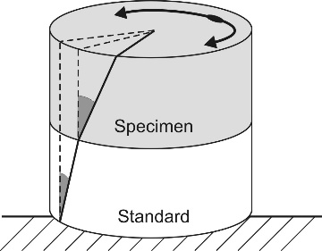
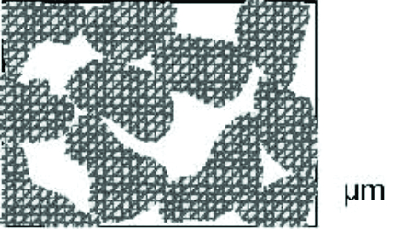



Generalized coordinates
Up to this point, we used N_{p} particles with Cartesian coordinates x_{k} to describe the mechanical system (rock)
However, the variational approach allows much broader parameterizations by arbitrary selections of generalized coordinates to describe the state of the system
  The generalized coordinates should be some parameters which are the simplest, most sensitive, or most important for the goals of analysis
    For example, the green or red elements of bridges undergoing compression and tension, or shearing angles of a rock sample on the right)
The equation of stationary action is the same in any coordinates
ϕ₁
ϕ₂
The Lagrangian and dissipation function are functions of generalized coordinates q and their time derivatives , and possibly time t:
φ, α_{ij}, δT, θ
and

Slide 10
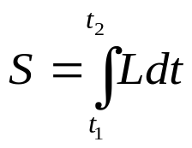
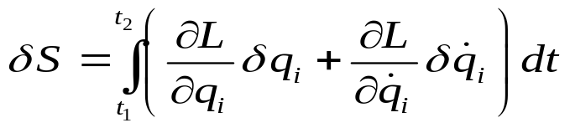
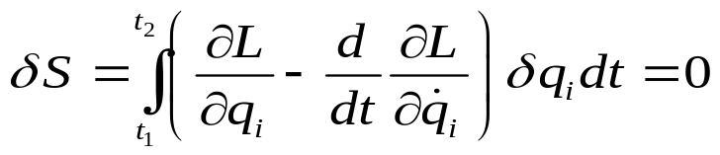
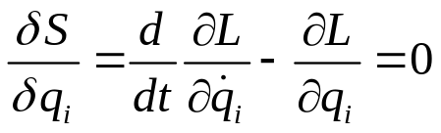
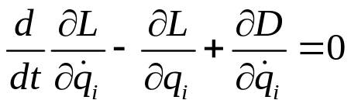
Euler-Lagrange equations
In terms of the generalized variables, the perturbation of action equals (summation over repeated subscripts ‘_{i}’ assumed)
Transforming the second term by integration by parts, so that it contains δq_{i} this eq. becomes:
Therefore, for any i, q(t) must satisfy the Euler-Lagrange equation:
This expression is called the functional derivative of functional S with respect to function q_{i}(t)
Adding forces of friction from dissipation function D, this equation becomes:

Slide 11
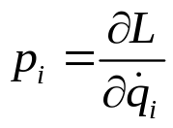
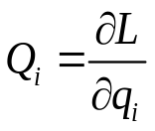
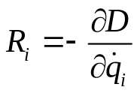
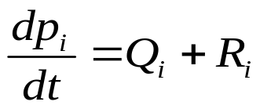


Generalized momentum, forces, and energy
The derivative
is called the generalized momentum:
  Regular momentum when q_{i} is a coordinate
  Angular momentum when q_{i} is a rotation angle, etc.
Similarly, the derivatives and are generalized forces (conservative and dissipative
Therefore, the Euler-Lagrange equations become just like second Newton’s law:
Function (if p_{i} is expressed through q and ) is called the generalized energy (total mechanical energy of the system; again note the summation over repeated subscripts ‘i’)
  Function H is also called the Hamiltonian if expressed through p and q, or the Helmholtz free energy if adding effects of temperature

Slide 12
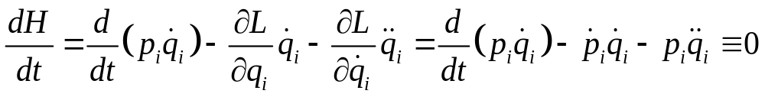
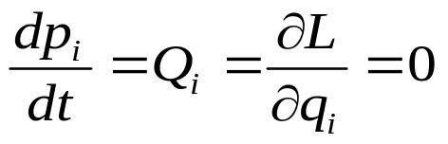
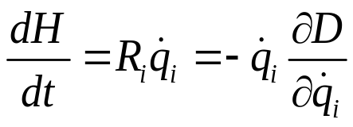
Conservation laws
Conservation laws are obtained by noting the general properties of functions L and D:
  Conservation of mechanical energy: If D = 0 and function L is explicitly independent of time, then the total mechanical energy H is conserved:
  Conservation of momentum: If D = 0 and function L is explicitly independent of some q_{i}, then the corresponding momentum p_{i} is conserved:
If D ≠ 0, mechanical energy varies (dissipates) at rate
If function D is quadratic (as it usually is), this rate equals (-2D)

Slide 13

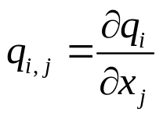
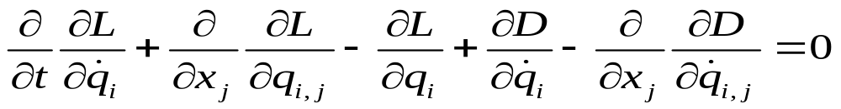
Spatially-dependent variables (fields)
When modeling continuous media, variables q_{i} often represent functions of spatial coordinates x. Therefore, in addition to q and time derivatives , the Lagrangian and dissipation functions depend on the spatial derivatives of q:
  For example, this is the common case in the mechanics of solids: q_{i} is the components of spatially-variable displacement, and their spatial derivatives are the strain tensor
Let us denote the spatial derivative with respect to coordinate x_{j} by comma in the subscript:
Then, the Euler-Lagrange equations include additional spatial derivatives similar to the derivatives with respect to t:

