Slide 1
Lecture 4: Applications of Lagrangian Mechanics
Key examples: Linear oscillator, multidimensional oscillator
Mass-Stiffness-Damping model
Oscillation modes and waves
Attenuation coefficient
Q-factor: meaning, definitions, resonance and forced-oscillation Q, multiple forms
  Frequency dependence of Q
Effective viscoelasticity and effective density
Reading: Chapter 4 in the text

Slide 2
Goals of this lecture
You have likely heard about the “Q-factor” for Earth materials
Is Q the same thing as “attenuation” and “energy dissipation”?
This is not quite so, and we are going to elucidate these concepts

Slide 3
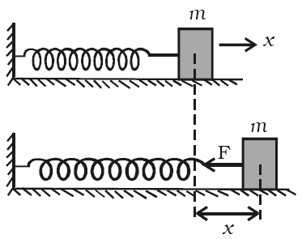
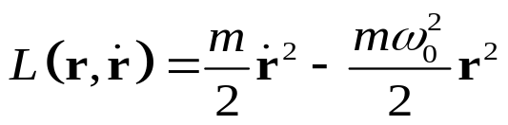

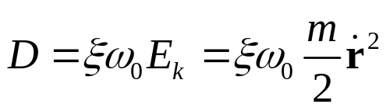
Linear harmonic oscillator with damping
Linear harmonic oscillator is the simplest mechanical system containing all key features of laboratory experiments and waves
  This may be a good model of low-frequency mechanical testing of a rock core in the laboratory
  This is a system with a single observable variable x and elastic force F proportional to x (‘linear’)
  Three “material properties”: mass m, natural frequency ω₀, and damping constant ξ
The Lagrangian (kinetic energy E_{k} minus potential energy E_{p}) is:
At equilibrium
Displaced
, where
is the spring constant
The dissipation function is proportional to the kinetic energy:

Slide 4
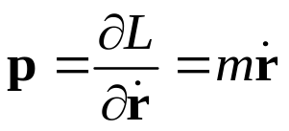
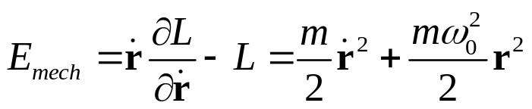
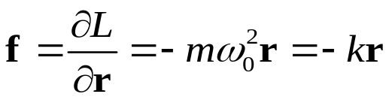
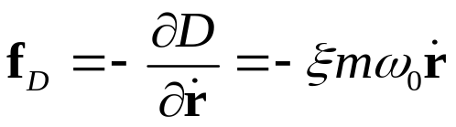
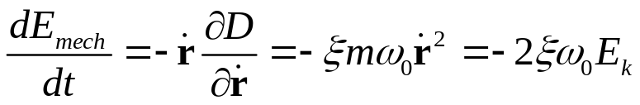
Linear oscillator
From the Lagrangian:
  Momentum:
  Mechanical energy (denoted H in Lecture 3):
  Elastic force (denoted Q before):
At equilibrium
Displaced
From the dissipation function:
  Force of friction (R before):
  Mechanical-energy rate of change:
Note that the force is proportional to velocity (due to linear viscosity)
Note that energy dissipation occurs “from the kinetic energy” rather than from the “stored” elastic energy as argued in seismology or materials-science texts

Slide 5



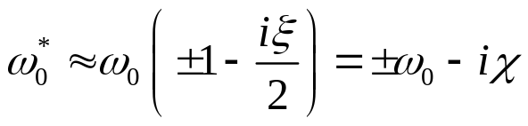
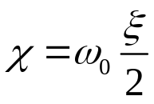

Linear oscillator
Euler-Lagrange equation gives Newton’s equation of motion:
At equilibrium
which simplifies to the “damped linear oscillator” equation:
This is why factor ‘m’ was included in all terms in L and D
Displaced
With ξ << 1 (weak damping), the general solution is:
Case ξ = 1 is called “critical damping”
where
, and
is the attenuation coefficient (discussed below)
and so:
Oscillations at ω₀ with amplitude decreasing with time

Slide 6

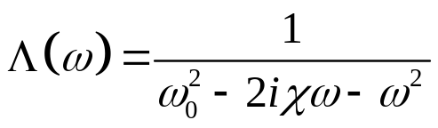
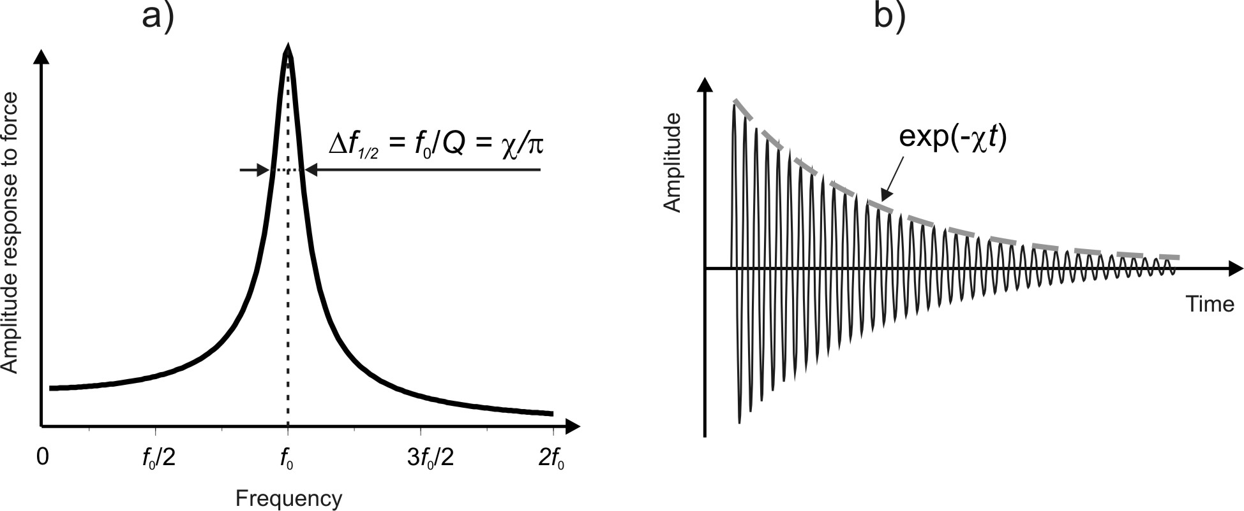
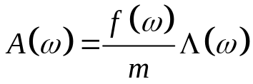
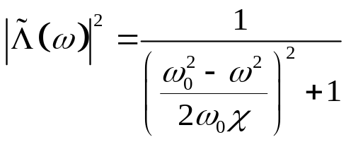
Q of a linear oscillator
Let us consider two questions:
  What is the meaning of the Q-factor for an oscillator?
  Does this quantity apply to forced oscillations?
The answer to the first question is simple: Q is a positive number measuring the relative width of the resonance peak in the amplitude response, taken at of the peak level
  The same width is more directly measured by parameter χ
This is the meaning of the Q for oscillator (resonator)
Equation for displacement:
Complex response function:
f(ω) is the spectrum of the force, A(ω) is the oscillation amplitude, Λ(ω) is the response function
Power:

Slide 7
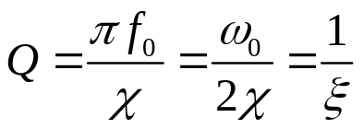
Q of a linear oscillator
Thus, the Q-factor is half of the ratio of the frequency of a resonance peak to its spectral width (which is the attenuation coefficient):
Note that this quantity:
  Only refers to the resonance peak. It does not exist for non-resonant systems such as boundless rock
  It should not be related to a modification of the spring constant k or mass m
  It cannot be frequency-dependent (because the resonance contains only one frequency ω₀). The Q of a resonator is simply a constant equal 1/ξ.
So, what is meant when measuring a frequency-dependent Q from strain-stress relations in a forced-oscillation experiment? (answers will be given below)

Slide 8
Quiz #1:
Consider a cylindrical rock sample, of length L and cross-sectional area A (Figure). The cylinder is mounted on one end, and force F(t) is applied to the other end. The density of the cylinder is ρ, and the Young’s modulus is E. In addition to elastic modulus, the sample also has extensional viscosity η_{E}.
Write the equation of motion for variable ε.
Determine the natural frequency of oscillation and Q-factor of the sample

Slide 9
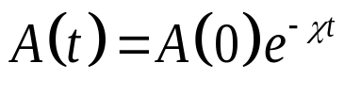
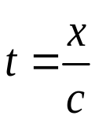

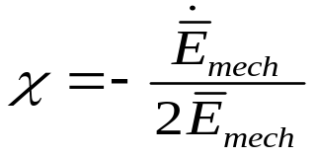



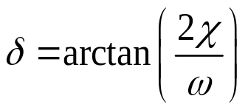

Attenuation coefficient
When discussing “attenuation,” we need to look at the attenuation coefficient first
Term “attenuation” usually refers to observing a decrease of amplitude with time t (for oscillation of a finite body) or with travel distance x (for a wave):
For a wave, the ‘t’ in the exponent is the travel time:
Parameter χ in this relation is the attenuation coefficient
From an observed decay of A(t) with time, χ can be obtained in two ways:
  By measuring the decrease of mechanical energy averaged over a period:
therefore:
  By measuring the displacement-acceleration phase lag: if , where , then , and its phase advance relative to u(t) equals
(usually χ << ω)
this phase lag is viewed as strain-stress phase lag in the viscoelastic approach
this is usually denoted Q⁻¹
(but this notation should be understood carefully)

Slide 10
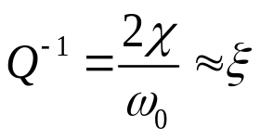
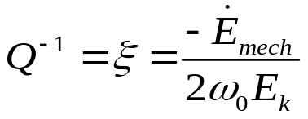

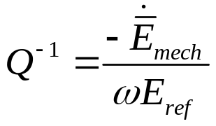
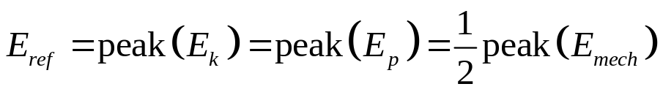
Definitions and meanings of Q
It is always better to use the inverse Q⁻¹ (which equals zero when there is no energy dissipation) instead of the “quality factor” Q. Recall that for a resonance peak (oscillator), the Q⁻¹ is simply ξ:
Physically, this quantity can be understood as the ratio of the energy dissipation rate to the kinetic energy of oscillation:
(taken at any time t)
(***)
However, in seismic and lab applications, different types of Q⁻¹ are used. Let us consider them
For waves (Aki and Richards, 2002), the wave-period average energy-dissipation rate are measured as in eq. (***): , but in the denominator, the peak kinetic or elastic energies are taken. Thus, the definition of seismic Q⁻¹ is
where the reference energy level:

Slide 11

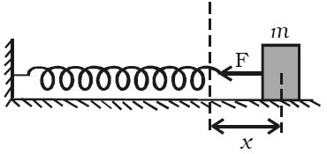
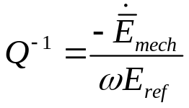
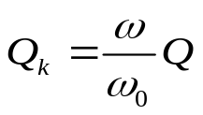
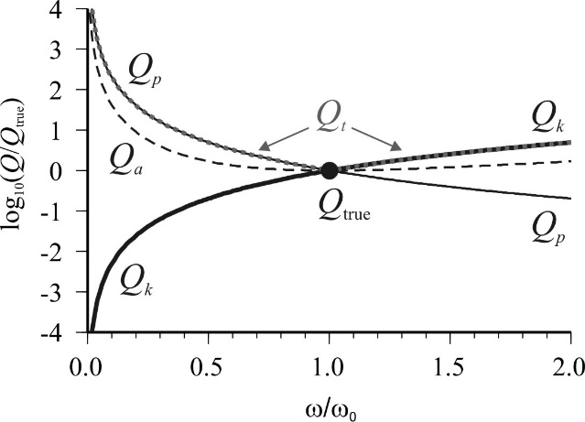
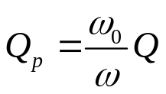
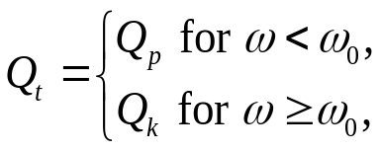
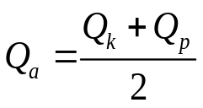
Q-factors for forced oscillations
For forced oscillations at variable frequency, the same definition of Q⁻¹ is used, but ω₀ (fixed) is replaced with the variable frequency ω of the applied force:
This replacement makes Q⁻¹ frequency-dependent, and also dependent on how one specifies E_{ref}. Consider several approaches giving different “Q-factors” (graphs on the right):
If we think that the kinetic energy is the one which “dissipates”, then E_{ref} = peak(E_{k}) and Q increases with ω:
If we consider the potential energy as the dissipating one, then Q decreases with ω:
We can also assume that the peak total mechanical energy dissipates, and then:
Also, some people define Q⁻¹ using the total mechanical energy averaged over a period. In this case:

Slide 12
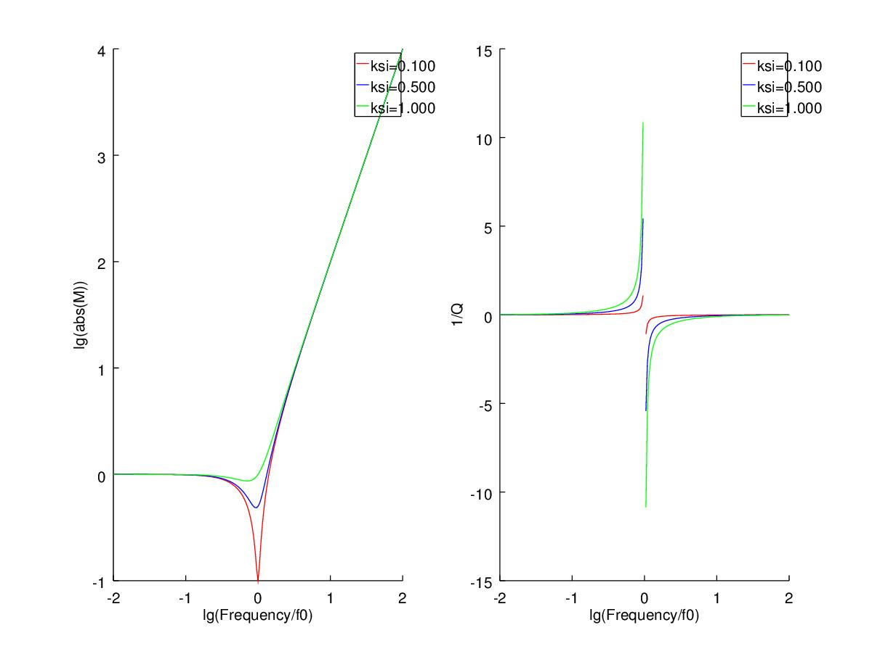

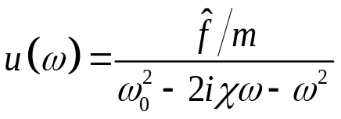
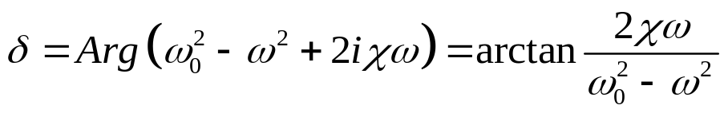
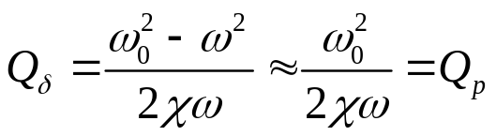
Phase-lag Q
M(f) and Q⁻¹(f) for an oscillator
The above Q-factors measured from the dissipated power come from studies with seismic waves (Aki and Richards, 2002), but in the laboratory, the stress-strain (displacement-force) phase-lag Q is typically used:
The complex-valued displacement equals:
Therefore, the phase lag is also related to the attenuation coefficient χ:
At ω << ω₀, this Q is close to Q_{p} and inversely proportional to frequency:
At ω >> ω₀, the phase lag is near 180°, and the Q is negative: Q_{δ} < 0
This low-frequency limit is used in practice

Slide 13
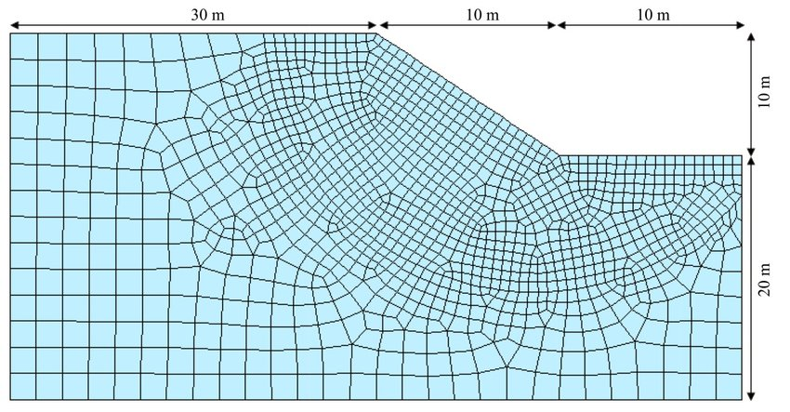
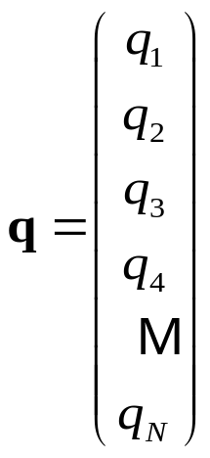
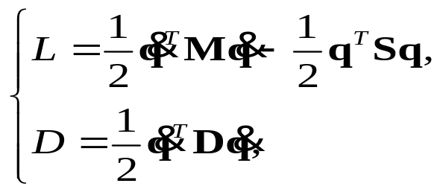

Systems with many oscillation/relaxation modes:
Mass-Stiffness-Damping (MSD) method
Now let us consider an arbitrarily complex but finite linear mechanical system
  For example, this system can be a 3-D volume of subsurface gridded on a regular grid or a variable mesh
All generalized coordinates of the system can be combined in a single vector of variables:
Then, in the most general linear case, the dynamics of the system is completely described by three matrices: “mass” M, “stiffness” S, and “damping” D:
The stiffness matrix is often denoted Κ, but we reserve this symbol for bulk modulus
These matrices are symmetric and non-negative definite (i.e., for example, for any vector q)

Slide 14
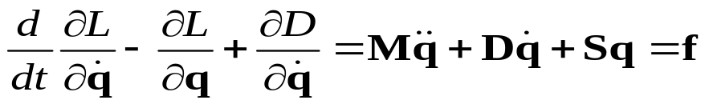


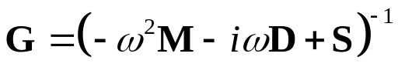
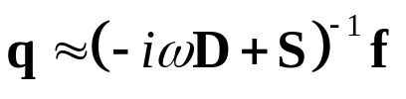

MSD equations and solutions
The Euler-Lagrange equations with external force f:
In full-waveform inversion or modeling forced oscillations of a rock sample in the lab, this time-spatial domain equation is often transformed into the frequency-spatial (“f-x”) domain (time derivatives replaced with factors –iω):
This equation can be solved with some form of matrix inverse:
where
is the frequency-domain response function for the mechanical system
At low frequencies and short distances, the effect of M may be negligible compared to D and S (like when modeling a rock sample in the lab), and the quasi-static approximation can be used:
Static equilibrium under force f:

Slide 15

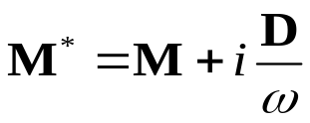
Effective viscoelasticity and/or effective mass
In the above equation:
The term –iωD can be included in one of the other ones, giving two possible, alternate interpretations:
  As part of an effective, complex-valued “viscoelastic modulus (stiffness)” matrix:
    This approach is taken in viscoelastic interpretations
    It works better for lower ω. Ιn this case, D gives a small correction to the ‘elastic’ stiffness S. This modification illustrates the correspondence principle.
  As part of a complex-valued “effective density”:
    This approach is used to explain empirical-modulus relaxation in Biot’s poroelasticity and in models of oscillations of granular media
    This interpretation seems more appropriate at higher ω

Slide 16



Oscillation modes and waves
Consider external force f = 0 in the above equation (i.e., homogenous equation):
This equation describes free oscillations or waves (in a spatially unbounded model). Its solution consists of multiple mode vectors q^{(n)} satisfying a generalized eigenvalue problem:
Vector q^{(n)} here gives the spatial distribution of the oscillation or wave mode, and ω_{n} is its frequency
Because of the matrix character of this equation, it is only satisfied by certain vectors q^{(n)} (eigenvectors, or eigenmodes), and a above is the eigenvalue corresponding to the n^{th} mode

Slide 17


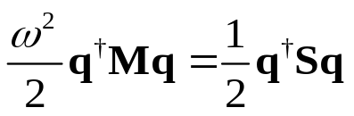
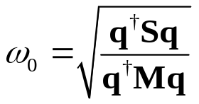
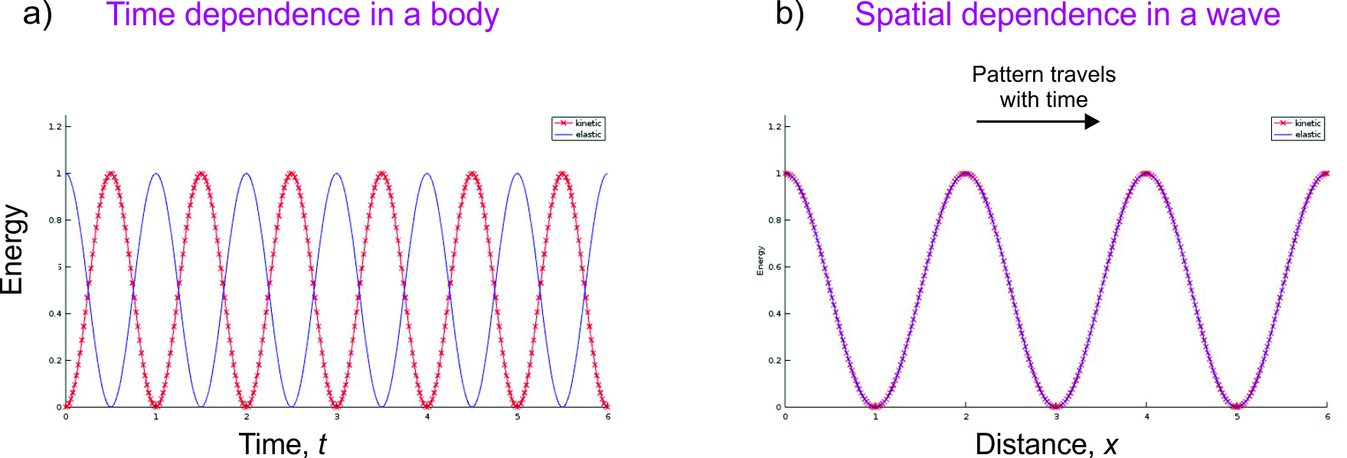
Mechanical-energy conservation and equipartitioning
In the absence of friction (D = 0), the spatially-averaged kinetic and elastic energies equal each other:
, or
(using Hermitian conjugate instead of transpose for complex-valued q)
, or
This equation is known as the equipartitioning of energy
  It can be used, for example, for determining the frequency of a surface waves from a given wavenumber:
In an elastic body, the energies oscillate at double frequency. Oscillations of elastic and kinetic energies are phase-shifted by 180°, and their sum is constant in time (plot a))
In a wave, the energies are in-phase, and the pattern of total-energy highs and lows travels in space (plot b))

Slide 18
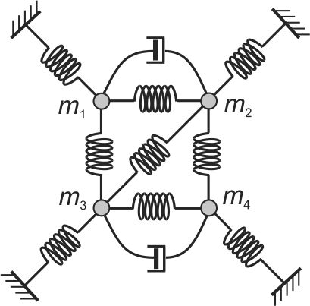
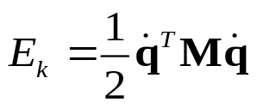
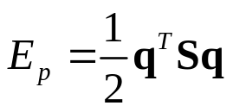
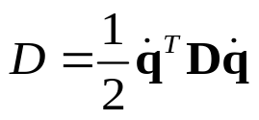

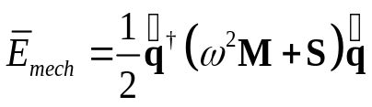
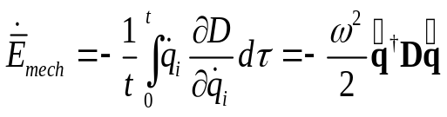


Linked oscillators
A system of interlinked linear oscillators (multidimensional oscillator) represents a close analogy to the elastic medium
It helps understanding the behavior of a rock sample in the laboratory or multiple types of waves in the field. Such models can also be viewed as a simplified (but insightful) approach to “digital rock”
With D = 0, the elastic system would show harmonic oscillations satisfying:
The time-averaged total mechanical energy equals
…the energy dissipation rate:
…therefore, attenuation coefficient:
…and finally, Q for the mode:
(quasi-static approximation)

Slide 19
Quiz #2
Taking X and Y coordinates of the masses in the preceding slide (repeated here) as generalized variables, write elements of matrices M, S, and D related, for example, to mass m₁

Slide 20



Conclusions about the frequency-dependent Q and χ
A well-defined and meaningful Q-factor only exists for an oscillator (resonator), or oscillation mode for a complex mechanical system
For forced oscillations or waves at variable frequencies, values of Q and their frequency dependencies are sensitive to the adopted definitions and measurement procedures
Conventionally, the phase-lag Q_{δ} is used in laboratory experiments
  When using this quantity, note that with this attenuation Q⁻¹ contains a built-in increase proportional to the frequency even for the simplest mechanical system (oscillator)
The measured Q⁻¹(f) can be transformed to a more useful and mechanically meaningful quantity - the frequency-dependent (empirical) attenuation coefficient:
  This χ(ω) directly relates to the rate of amplitude decay in a seismic wave:
  It has a simple frequency dependence with often nonzero χ(0):
These first two terms are most important in χ(f), but they are practically lost when looking at the data in Q(f) form

Slide 21

Conclusions about the frequency-dependent Q and χ
For example, compare Q(f) and χ(f) plots for a Berea sandstone sample at variable temperatures:
Note that the major effects are the variable increases of attenuation with frequency (seen in χ(f) form on the right)
… but presentation of the data by Q(f) (left) misses these effects and only emphasizes the small bumps in χ(f)

Slide 22

Scalability of χ or Q⁻¹
Attributes χ(f) and Q⁻¹(f) also differ in terms of scalability between laboratory and field experiments
  Q⁻¹(f) (phase lag) is an attribute sensitive to the phase of the signal (caused by scattering, layers)
    It downplays the low-frequency parameters γ, q_{e} and τ_{e}
  Quantity χ(f) has the same meaning as attenuation coefficient for a traveling wave (relative energy decay rate)
    Quantities γ, q_{e} and τ_{e} should be more reliably scaled from laboratory to the layering and wavelength scales
22
Note that Q⁻¹ of layers represents the differences between the “unrelaxed” and “relaxed” moduli, but contrasts between layers are often stronger.
Thus, the Q⁻¹(f) seen in field data is mostly controlled by layering, which is not seen in lab experiments.

