Slide 1
Lecture 5: Lagrangian Mechanics of Continuous Media
Key concepts of classical mechanics of continuous solids
  Strain, stress
  Elasticity, viscosity
  Lagrangian and dissipation functions
  Hooke’s law, Navier-Stokes law
Media with internal structure (“General Linear Solid”, GLS)
  Two types of GLS models
Equations of motion
Extensions of the model: nonlinearity, thermal effects, anisotropy
Effective media
Reading: Sections 5.1 – 5.3 in the text

Slide 2
Lagrangian approach
Here, we will consider weak reversible deformations of isotropic solid or liquid materials
  Solid and liquids obey generally the same laws in small deformations
Like with any problem in physics, to determine the motion of a solid body, we need to:
  Identify the generalized coordinates (parameters of deformation)
  Specify the Lagrangian (L) and dissipation function (D)
  From functions L and D, Determine the generalized forces, momenta, energies and establish the conservation laws
  The relations of forces to parameters of deformation (displacements, strains) will give the constitutive relations
  Write the Euler-Lagrange equations. They will be the equations of motion.
  Solve the equations of motion with appropriate boundary conditions representing the shape of the body, thermal regime, external forces, etc.
Note that the construction of Lagrangian and dissipation functions is based on general principles of linearity, scales, and symmetries
  Therefore, all possible interactions are included in the obtained equations

Slide 3
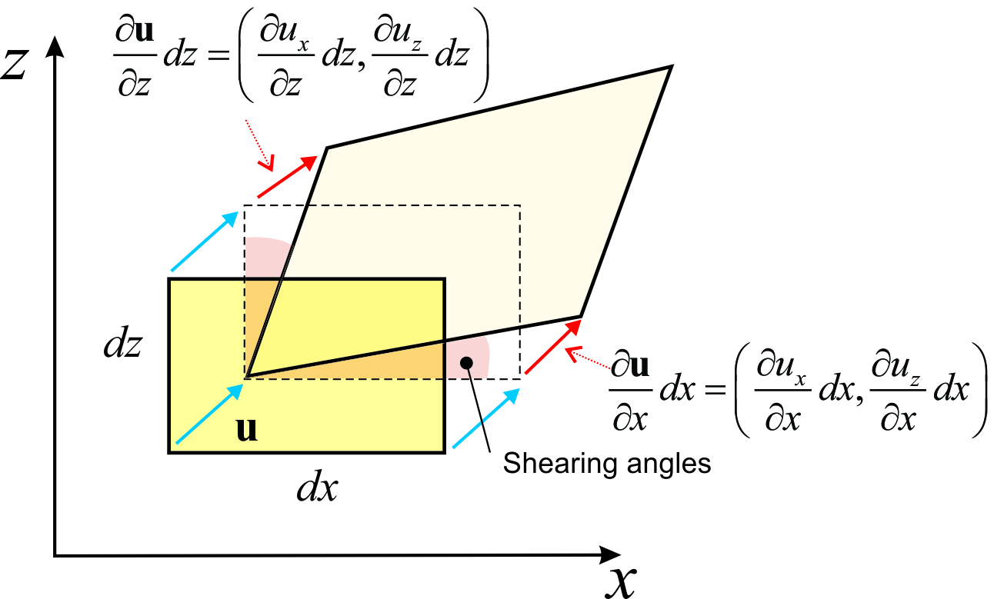
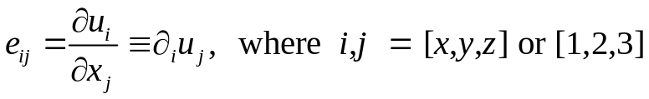
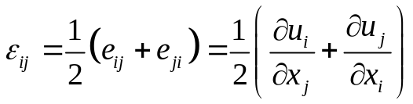
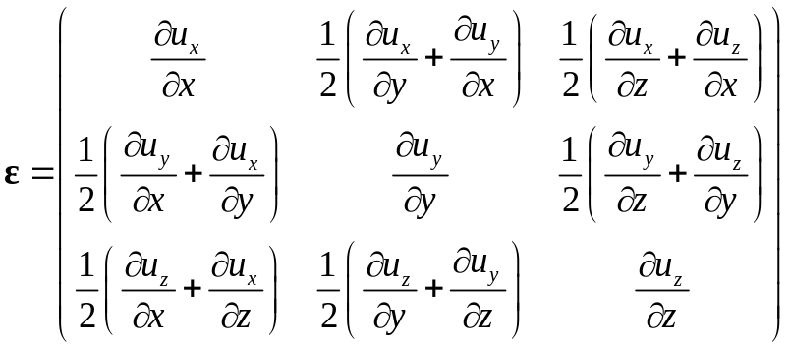
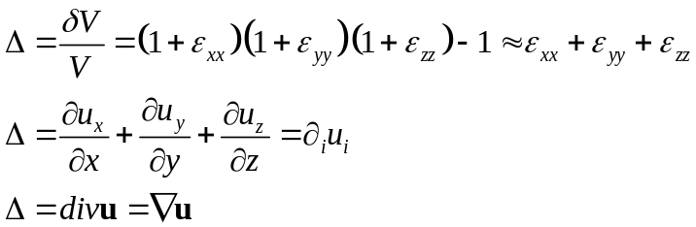


Description of deformation
To describe deformation of a continuous body, we use several fields (plot on the right):
  Displacement vector u(x) of each point x (blue and red in the figure). Its components are the generalized variables for deformation.
  To obtain the Lagrangian and dissipation function, additional quantities are derived from u(x):
    “Elementary strain” tensor:
    Strain tensor:
    Dilatational (volumetric) strain Δ (scalar quantity, relative volume change). Several expressions for it:
    Deviatoric (shear) strain:
This tensor excludes translations from u_{i} and describes the change of shape of yellow rectangle above
This symmetric tensor excludes rotations from e_{ij}
This tensor contains no volume change:

Slide 4
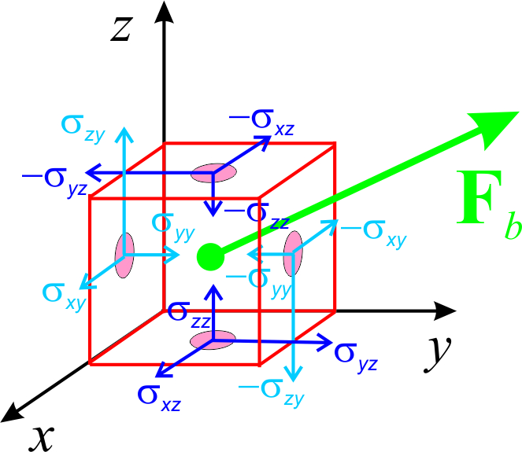
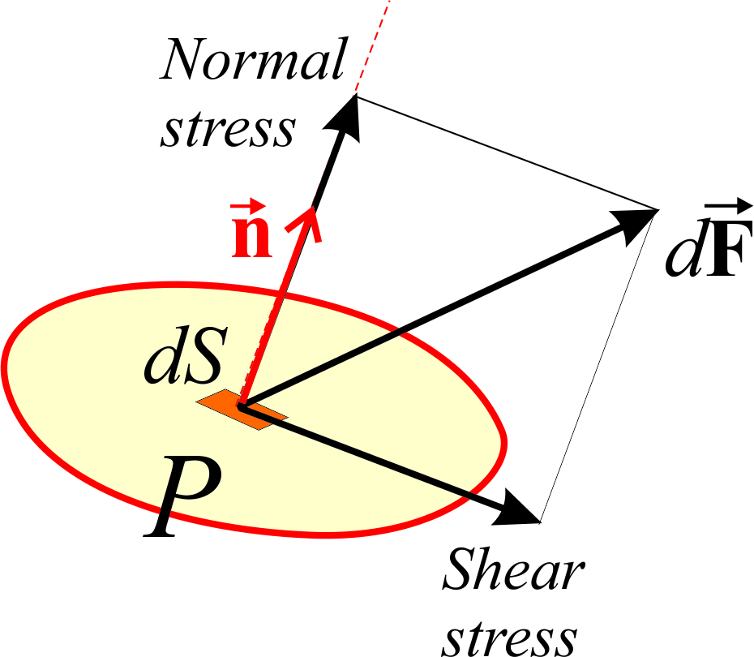

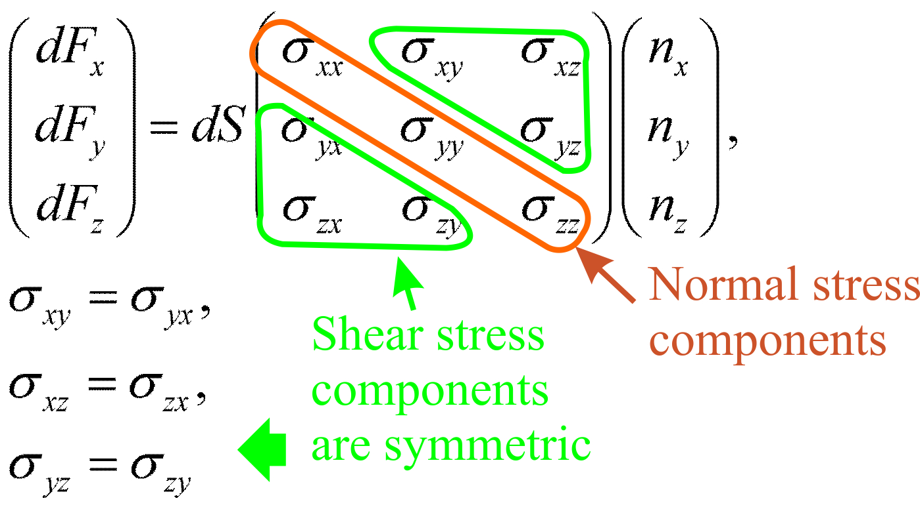
Description of forces
Two types of forces can act on an elementary volume within rock (REV; plot on the upper-right):
  Body force F_{b} applied to the whole volume and proportional to its volume dV (green)
  Surface forces applied to the six faces of the REV, proportional to their surface areas dS. The i^{th} component of force per unit area applied to the face oriented in the j^{th} direction is denoted σ_{ij.} These components form a Cauchy stress tensor σ (matrix; bottom right)
    Definition of surface force through the stress tensor (middle plot and matrix product in the bottom):
    It can be decomposed to normal component (parallel to normal vector n) and tangential (shear, traction)
  The stress tensor is always symmetric because of the invariance of the elastic energy with respect to rotation of the frame of reference
Both of these types of forces can in principle exist for both elasticity and friction (viscosity)
  However, body forces do not exist for ordinary material without internal structure

Slide 5







Forming the Lagrangian and dissipation function
Here are the general rules for defining the Lagrangian (almost the same rules apply to the dissipation function):
  The Lagrangian of the body is a functional of the displacement field u(x,t) and its time derivative (velocity field)
  The Lagrangian of the whole body is an integral of the Lagrangian density function L:
  At point x, the density function L depends on the displacement vector u, velocity , and strain tensor ε
  To describe linear interactions, L must be a quadratic function of u(x,t) and its derivatives
  To describe a linear isotropic medium, L should be a function of quadratic scalar invariants derived from u and ε. Such invariants are:
    Square of displacement (or velocity) vector
    Two similar invariants of the strain tensor:
This means that current displacement and velocities uniquely determine all future motion of the rock
This means that the interactions are local within volume dV
But it does not depend on stress σ or derivatives of ε, for example!
Note that summation over repeated subscripts is implied
You can also use , this would be just a combination of the invariants shown here

Slide 6
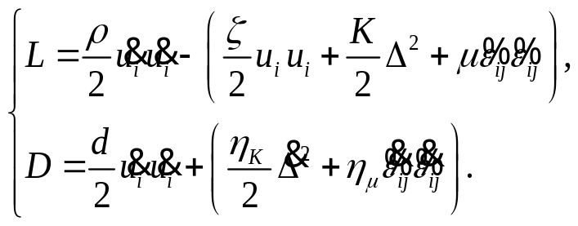

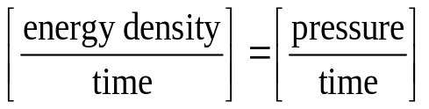
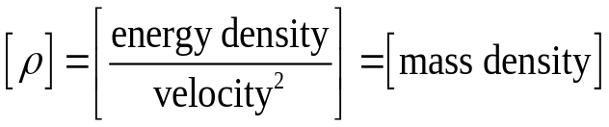


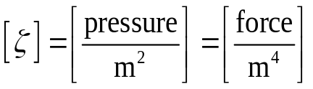
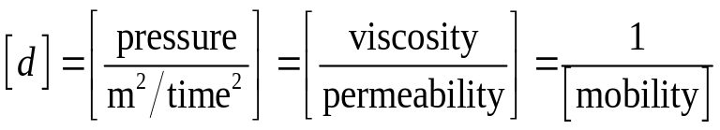
Lagrangian
Thus, functions L and D for an isotropic linear solid or fluid are obtained by combining all possible quadratic scalar terms satisfying the above requirements:
Material properties d and ζ equal zero for an ordinary material without internal structure.
Thus, there are generally 5 material properties in a structureless rock
Each term in L and D contains a factor, which is the corresponding material property. Meanings of these material properties are established by setting up some mechanical experiment involving this factor (we discuss them later)
The unit of L is , and the units for D are . Therefore, the units for material properties are:

Slide 7

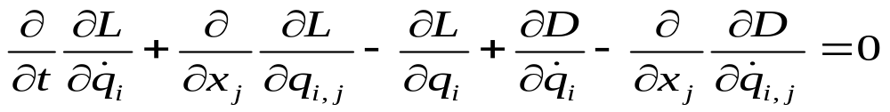


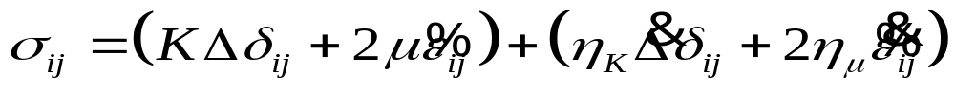

Forces, stresses, and equations of motion
Recall the Euler-Lagrange equations from Lecture 3 for generalized variable :
Considering the case ζ = 0 and d = 0, and taking the derivatives, this equation turns out to be:
… and the stress tensor is:
, where the force is the divergence of a stress tensor σ:
In each pair of parentheses here, the first term is the bulk elasticity or viscosity, and the second is the shear one
Hooke’s law -
Elastic stress proportional to
strain ε
Navier-Stokes law - Viscous stress proportional to strain rate
These are “constitutive relations” in mechanics

Slide 8
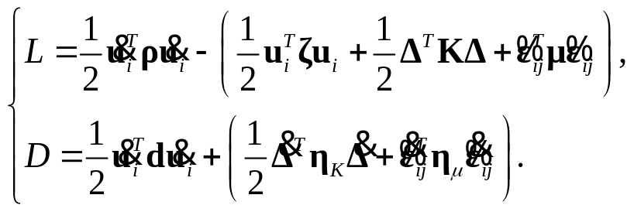
Medium with internal structure (“General Linear Solid”, GLS)
Internal structure of a rock can be described macroscopically by adding additional variables (fields) to the observable displacement variable u_{i}(x,t). There are two ways to add such variables:
  Using completely different scalar variables, which I combine in another vector field θ(x,t)
    Elements of this vector can represent pore volume variations, grain expansions or rotations, temperature variations, etc.
    This variable θ will be considered later
  Using variables with meanings of displacements of some internal structures
    Average displacements of pore fluids, relative displacements of groups of grains, etc.
    These internal-displacement fields can be added to displacement u_{i}(x,t), making it a vector in model space, u_{i}(x,t)
With this second type of model extension, L and D functions look the same, but all material properties become matrix-valued quantities:
First rows and columns in matrices d and ζ (for the observable displacement) must equal zero to ensure translational invariance (independence of the selection of point u_{1x} = u_{1y} = u_{1z} = 0)

Slide 9
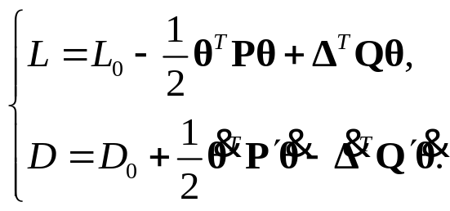
Other macroscopic variables in a GLS model
Additional (arbitrary!) scalar variables of macroscopic internal structure can be combined in vector field θ(x,t)
Again considering the most general (possible) quadratic terms, functions L and D become
L₀ and D₀ are functions from
the original GLS model.
Inertia (term with density) is not considered in this Lagrangian (it is likely negligible)
Elements of matrices P, Q, P′, and Q′ are the new material properties:
  P contains elastic properties of variables θ
  P′ contains viscous properties of variables θ
  Q contains elastic coupling of variables θ with u
  Q′ contains viscous coupling of variables θ with u
As you see, different structures within rock can interact with each other elastically and viscously (and also inertially).
All this is easily seen from the general forms of Lagrangian functions.

Slide 10

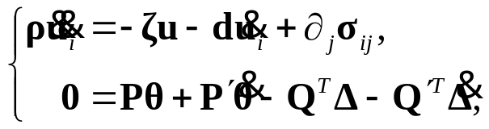



Equations of motion
The Euler-Lagrange equations are also similar to those above, but they become matrix
  They also contain body forces from matrices ζ and d (not only surface stresses as in the viscoelastic model):
Elastic body force
Viscous drag
Elastic and viscous surface forces
With variables θ, the equations modify to:
This equation with zero mass in the left-hand side means quasi-static equilibrium (and kinetic equations) for variables θ.
This equation is similar to the
(matrix) Zener’s equation:
…and stress tensors become:
  Elastic (Hooke’s law):
  Viscous (Navier-Stokes law):

Slide 11
Examples
Let us briefly consider three examples from sections 5.3, 7.1 and 7.2 in the text:
  Static deformation under gravity or thermal forces
  Steady-state Darcy flow
  Plane P and S waves
Some more complex cases are described in the text:
  Extensional waves in an infinite rod
  Forced oscillations of a cylinder with thermoelastic effects
  Layered cylinder

Slide 12





Static equilibrium
If deformation is independent of time, all time derivatives equal zero, and equations become:
If material properties are constant in space, then these equations give:
This equation needs to be solved for u with the appropriate boundary conditions
If there is a uniform gravity g_{i} applied to the solid (with fluids and other internal variables inside), this equation modifies to
If there is a nonuniform temperature T, the equilibrium is modified by thermoelastic body forces proportional to gradients in the right-hand side:

Slide 13


Static (Darcy) pore flow
If some GLS stress (confining, pore pressure, etc.) distribution is created within the rock as in the preceding slide, then the resulting pore flow (or another equivalent of internal motion) is obtained from the part f equation containing matrix d (mobility):
, or
Boundary conditions are again important for this flow to remain steady or to modify the distribution u(x)

Slide 14



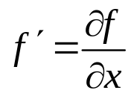




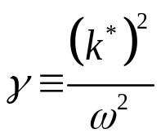


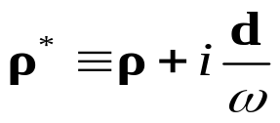

Plane P wave
To obtain a plane P wave traveling in the direction X, we need to consider displacements in the form:
prime denotes derivative
Equations of motion become a matrix differential equation for function u(x,t):
is the P-wave modulus matrix,
is the P-wave viscosity matrix
ω is the angular frequency,
k is the wavenumber
α is the spatial attenuation coefficient
For a harmonic wave, the dependence on x and t consists of harmonic functions:
is the complex wavenumber
…and the final eigenvalue equation for n^{th} wave mode is:
effective density
effective modulus

Slide 15
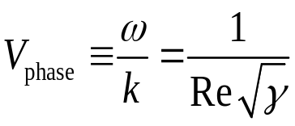
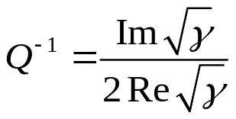
Plane P wave (cont.)
From the eigenvalue γ obtained for n^{th} mode, the phase velocity of the wave is
…and inverse Q-factor (from imaginary part of complex-valued slowness 1/V*)

Slide 16






Plane S wave
For a plane S wave polarized in the direction of axis Y (subscript 2) and traveling in the direction X, the displacement and strain components are:
Equations of motion become differential equation for function u(x,t):
For harmonic waves, the eigenvalue equation for n^{th} wave mode is:
, where
is the effective “viscoelastic” shear modulus
…and the equations for V_{phase} and Q⁻¹ are the same as in the P-wave case

Slide 17
Extensions of the linear Lagrangian (GLS) model
Above, we only discussed the case of linear interactions within an isotropic medium without thermal effects. What happens when these restrictions are lifted?

Slide 18
Thermal effects
Regarding the effects of temperature, the accuracy of the above approximation is difficult to . The equations without temperature are suitable in two limits:
  When the deformations are extremely slow, so that the temperature equilibrates by heat flows between parts of the body. In this case, the elastic moduli above are the isothermal (constant-temperature) moduli
    However, this limit seems impractical in most laboratory and seismic measurements
  When the deformations are extremely fast, so that the heat exchange between parts of the body is negligible. In this case, the above moduli are adiabatic moduli. Adiabatic moduli are always larger than isothermal ones.
    This limit is close to seismic case; however, at low frequencies and for grainy media with small grains, heat flows between grains or pores may cause significant effects on wave propagation and on the behavior of rock samples in the lab
In reality, temperature T is variable during deformation, and it contributes to bulk pressure

Slide 19
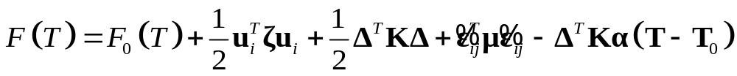
Thermal effects
The elastic energy in the Lagrangian is replaced with the “free energy” equal F = E – TS
  E is the internal energy (of random particle motions), T is the temperature, S is the entropy
  F is the energy which can be transformed to mechanical work (product of pressure p and volume change dV)
As the Lagrangian, the free energy is also constructed by identifying the possible second-order combinations of bulk deformation and temperature variations T:
T₀ is the equilibrium temperature
  T is also a model vector, because the different components (pore fluids, grain types) have different temperatures during deformation (this variation of temperature is called the thermoelastic effect)
  α is a diagonal matrix of volume expansion coefficients for the different components
The resulting equation for stress is:
  Note that temperature variations create additional bulk stress (thermoelastic effect)
  Additional kinetic or diffusion equations for temperature should also be is added to the mechanical equations

Slide 20

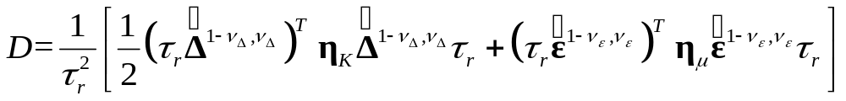


Nonlinear internal friction
Nonlinear relations between stresses and displacements and strains are described by non-quadratic forms of the Lagrangian and dissipation function
The elasticity laws are likely linear (i.e., the Lagrangian quadratic) likely for weak deformations, but dissipation may be nonlinear
  For example, dry friction (Coulomb’s law) has F_{friction} = const, which means dissipation function (non-quadratic)
Thus, we proposed, for example, this dissipation function:
, where notation:
    It increases with slower than with power = 2 (i.e., it is partially “dry”)
    However, it increases with the total wave amplitude as power = 2, so that the friction acts equally on waves of different amplitudes
    The nonlinearity is described additional parameters ν (different for bulk and shear)
  This dissipation function (with the usual GLS function L) describes the so-called Cole-Cole rheology (next slide)

Slide 21
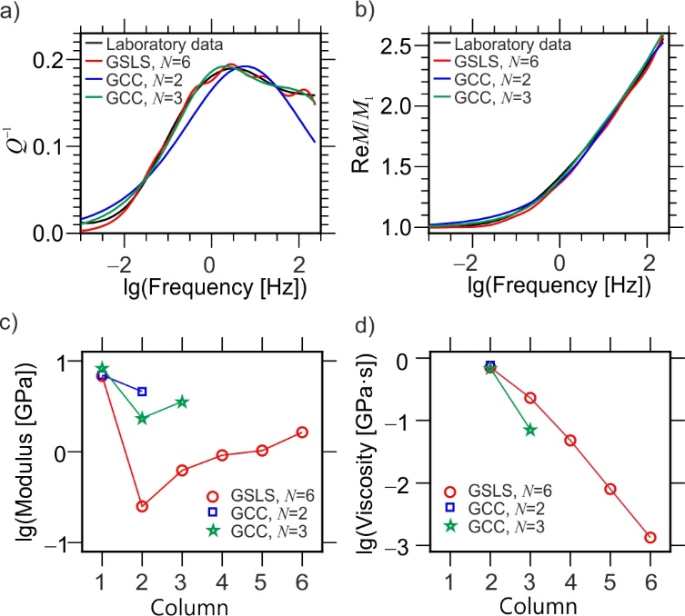
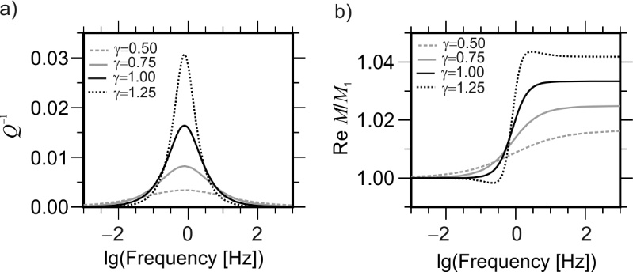
Observations of nonlinear internal friction
Fitting lab data for bitumen sand (Spencer, 2013)
  GLS models not only fit data but obtain values of moduli and viscosity of the sample (plots c and d)
  Note that nonlinear models can (sometimes) fit data using smaller values of N
Cole-Cole spectra predicted by nonlinear SLS (Zener) models with different parameters γ = 2ν – 1:
With ν = γ = 1, this is the (linear) Zener body response
Narrower attenuation peaks for γ < 1, broader peaks for γ > 1
Plots from Deng and Morozov (2016)

Slide 22
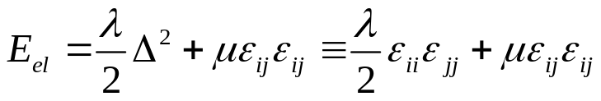
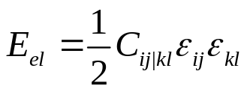
Anisotropic media
For anisotropic media, there are many more inertial, elastic, and viscous constants in the model. Each term in the Lagrangian and dissipation function becomes a matrix product involving all components of u or ε (and not only the rotational invariants)
  For example, the isotropic elastic energy (case N = 1 for simplicity):
  becomes
  The elastic stiffness matrix C_{ij|kl} is a 6 by 6 matrix symmetric with respect to swapping pairs of indices ij ↔ kl
    Therefore, there are 21 anisotropic elastic constants, and similarly 21 constants for viscosity
    If there are three axes of rotational symmetry (“orthotropic” medium), then there will remain 9 independent elements in matrix C_{ij|kl}
Anisotropic problems are usually easier to consider in coordinate axes of the principal directions of the applied stress

Slide 23
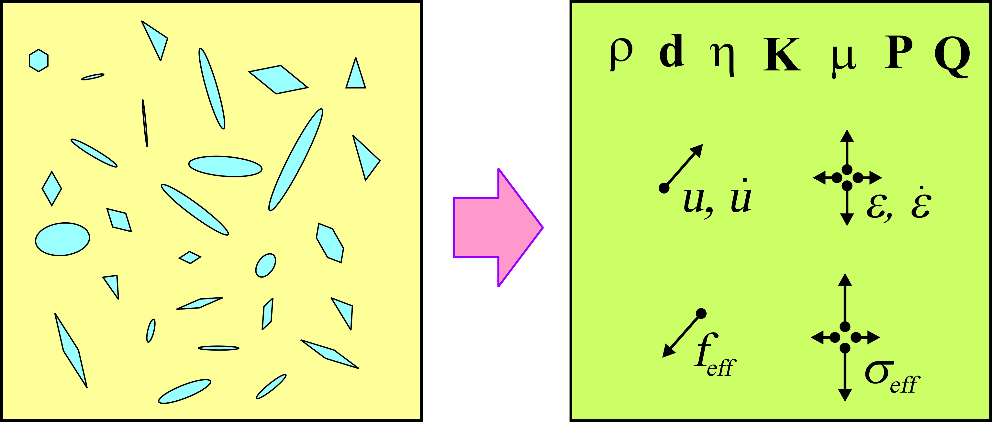
Effective medium
The concept of “effective medium” refers to the following (typical) situation:
  Assume we have a rock with known microstructure, such as pores, inclusions, or a digital-rock model
  This rock is tested in a set of macroscopic mechanical experiments, such as measurement of its drained and undrained moduli, coefficient of thermal expansion, etc.
  All detail of the microstructure cannot be constrained from the experiment. Therefore, we want to replace the medium with a quasi-homogeneous GLS medium which would account for all of the observations
  This quasi-homogeneous medium is the “effective medium” described by material-property matrices ρ, d, η, K, μ, P, Q and similar (here, “Q” is not the Q-factor!):
The state of effective medium is described by average displacement u and displacement rate u, which produce drag friction force f_{eff} and stress σ_{eff}
Note that quantities u, ε, f, and σ can be multicomponent (include pore flows, etc.)
.
For example, Gassmann’s model is the effective matrix K for an arbitrary isotropic rock with connected pores under static mechanical testing

Slide 24
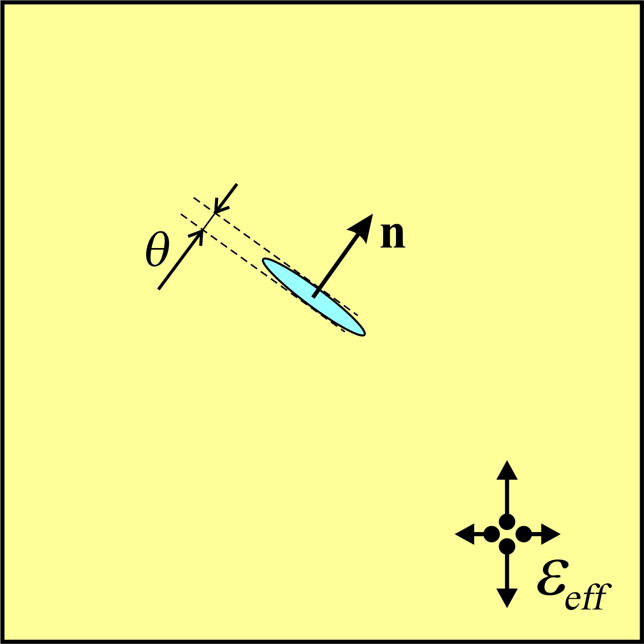


Effective medium
Let us very schematically see how such effective media are obtained for a medium with sparse heterogeneities (typical case)
First, for a given shape of heterogeneity, its deformation is described by appropriate generalized variables, like θ in this plot:
  A Lagrangian function is constructed for the given shape of the inclusions
Then, considering an arbitrary deformation of the effective medium, u_{eff} (and ε_{eff}), a solution for θ is obtained as a function of u_{eff} and u_{eff}
  This is done by classical analytical solutions (Eshelby), variational principles (Hashin-Shtrikman), or numerical modeling
  The change of the Lagrangian due to the inclusion becomes function of the effective strain:
The additional Lagrangians due to inclusions are summed over their locations, types, and orientations, giving the total Lagrangian of the effective medium:
.
.
Typical end-member problem studied in elastostatics – ellipsoidal inclusion in a homogeneous medium (search for “Eshelby problem”, “Eshelby tensor”)

