Slide 1
Lecture 6: Fluid-saturated porous rock (Biot’s model)
Biot’s poroelastic model as a GLS with N = 2
Elastic moduli and Skempton coefficients
Gassmann’s equation
Waves
Extensions of Biot’s model
Reading: Section 5.4 in the text

Slide 2
Biot’s poroelasticity
Biot’s model of porous rock is well known from around 1940’s. Its structure and approximations can be clearly seen in matrix GLS form:
  The model is macroscopic, i.e. it contains no notions of internal rock or pore structure (pore shapes, distribution, pore connectivity, etc.)
    However, perfectly connected pores are assumed when considering dynamic processes, so that the pore pressure can equilibrate within the time span of the experiment
  The model describes the rock by only two generalized variables: displacement or the whole rock and only one pore fluid. This means that Biot’s model is a GLS with N = 2.
    Variable number 1 (u_{Ji} with J = 1) represents the observable displacement of the whole rock, and variable J=2 is the (hard to measure) average displacement of pore fluid
    Accordingly, there is only one pair of stresses: pressure applied to the whole rock and to its pore fluid
  The elastic energy is only due to stresses of the rock and pore fluid, and not to the relative displacement between them. This excludes matrix ζ from the model.
  The pore fluid affects only bulk deformation. This means that the shear elastic modulus matrix μ is of a simple form discussed later.
  The pore fluid is viscous, but this viscosity causes only Darcy type (body-force) friction. This constraint means viscous GLS matrices equal zero.

Slide 3
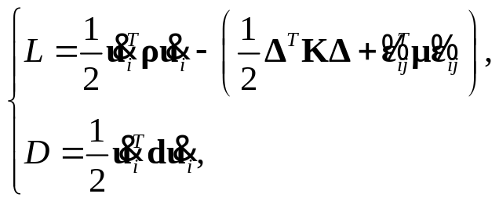
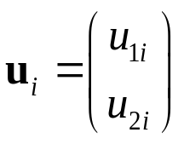

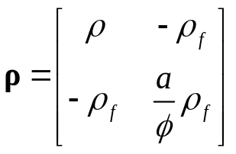
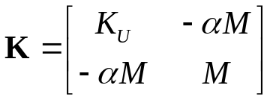
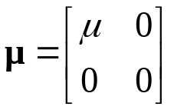
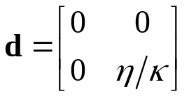
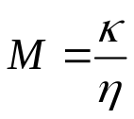


Biot’s poroelasticity
With the above assumptions (simplifications), Biot’s model is a special case of a GLS model with N = 2:
where the i^{th} spatial component of the bivector of variables is a vector in 2-D model space (6 variables in total):
and
Fluid mobility:
Density matrix
Bulk modulus matrix
Shear modulus matrix
Inverse mobility
matrix
Scalar quantity is called the fluid content
Darcy law:

Slide 4
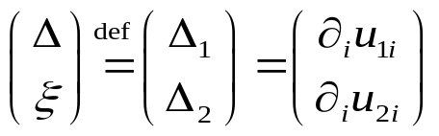
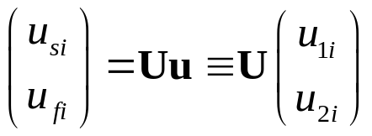
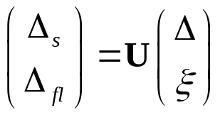
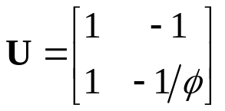
Relations of generalized coordinates to actual displacements
Our second GLS variable is often called “fluid content” and denoted ξ:
From these vectors of displacements and dilatations, the displacements and dilatation of the solid and fluid phases are obtained by matrix products:
,
, where matrix

Slide 5
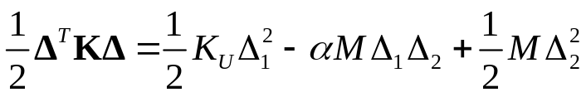
Selections of matrix forms for material properties
Among the above material-property matrices, only K and ρ require further comments (others are simply definitions of K_{U}, μ, M, α, and m)
In matrices K and ρ, the off-diagonal elements are negative. Why?
The general answer is in the following observations:
  Note the meaning of matrix expressions for energy, for example:
  The diagonal elements represent the values of energy in the end-member cases u₁ = 0 or u₂ = 0.
  The variables are defined so that if u₁ and u₂ are nonzero and of the same sign, then the resulting energy is lower (because of the negative -aM) than the sum of energies due to the variables alone.
  Thus, from energy standpoint, the system will prefer deformations with nonzero values of u₁ and u₂ of the same sign.

Slide 6
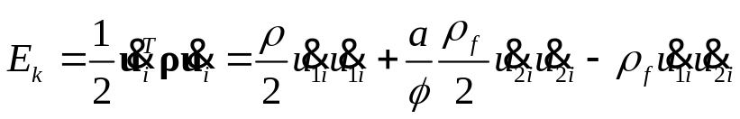
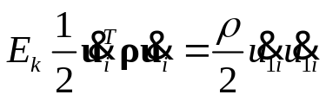


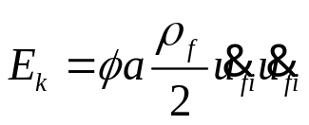


Density matrix
Elements of the density matrix can be understood as follows:
  This matrix means the following expression for kinetic energy:
  So, if u₂ = 0 (pore fluid not moving relative to the rock), . This means that ρ is the density of the average rock:
  If u₁ = 0 (rock is not moving), then , and therefore This is the definition of tortuosity a (ratio of the actual kinetic energy in a flow to the energy of its averaged macroscopic equivalent)
  The third coefficient in term is merely a Lagrangian representation of the force exerted on a solid body with coordinate u₁(t) placed within a fluid flowing at velocity .

Slide 7
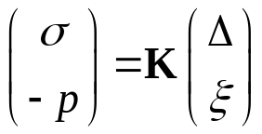
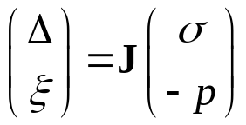
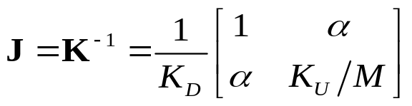
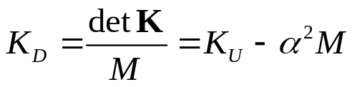

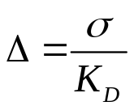

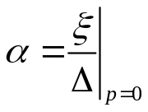
Elastic parameters
Elements of the bulk-modulus matrix can also be understood by considering various experiments with porous rock. For static (time-independent) experiments, the applied stress σ and pore pressure p are related to deformations as:
, and inverse
, where compliance matrix
  where
  Under ‘undrained’ compression (zero pore flow, sealed sample, ξ = 0), , and therefore K_{U} is the ‘undrained’ modulus
  Under ‘drained’ compression (zero pore pressure variation, pores freely communicating with the outside space, p = 0), , and therefore K_{D} is called the ‘drained’ modulus
  Under the same drained conditions, , and therefore the Biot-Willis parameter can be measured experimentally as ratio .

Slide 8
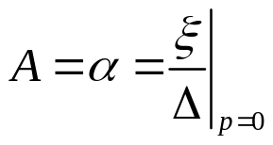
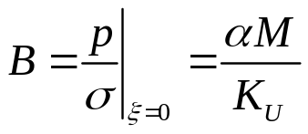
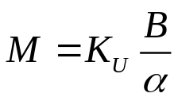
Skempton coefficients
Skempton coefficients are important ratios of experimental observations useful for obtaining poroelastic moduli
  Skempton A is the same as Biot-Willis α -- ratio of change of fluid content to rock volume change under drained condition:
  Skempton B is the ratio of the induced pore pressure to the change of stress loading under undrained condition
These relations give a way to measure poroelastic modulus M:

Slide 9
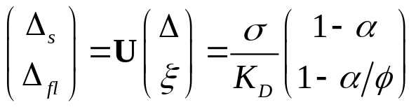
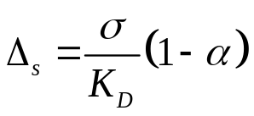
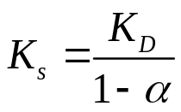
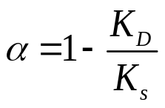

Elastic parameters
To find the elastic modulus of the material of solid matrix (“solid grains”), again consider drained experiment (p = 0) and look at the expansion of the solid and fluid:
, and therefore
Because the fluid exerts no pressure in this experiment, all stress s should be supported by the solid frame. Therefore, the modulus of the material of the frame equals:
… or conversely, the Biot-Willis parameter is determined from the ratio of the modulus of the empty porous matrix to the modulus of its material
From these relations, α must satisfy:

Slide 10
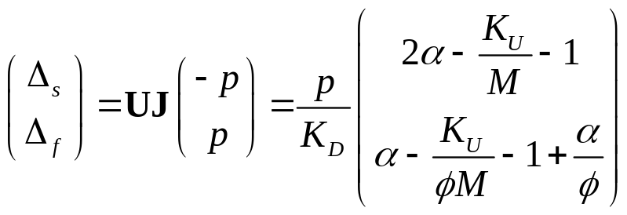
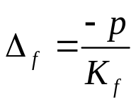
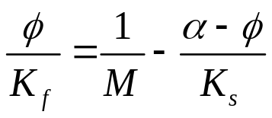
Elastic parameters
To find the elastic modulus of the pore fluid in matrix K, consider an experiment in which the rock frame and the fluid are held at equal pressures (σ = -p). This is an experiment with unjacketed rock sample
  Then, the deformations of the solid and fluid phases are:
Δ_{f} here should equal , and after some simplifications, K_{f} can be expressed:

Slide 11
Gassmann’s equation
Gassmann’s equation (next slide) predicts the bulk modulus of fluid-saturated rock (K_{U}) from porosity φ and the moduli of:
  Solid grains (K_{s})
  Drained (empty) porous matrix (K_{D})
  Pore fluid (K_{f})
Because of the ability to use different K_{f} with the same rock frame, this equation is often used for fluid substitution (modeling the behavior of rock with different saturating fluids)
Gassmann’s equation K_{U} = K_{U} (φ , K_{s}, K_{D}, K_{f} ) is just one relation satisfied by the static (elastic) limit of Biot’s or any other model with single porosity

Slide 12

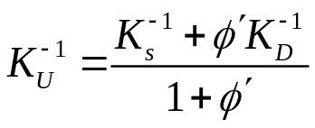
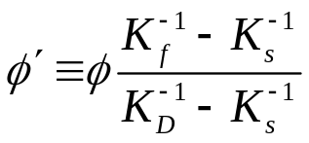
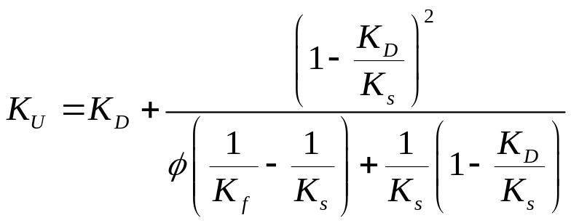
Gassmann’s equation
Gassmann’s equation is simply an identity relation satisfied by the elastic matrix Κ
Matrix K contains only three independent elastic constants in (K_{U}, α, and M), but four empirical moduli K_{U}, K_{D}, K_{s}, K_{f} are measured from it in various experiments
  Therefore, the empirical moduli must be mutually related. This relation is the Gassmann’s equation
  The simplest form of this relation was given above:
, therefore
  There are several forms of final relations excluding α and Μ using K_{s} and K_{f} . The following one looks most elegant, in the form of a Reuss average of the solid and drained compliances:
, where
  One of the commonly used forms of Gassmann’s equation is:

Slide 13
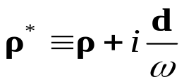


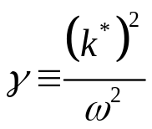
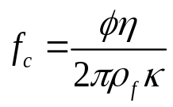
Waves in porous media (“global flow”)
  Plane harmonic waves are obtained from the same GLS eigenvalue equation (matrix M is real-valued in Biot’s model):
This equation gives:
  Two P-wave modes (primary wave and a diffusive “slow” secondary wave)
  One S-wave mode for a given polarization)
Biot’s characteristic frequency:
  At this frequency, there is a peak of Q⁻¹(f)
  However, f_{c} is usually very high (30 kHz to 1 GHz for water), and therefore, the attenuation and dispersion due to this primary-pore (“Biot’s”, or “global”) flow is usually weak
Note that the frequency increases with viscosity

Slide 14
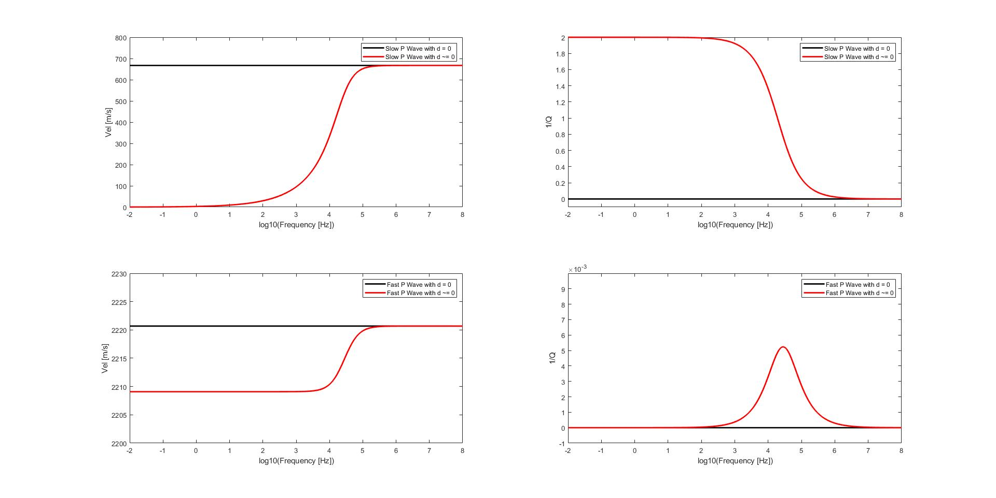
Wave velocity dispersion and attenuation (Q⁻¹)
Secondary (“slow”) P wave
d = 0
d > 0
d > 0
d = 0
f_{c}
f_{c}
Primary (“fast”) P wave
d = 0
d > 0
Effect of “complex density” ρ*
d > 0
d = 0
f_{c}
f_{c}

Slide 15
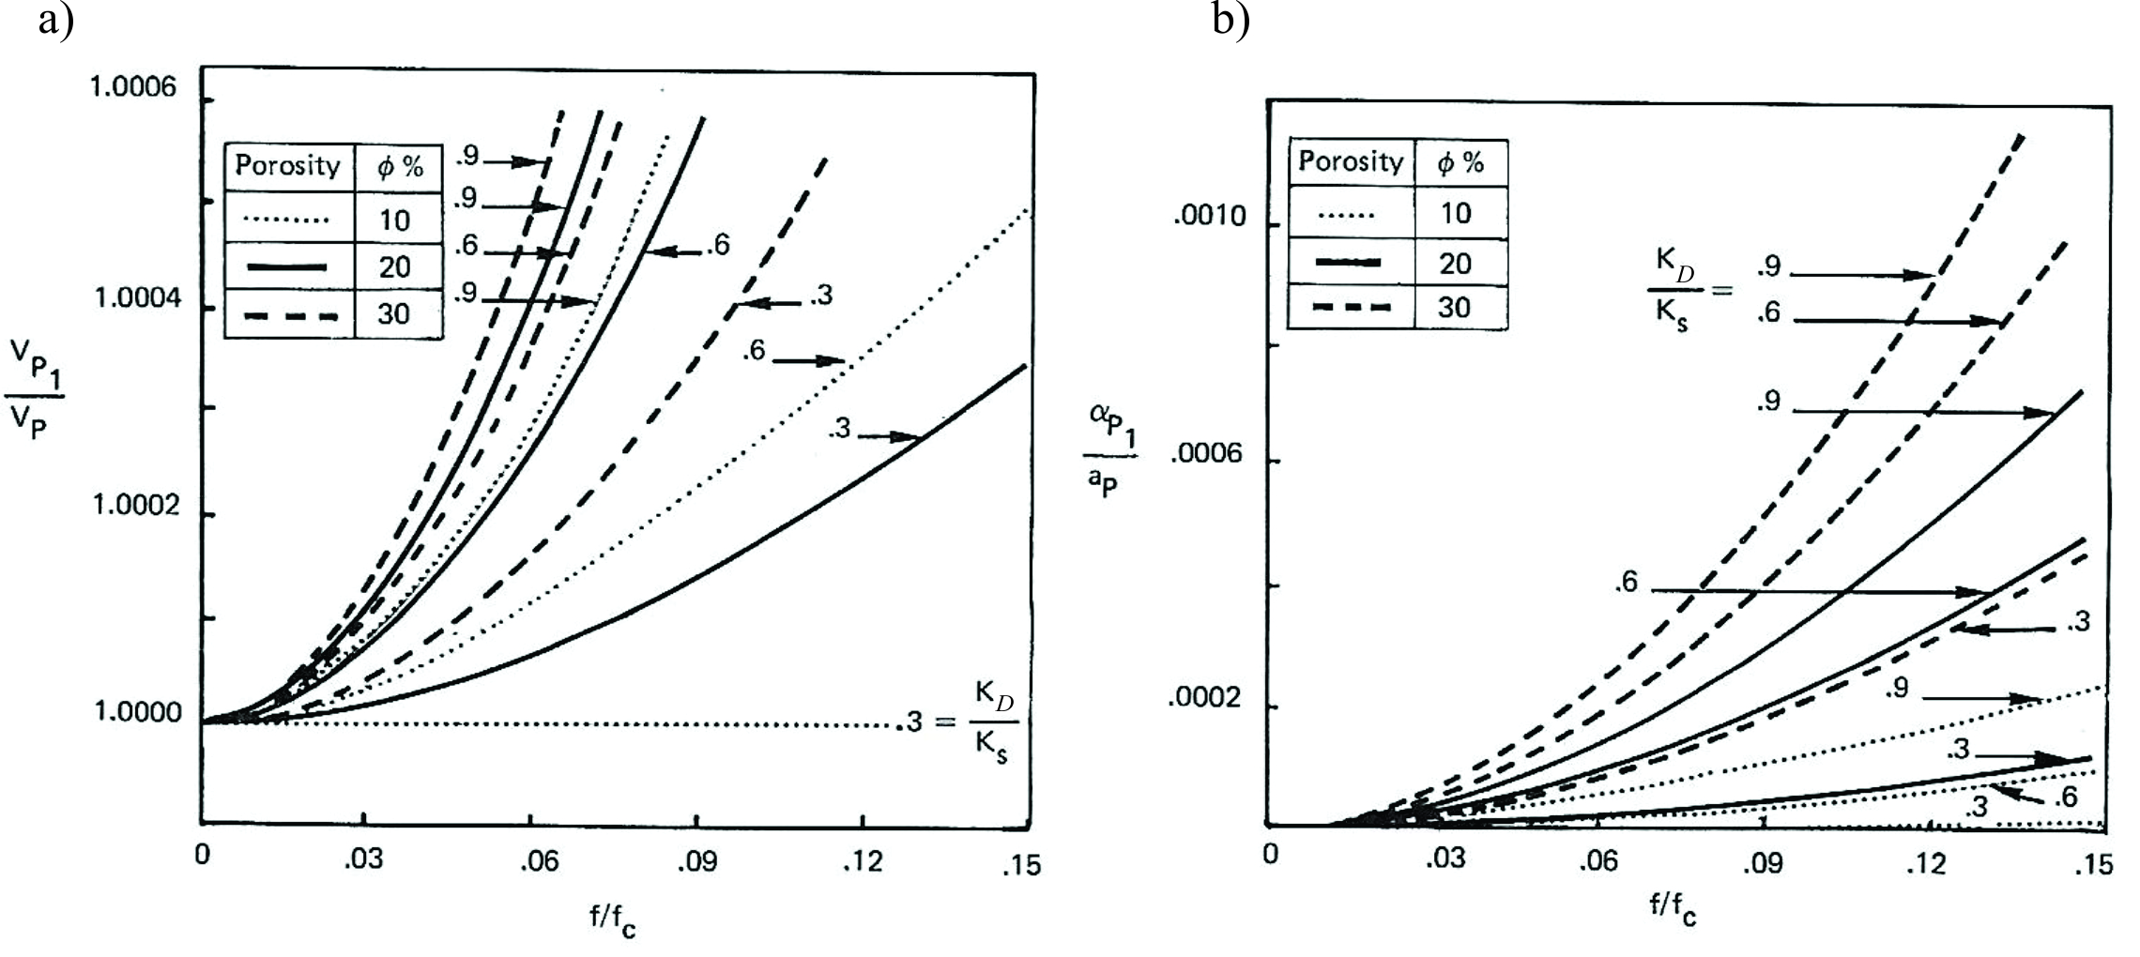

Primary P wave
  Attenuation α(f) scaled by
From Bourbié et al., 1987

Slide 16
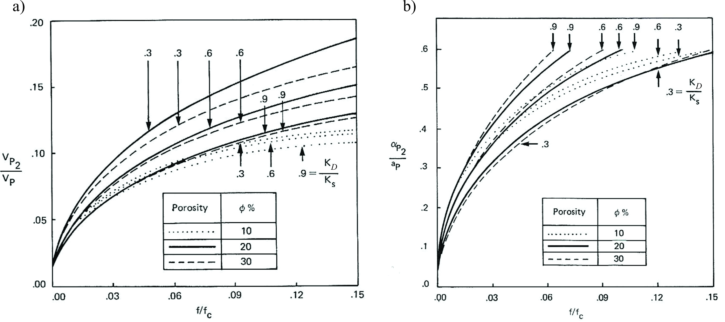
Secondary P wave
  Attenuation α(f) scaled by

Slide 17
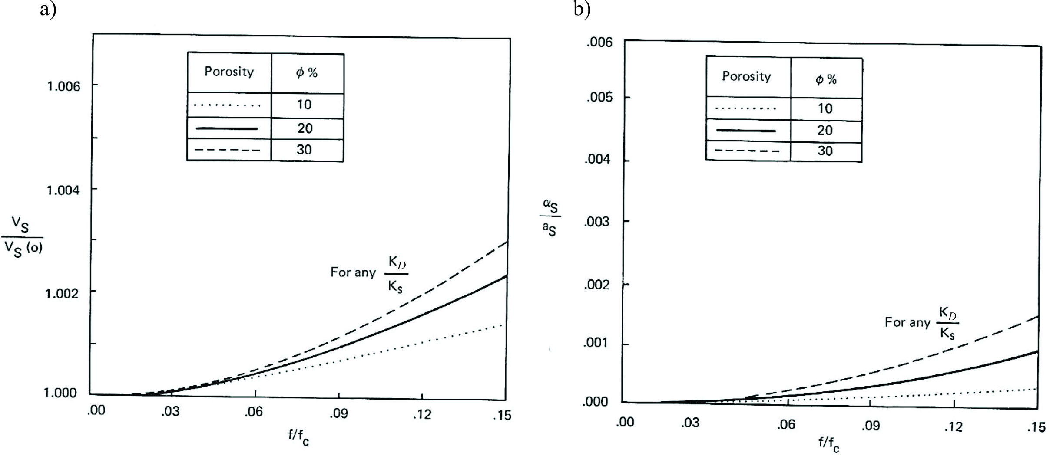

S wave (only one)
  Attenuation α(f) scaled by

Slide 18
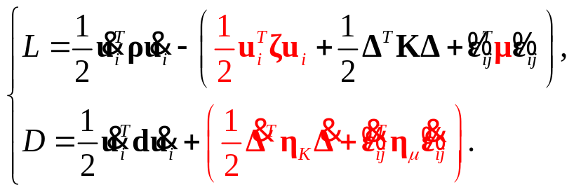
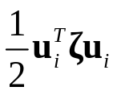
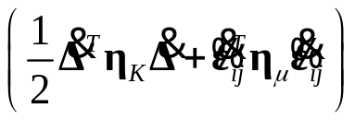
Extensions of Biot’s model
Consider all possible extensions of Biot’s model of poroelasticity without additional porosities, nonlinearity, and anisotropy (which were sort of missed by Biot)
These extensions are seen in the complete GLS model with N = 2:
Red shows terms omitted in Biot’s model, or matrix μ was selected in a too simple form
Using N > 2 gives many models of multiple porosities (e.g., “squirt flow” models)
Replacing the terms highlighted in red in the case with N = 2 also gives interesting extensions:
  Including wettability (capillary forces) effects – elastic term for pore fluid:
    Note that capillary forces are related not to strain (ε_{ij}) but to relative displacement of the pore fluid (u_{2i})
  Including viscosity of the frame and pore fluid – terms
  Partially solid saturation material (bitumen?) – should give a more complete structure of the shear modulus matrix μ

